Slide 1
Parental Leave Policy
Presented By:
Suzanne Roggenkamp, Jade Tonjes, & Annaleigh Hobbs
Notes:
Introduction
Good morning everyone! Today Suzanne, Jade, and I will be presenting our project on Parental Family Leave Policy. We have really enjoyed learning about this topic and we hope that you all will enjoy it as well and learn a few things along the way.

Slide 2
Introduction
Today we are mainly focusing on the economic implications, impacts, and long term effects of parental leave, not the idea that parental leave is necessary.
Introduction
How the Policy is Structured
Economic Theory
California Paid Family Leave Policy
Benefits & Costs
Conclusion
Notes:
Introduction:
To start off, we wanted to make a statement to center in on what we specifically will be addressing this morning. The United States is a global outlier when it comes to guaranteeing paid parental leave for mothers and fathers, with no national law guaranteeing it. Today we are mainly focusing on the economic implications, impacts, and long term effects of parental leave, not the idea that parental leave is necessary.
With that being said, I am going to quickly walk us through the order of our presentation this morning. We are just wrapping up the introduction, then we will move into how the policy is structured, and then the economic theory behind Parental Family Leave Policies. After that we will move on to specifically looking at the California Paid Family Leave Policy, then the benefits and costs of Parental Family Leave Policies before moving onto our conclusion. Once we have concluded, we will have time for you all to ask any questions if you have any!
Now, Jade will be addressing how Parental Family Leave Policies are structured.

Slide 3
How Do Parental Leave Policies work?
Background on United States
  Three States (as of 2017): California, New Jersey and Rhode Island
Payroll Tax and Payroll Deductions
Maternity Leave Options vs. Paternity Leave Options
Focus on the California Parental Leave Policy
Notes:
How Do Parental Leave Policies Work?
The first thing you need to know is that “the United States is the only industrialized country without a national paid leave mandate” (paid family leave in the states). Since 1993 the Federal Family and Medical Leave Act “offers 12 weeks of unpaid, job-protected leave to care for newborns… for employees who have worked at least a year for a larger employer” which has typically 50 or more employees according to the National Conference of State Legislatures (paid family leave in the states). That may seem like it does the job because these protections cover 60% of the workforce in the country, however many eligible employees don’t take the leave they need because they cannot afford it. Only three states out of fifty require paid family leave, these states are California, New Jersey and Rhode Island, other states are hesitant to follow in their footsteps because of the economic repercussions, but continue to observe the effects paid parental leave has.
In these states where paid parental leave is required, they are paid for by a payroll tax and payroll deductions on employees and employers.
Maternity Leave Options are more common in many workplaces given that the mother needs time before and after the birth to establish a healthy bond with their child. Because of this there is more reason to offer women leave options rather than men, however (yes) paternity leave options still need to be considered and included when making these decisions about leave options. “Fewer than half the countries in the world provide men with access to paid leave to care for a new child, while virtually all provide paid maternity leave.” according to a DOL Policy Brief by the United States Department of Labor. (source 2 in dol)
Plus The “theoretical effects [of parental leave] have proven much more challenging to test empirically…” which was discussed in an article called The Long Run Effects of America’s First Paid Maternity Leave Policy, which we discussed in class. (first paid maternity leave)
This is why we have chosen to focus on how this First Paid Parental Policy, or more specifically the California Parental Leave policy, is structured due to a lack of research in parental leave and life. Suzanne will now tell you more about the Economic Theory behind Parental Policies.

Slide 4
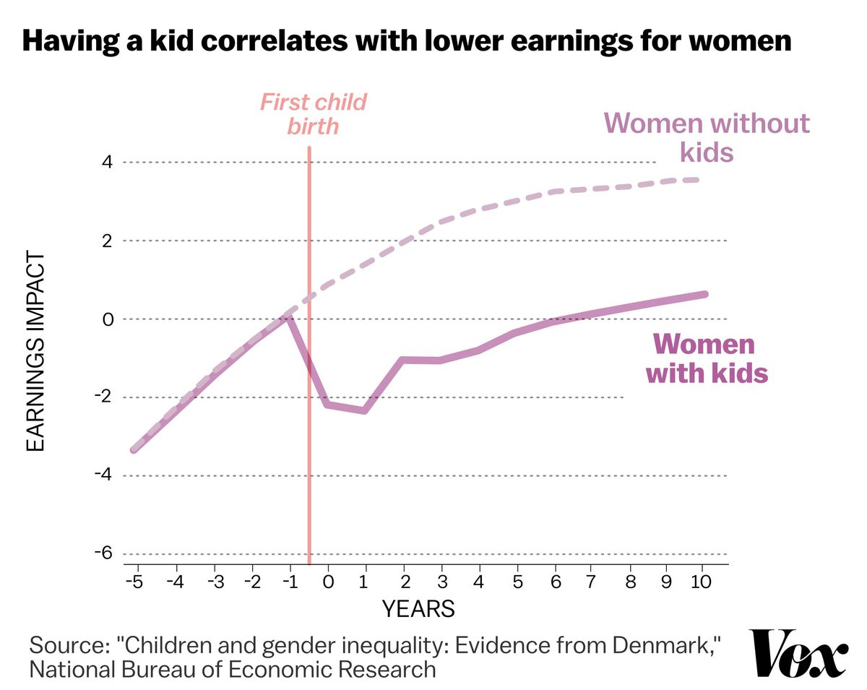
Economic Theory
Women are less likely to be hired and will be given lower incomes
  Women are seen as more expensive to employ
  Tax incidence
Tolerance level of gender-based discrimination and the length of maternity leave are correlated
  Think of tax incidence and elasticities
  Less tolerance leads to longer maternity leave benefits
Notes:
Economic Theory:
Hello, so I will be talking about the theory behind parental leave. As I will mention later, one limitation of parental leave is that there is not too much research that has been done. Therefore, not every idea about the policy has yet to be proven by empirical research, but there have been some studies conducted and I will be using those to discuss the theory.
A research study conducted by Martha Bailey points out that women are less likely to be employed when parental, specifically maternity, leave policies are enacted. Women will also have lower incomes. This is not because the women themselves are worse at their jobs than men. Rather, with paid leave programs, women are more likely to take leave. This results in employers viewing women as more expensive to hire, so the research has proven that they will be hired less often. Furthermore, sometimes employers will give women lower wages as a result of paid leave. Like with taxes, sometimes the “producer”, the employer, will put a higher tax incidence on the “consumer”, the employee. So, they make women pay this “tax” through a lower income. This means that paid leave policies still lead to women having to pay more money to take leave. Even when policies are gender neutral, women are more likely to be discriminated against as fathers face economic, cultural, and social pressures to not take leave.
Speaking of discrimination, a study by Givati and Troiano from Harvard University found a correlation between the tolerance of gender-based discrimination and the length of maternity leave. Basically, they looked at the situation as the employer must hire either a man or a woman. Additionally, the employer has to pay maternity leave to any new mothers that need it. As a result, the employer tends to discriminate against women, by giving the women lower wages and hiring more men. Furthermore, the more that this discrimination is tolerated in a society, the less long maternity leave benefits will be. To help understand this, you can also think of this like tax incidence. When gender-based discrimination is more tolerated in a society, employers have a more elastic demand. This means that they pass more of the cost of the “tax” onto women, which results in shorter leave, like 3 weeks off. When gender-based discrimination is less tolerated in a society, employers have a more inelastic demand, and have to bear more of the cost the “tax”, which benefits women and gives a longer maternity leave, like 14 weeks off. This is the theory portion, and we will now go to Annaleigh to discuss California's paid family leave act in more detail.

Slide 5
California Paid Family Leave (PFL)
How Much Will PFL Pay?
Provides partial wage replacement benefits to California workers to bond with a new child
  including newly fostered and adopted children
PFL is funded entirely by California workers through a State Disability Insurance (payroll deduction)
If eligible, one can receive approximately 60 to 70 percent of your weekly salary
PFL can be taken all at once or can be split over a 12-month period
  Leave can be taken anytime within the first 12 months of a child entering your family.
Notes:
California Paid Family Leave Policy
The California Paid Family Leave (or PFL) provides partial wage replacement benefits to California workers who take time off from work to care for a seriously ill family member, to bond with a new child (including newly fostered and adopted children), or to participate in a qualifying military event. PFL is funded entirely by California workers through a State Disability Insurance payroll deduction.
If eligible, you can receive approximately 60 to 70 percent of your weekly salary (from $50 to $1,357). Your employer may allow you to use vacation, sick, paid time off, or other leave to supplement your PFL benefits to receive up to 100 percent pay. A PFL claim can be taken all at once or can be split over a 12-month period. Specifically for bonding claims, leave can be taken anytime within the first 12 months of a child entering your family
A study called “The Effects of California’s Paid Family Leave Program on Mothers’ Leave-Taking and Subsequent Labor Market Outcomes” by Maya Rossin-Slater, Christopher Ruhm, and Jane Waldfogel utilized March Current Population Survey data from 1999–2010 and a differences-in-differences approach to examine how California’s first in the nation PFL program affected leave-taking by mothers following childbirth, as well as subsequent labor market outcomes. The study obtained robust evidence that the California program doubled the overall use of maternity leave, increasing it from an average of three to six weeks for new mothers – with some evidence of particularly large growth for less advantaged groups. We also provide evidence that PFL increased the usual weekly work hours of employed mothers of one-to-three year-old children by 10 to 17% and that their wage incomes may have risen by a similar amount.

Slide 6
Effects of PFL
Study Results from “The Effects of California’s Paid Family Leave Program on Mothers’ Leave-Taking and Subsequent Labor Market Outcomes” by Maya Rossin-Slater, Christopher Ruhm, and Jane Waldfogel show that:
  California Paid Family Leave Doubled the overall use of maternity leave
    Increasing it significantly for less advantaged groups
  PFL increased the usual weekly work hours of employed mothers of young children and raised their wage incomes
Notes:
This analysis uses March Current Population Survey data from 1999–2010 and a differences-in-differences approach to examine how California’s first in the nation paid family leave (PFL) program affected leave-taking by mothers following childbirth, as well as subsequent labor market outcomes. We obtain robust evidence that the California program doubled the overall use of maternity leave, increasing it from an average of three to six weeks for new mothers – with some evidence of particularly large growth for less advantaged groups. We also provide evidence that PFL increased the usual weekly work hours of employed mothers of one-to-three year-old children by 10 to 17% and that their wage incomes may have risen by a similar amount.
https://www.ncbi.nlm.nih.gov/pmc/articles/PMC3701456/

Slide 7
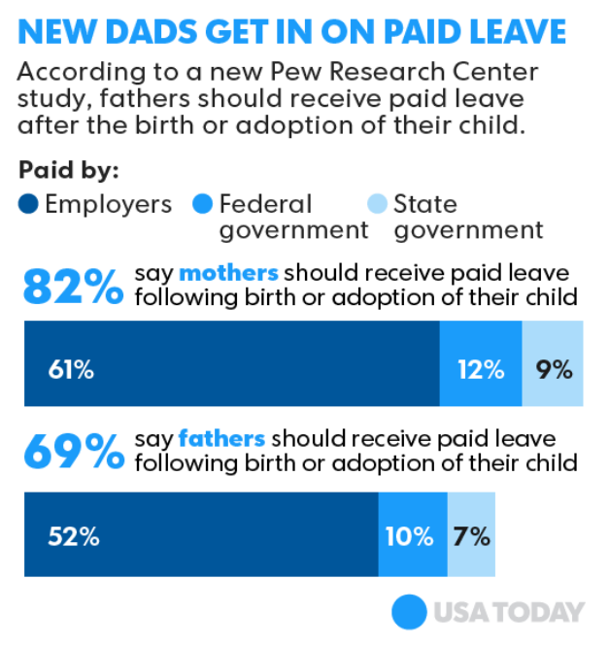
Benefits of Parental Leave Policy
Healthy Babies and Better Futures
Personal and Economic Wellbeing of Families
  Higher Earnings
Gender Equity at Home and in Workplace
Paternity Leave benefits in the Workforce for Mothers
Notes:
Benefits of Parental Leave Policies
One of the first benefits of parental leave policies include “healthier babies who have better outcomes later in life” based on a Maternity leave study that was discussed in the Paid Family Leave in the States article I mentioned earlier. (paid family leave in states). When making those early on connections between a parent and their child, It is crucial to establish a secure relationship and a safe environment for the child, so they feel safe when growing up.
One of the next benefits is when parents can “Prioritize… family responsibilities, while also meeting [their] work demands, [this] can significantly increase the… wellbeing of families” according to the United States Department of Labor (dol policy brief). Paid Parental Leave also gives incentive to take the time you are given to focus on your parental responsibilities, while retaining job security.
We also found that “...Longer leaves of several weeks or months can even increase gender equity at home and in the workplace” (DOL). And that this can be seen as early as considering the respective needs of paternity and maternity leave.
The United States Department of Labor also says that “When fathers take leave, it can increase employment and pay for mothers… when fathers take more paternity leave [than what is expected], it may increase the ability of mothers to engage in paid work, with a positive effect on female labor force participation and wages” (DOL).
Now that I’ve discussed some of the benefits with you, I’ll quickly dive into the Paid Leave Effects on Fathers on the next slide.

Slide 8
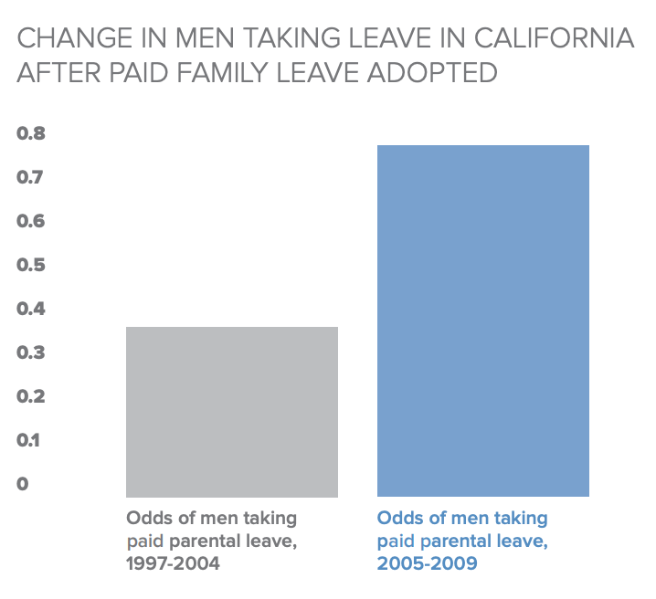
Paid Leave Effects on Fathers
Odds of men taking parental leave both before and after the paid family leave policy was adopted in California
Makes it more affordable for families in general to take leave
Reasons why the increase happened
Notes:
Paid Leave Effects on Fathers
So, In the graph shown on the screen currently, you can see the odds of men taking parental leave both before and after the paid family leave policy was adopted in California. This should make sense, as the paid leave gives families more opportunities to take the time they need to be with their families.
Before the change, many families couldn’t afford to take leave even if they needed it. They saw working as providing for their families, even if they couldn’t physically be with them. For those who could afford to take unpaid leave, they worried about their job security, and this discouraged them to take leave even if they could afford it.
After the change, these fathers continue to be employed and receive pay, while also spending the necessary time with their families.
We will now move onto discussing the Costs of Parental Leave Policies.

Slide 9
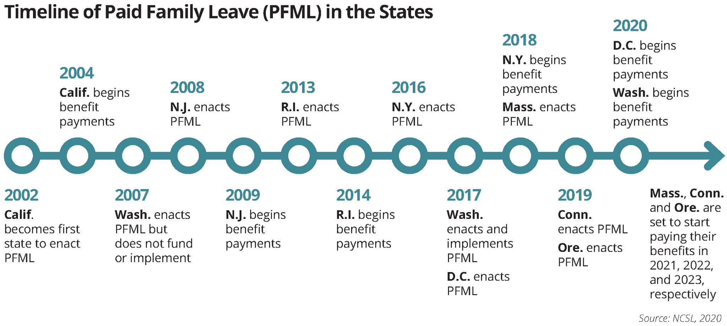
Costs of Parental Leave Policy
Little research has been done
Paternity leave is more limited
Women labor opportunities
Notes:
Costs:
I will now be discussing the costs, aka cons, of parental leave policy. Overall, I found 3 main cons. Even though there are more out there, I will focus on these 3.
The first con I found is that little research has been done. We’ve talked about California’s paid family leave policy a lot, but that is because it is basically the only policy that has had sufficient research. The reason is that these policies actively affect people’s lives, so they are hard to conduct, but we hope to see new research in the future.

Slide 10
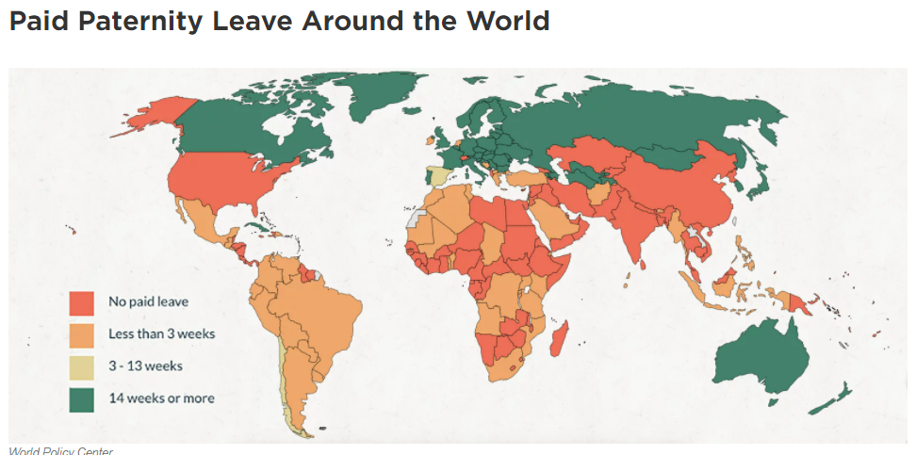
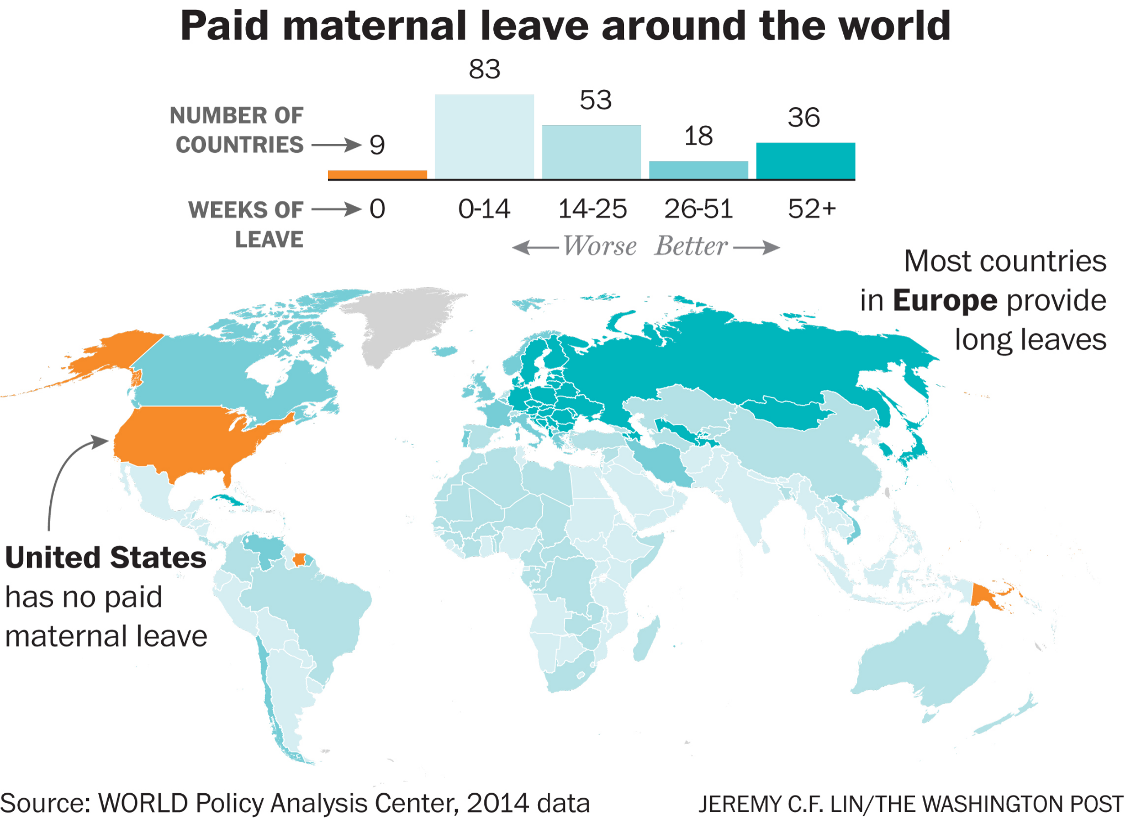
Paternity Leave is More Limited...
Inadequate access
  Quote if needed
Economic circumstances
Social and cultural pressures
“According to a data analysis released on Thursday by UNICEF, the U.N. children's agency, almost two-thirds of the world's children under age 1 — nearly 90 million — live in countries where dads are not entitled by law to take paid paternity leave.”
-(Which Countries Guarantee That New Dads Get Paid Paternity Leave?, 2018)
Notes:
The second is that paternity leave is more limited. 92 countries have no paid paternity leave policy, which are all of the red countries on this graph. There are approximately 200 countries on earth, which means almost half have no policy for dads to take leave. Equal accessibility is also uncommon worldwide as 185 countries have paid maternity leave with 106 of those having options for mothers to take paid leave for 14 or more weeks. Companies are also less likely to offer paternity leave, and it is commonly obsolete. This means that fathers have inadequate access. Of the fathers that can take leave, 70% take less than or equal to 10 days. One reason for this is that it is commonly unpaid, which means that fathers can not afford to take off any more time as the “breadwinners” of the family. Furthermore, there can be pressure from work to take less time off. This means that paternity leave is much more limited when looking at parental leave due to inadequate access, economic circumstances, and social and cultural pressures.

Slide 11
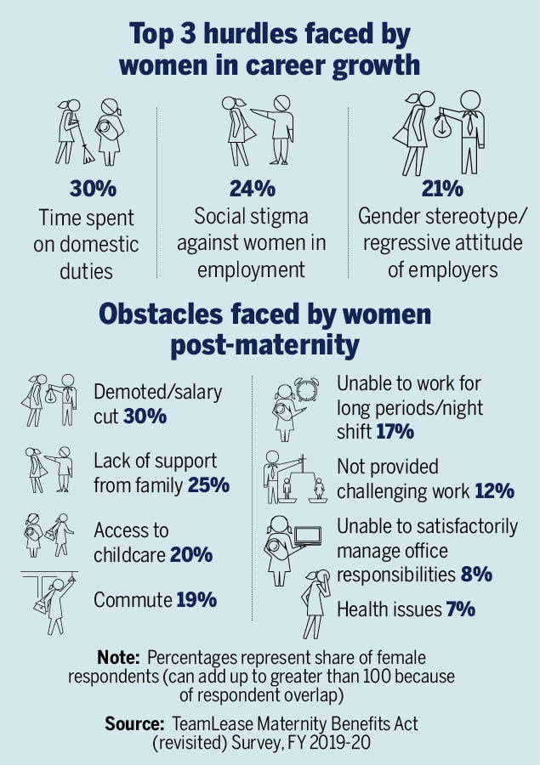
Women labor opportunities
Women are less likely to be employed and have higher incomes
Even gender neutral policies can harm women labor opportunities
  “Authors Heather Antecol, Kelly Bedard, and Jenna Stearns say that men were 17 percentage points more likely to get tenure in their first job when a gender-neutral policy was in place, while women were 19 percentage points less likely”
    (Parental Leave Presentation, 2021)
Notes:
The third con I found was that with leave policies, both for women or gender neutral, can actually hurt a woman's chance of getting employed. For example, Martha Bailey conducted a study involving California’s 2004 Paid Family Leave Act. She found that women were more likely to take leave, spend more time with their children, and have less children. However, the cost of this was that there was no evidence that the policy increased employment opportunities or income. Furthermore, new mothers were much less likely to be hired and would have lower incomes in the future. Another study conducted by Brenden Timpe also backed this up. He found that expanding family leave policies for new mothers decreased hourly wages, incomes, and employment opportunities. Women in academia are also less likely to have employment opportunities, even when under a gender neutral policy. For example, universities realized there was a lot of stigma for women who needed to take family leave as they would be perceived as not taking their career as seriously. As a result, the universities opened up tenure clock stopping policy to both men and women, which is a policy that allows new parents to take off, or reduce their workload, for one year after having a child. As a result, men were 17 percentage points more likely to get tenure in their first job while women were 19 percentage points less likely. So this proves that even policies trying to increase women employment when looking at family leave still fail to meet its mark. Now on to Annaleigh with the conclusion.

Slide 12
Conclusion
Economic Implications
  Tolerance of gender-based discrimination
Impacts
  Less Labor Opportunities
  Lower Incomes
Long term Effects
  Increased Familial Well-Being
  Better Futures for the Children
Benefits of the Policy
Healthier Babies and Better Futures
Personal/Economic Well Being
Paternity Leave Benefits Mothers
Costs of the Policy
Lack of paternity leave options
Unequitable labor outcomes
Lack of research
Notes:
Conclusion
In conclusion, throughout the presentation we have educated you on the workings, benefits, and costs of Parental Leave Policies. Specifically the economic implications of parental leave policies on the tolerance of gender-based discrimination, the impacts of less labor opportunities and lower incomes for disadvantaged workers due to parental leave policies, and longer term effects of increased familial well being and probable better futures for their children from parental leave policies.
We hope that you have learned a lot from our presentation this morning and thank you for listening! Please feel free to ask any questions you have.

Slide 13
Thank you for listening!
Please feel free to ask any questions.

Slide 14
Citations (APA 7th)
Am I eligible? (n.d.). Retrieved April 29, 2021, from https://edd.ca.gov/pdf_pub_ctr/de8714cf.pdf
Bana, S., Bedard, K., & Rossin-Slater, M. (2018). Trends and Disparities in Leave Use under California’s Paid Family Leave Program:
New Evidence from Administrative Data. AEA Papers and Proceedings, 108, 388–391.
https://doi.org/10.1257/pandp.20181113
‌Barron, D. (2017, November 29). The Economics of Paid Parental Leave. Scientific American Blog Network.
https://blogs.scientificamerican.com/observations/the-economics-of-paid-parental-leave/
‌Berger, L. M., & Waldfogel, J. (2004). Maternity leave and the employment of new mothers in the United States. Journal of Population
Economics, 17(2), 331–349. https://doi.org/10.1007/s00148-003-0159-9
Beuchert, L. V., Humlum, M. K., & Vejlin, R. (2016). The length of maternity leave and family health. Labour Economics, 43, 55–71.
https://doi.org/10.1016/j.labeco.2016.06.007

Slide 15
Citations (APA 7th)
DOL POLICY BRIEF Paternity Leave UNITED STATES DEPARTMENT OF LABOR. (n.d.).
https://www.dol.gov/sites/dolgov/files/OASP/legacy/files/PaternityBrief.pdf
Dustmann, C., & Schönberg, U. (2012). Expansions in Maternity Leave Coverage and Children’s Long-Term Outcomes.
American Economic Journal: Applied Economics, 4(3), 190–224. https://doi.org/10.1257/app.4.3.190
Equal opportunities? (2018). Aeaweb.org.
https://www.aeaweb.org/research/gender-neutral-clock-stopping-tenure-policies-professors
First Paid Maternity Leave.pdf: Public Finance(12805). (2021). Instructure.com.
https://k-state.instructure.com/courses/103670/files/16629427?module_item_id=2754400

Slide 16
Citations (APA 7th)
Gendered laws. (2020). Aeaweb.org. https://www.aeaweb.org/research/penny-goldberg-gendered-laws-women-workforce
How Does Job‐Protected Maternity Leave Affect Mothers’ Employment? | Journal of Labor Economics: Vol 26, No 4.
(2021). Journal of Labor Economics. https://www.journals.uchicago.edu/doi/full/10.1086/591955?
casa_token=o72OGpKICLQAAAAA%3AnU_nhKpKQRaPHs9MNqqJac6N5bChQ7ikBs8aoOsgwxzLAm2-
GiF38iYBfZaPgU2GlrEt8K12RTYM
Hyde, J. S., Klein, M. H., Essex, M. J., & Clark, R. (1995). Maternity Leave And Women’s Mental Health. Psychology of
Women Quarterly, 19(2), 257–285. https://doi.org/10.1111/j.1471-6402.1995.tb00291.x
The Incidence of Mandated Maternity Benefits on JSTOR. (2021). Jstor.org.
https://www.jstor.org/stable/2118071?origin=JSTOR-pdf&seq=7#metadata_info_tab_contents

Slide 17
Citations (APA 7th)
Maternity and paternity leave and career progression of black African women in dual-career couples | SA Journal of Human
Resource Management. (2017). Journals.co.za. https://journals.co.za/doi/abs/10.4102/sajhrm.v15i0.902
May, A. (2017, March 23). 69% of Americans say dads need paid paternity leave, study shows. USA TODAY; USA TODAY.
https://www.usatoday.com/story/news/nation-now/2017/03/23/69-americans-say-dads-need-paid-paternity-leave-
study-shows/99492858/
Ogrysko, N. (2020, August 13). A few more things to know about the paid parental leave program. Federal News Network;
Federal News Network. https://federalnewsnetwork.com/benefits/2020/08/a-few-more-things-to-know-about-the-
paid-parental-leave-program/
‌Paid Family Leave in the States. (2017). Ncsl.org.
https://www.ncsl.org/research/labor-and-employment/paid-family-leave-in-the-states.aspx

Slide 18
Citations (APA 7th)
Rossin-Slater, M., Ruhm, C. J., & Waldfogel, J. (2013). The effects of California’s paid family leave program on mothers’ leave-taking and subsequent labor market outcomes. Journal of Policy Analysis and Management : [the Journal of the Association for Public Policy Analysis and Management], 32(2), 224–245. https://doi.org/10.1002/pam.21676
The Economic Benefits of Paid Parental Leave (Published 2015). (2021). The New York Times.
https://www.nytimes.com/2015/02/01/upshot/the-economic-benefits-of-paid-parental-leave.html
Timpe, B. (2021). The labor market impacts of America's first paid maternity leave policy. Retrieved April 29, 2021, from
https://www.brendentimpe.com/home/research
‌Vahratian, A., & Johnson, T. R. B. (2009). Maternity Leave Benefits in the United States: Today’s Economic Climate
Underlines Deficiencies. Birth, 36(3), 177–179. https://doi.org/10.1111/j.1523-536x.2009.00330.x

Slide 19
Citations (APA 7th)
Waldfogel, J. (1998). Understanding the “Family Gap” in Pay for Women with Children. Journal of Economic Perspectives,
12(1), 137–156. https://doi.org/10.1257/jep.12.1.137
Which Countries Guarantee That New Dads Get Paid Paternity Leave? (2018, June 14). NPR.org.
https://www.npr.org/sections/goatsandsoda/2018/06/14/619604235/which-countries-guarantee-that-new-dads-get-
paid-paternity-leave
Why do mothers earn less? (2017). Aeaweb.org. https://www.aeaweb.org/research/why-do-mothers-earn-less

