Slide 1
A Risk Factor Study on Food Establishments in Kansas
Crystal Futrell
Kansas State University
MPH Candidate/Food Safety & Biosecurity

Slide 2
Topics:

Slide 3
Topics:
Field Experience
History of KDA
Risk Factory Study—Standard 9
Applied Coursework
Competencies

Slide 4

Virtual Field Experience
Kansas Depart of Ag (KDA)
Preceptor: Adam Inman
  Food Safety & Lodging Program
  Assistant Program Manager

Slide 5
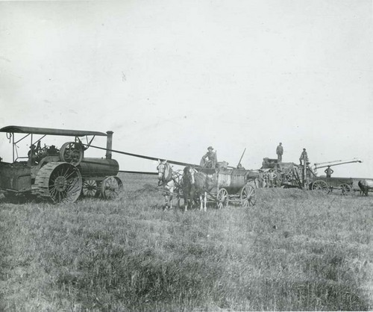
History of Kansas Department of Agriculture
Nation’s 1st state-run ag department
Started as the Kansas Agriculture Society when KS still a territory
Farmers regularly met to discuss land claims, share best practices
County/State fairs were gathering events for farmers
March 5, 1862, society became KDA
This photograph shows men harvesting wheat with a steam tractor, thresher, and horse-drawn water wagon in a field in Seward County, Kansas. (Between 1891 and 1912)

Slide 6

History of Kansas Department of Agriculture
Agricultural Laboratory
Agricultural Marketing
Dairy and Feed Safety Program
Division of Animal Health
Division of Conservation
Food Safety & Lodging Program
Grain Warehouse Inspection Program
Meat & Poultry Inspection Program
Pesticide and Fertilizer Program
Plant Protection & Weed Control Program
Division of Water Resources
Weights & Measures Program
Notes:
Today, KDA oversees the administrative, marketing and regulatory services for twelve departments or programs

Slide 7
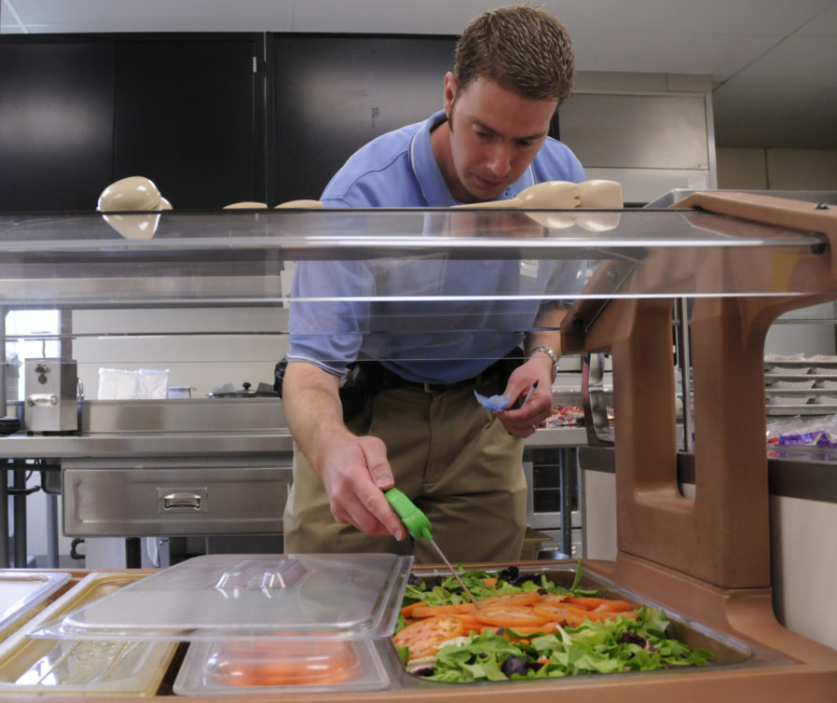
KDA’s Food Safety & Lodging Program
State’s regulatory arm for food production and public service facilities
Inspects:
  Egg production farms
  Senior meal sites
  Mobile food units
  Lodging facilities
  Food wholesalers
  Food warehouses
  Food processors
  Food manufacturers
  Restaurants
  Grocery stores
  Convenience stores
  Schools
Notes:
Today, KDA oversees the administrative, marketing and regulatory services for twelve departments or programs

Slide 8
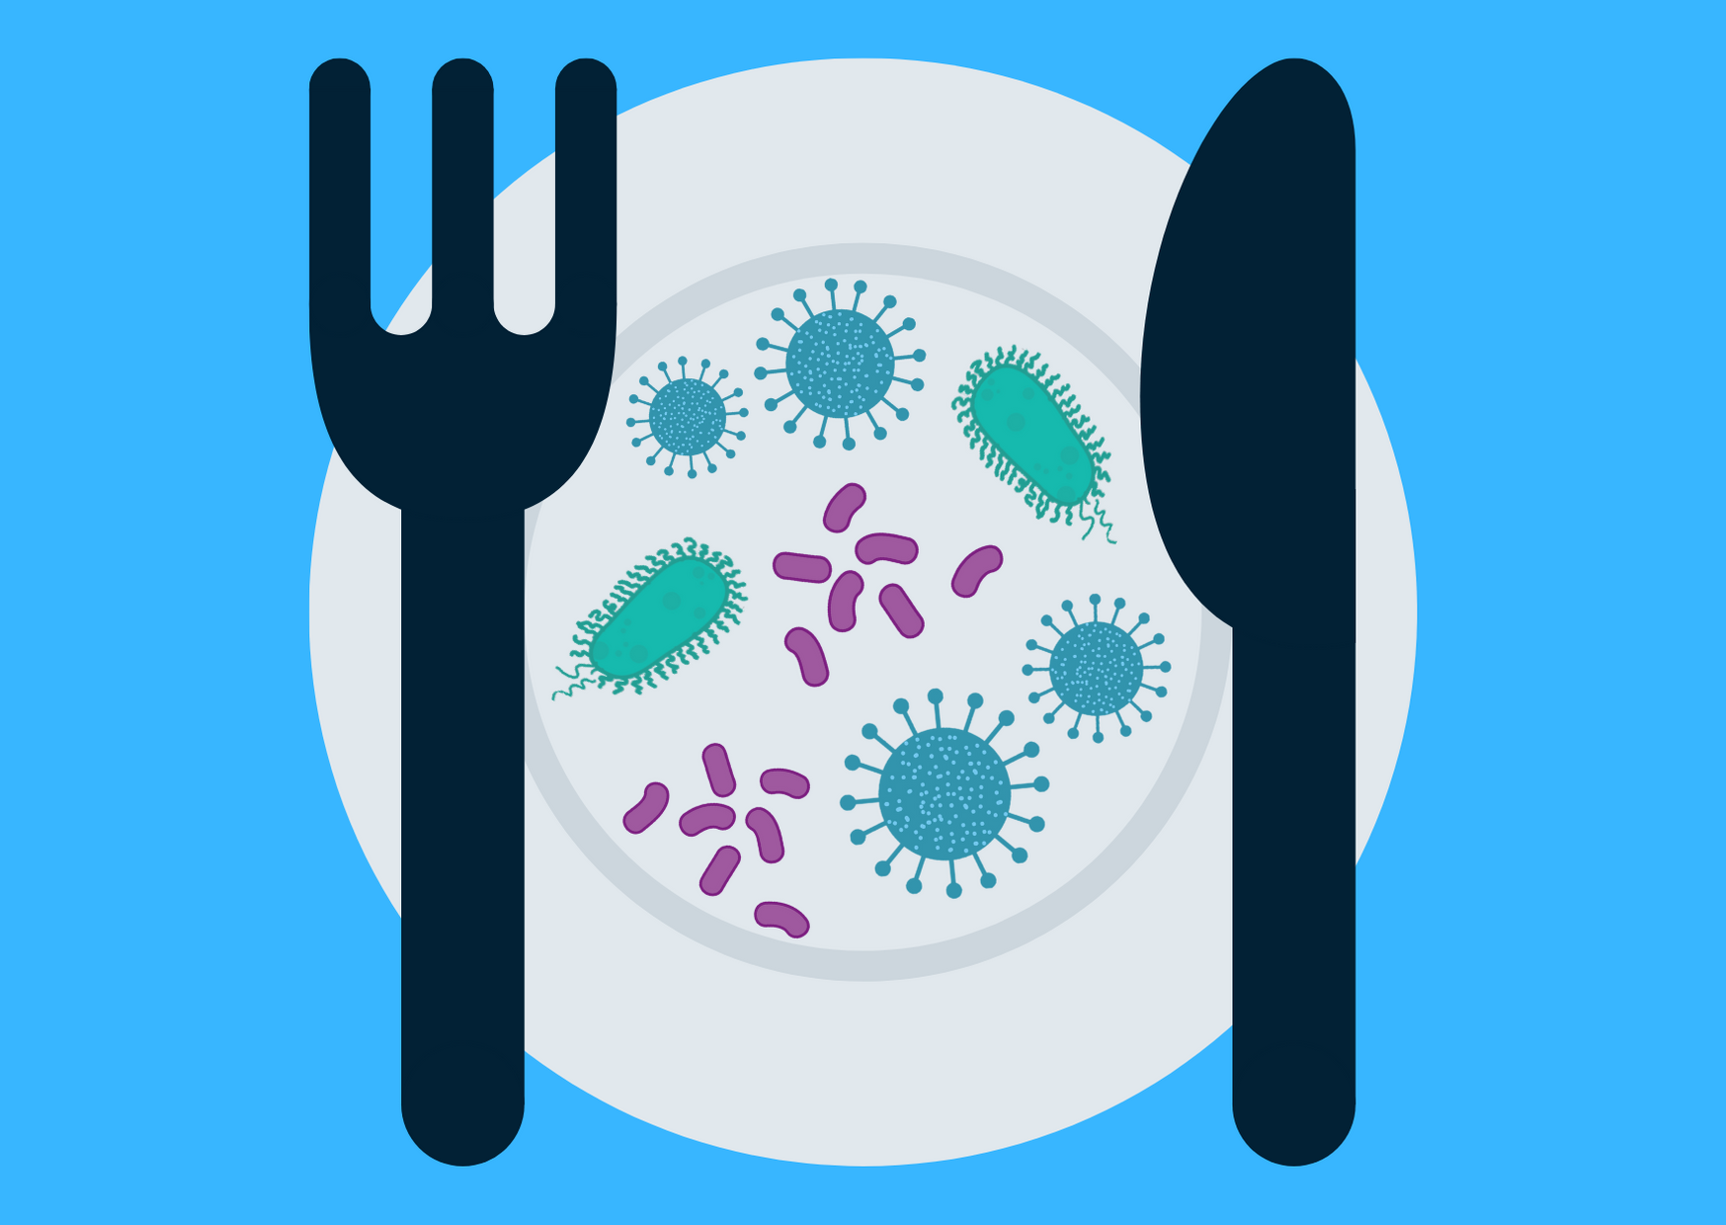
Food Safety is a Public Health Concern
Each year in the US, foodborne illnesses:
  Affect 48 million people
  Result in 128,000 hospitalizations
  Cause 3,000 deaths
  Carry an economic burden of $15.5 billion dollars

Slide 9

Notes:
Today, KDA oversees the administrative, marketing and regulatory services for twelve departments or programs

Slide 10
Risk Factor Study
Standard 9 Report
Measure the success in reducing the occurrence of foodborne illness risk factors

Slide 11
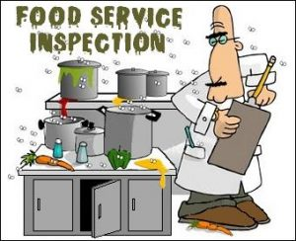
Risk Factor Study
Standard 9 Report
Measure the success in reducing the occurrence of foodborne illness risk factors

Slide 12
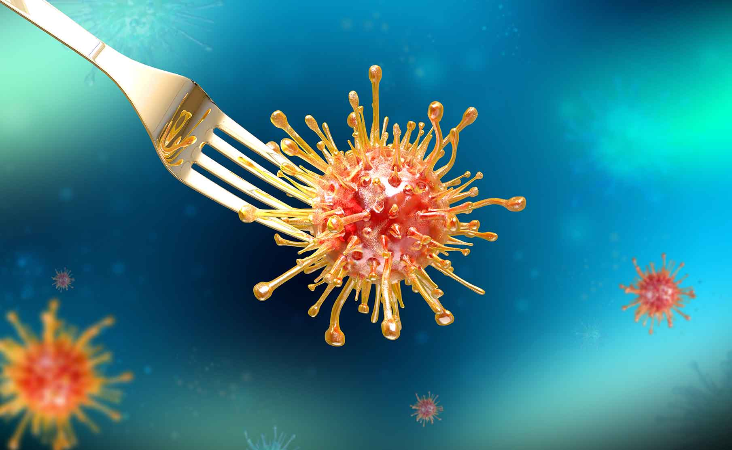
Risk Factor Study
Standard 9 Report
Measure the success in reducing the occurrence of foodborne illness risk factors

Slide 13
Risk Factor Study
Top 5 Foodborne Illness Risk Factors:
  Poor personal hygiene (leading cause of foodborne illness)
  Improper holding temperatures
  Improper cooking temperatures
  Food from unsafe sources
  Contaminated equipment/cross-contamination

Slide 14
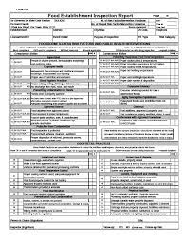

Slide 15
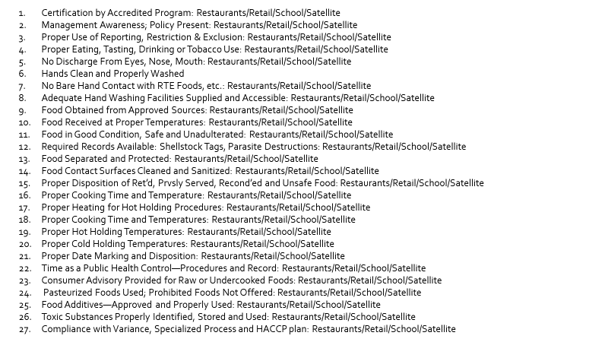

Slide 16
Risk Factor Study
Top 5 Foodborne Illness Risk Factors:
  Poor personal hygiene (leading cause of foodborne illness)
  Improper holding temperatures
  Improper cooking temperatures
  Food from unsafe sources
  Contaminated equipment/cross-contamination

Slide 18


Slide 19
Organize data

Slide 20
Organize data
Analyze data

Slide 21
Organize data
Analyze data
Interpret data

Slide 22
Organize data
Analyze data
Interpret data
Make suggestions for interventional strategies

Slide 23
Organize data
Analyze data
Interpret data
Make suggestions for interventional strategies
Standard 9 Report

Slide 24
Products Developed
Inspection Data Sheet (Excel Workbook)
Inspection Analysis Report
Standard 9 Report
Standard 9 PowerPoint Presentation

Slide 25
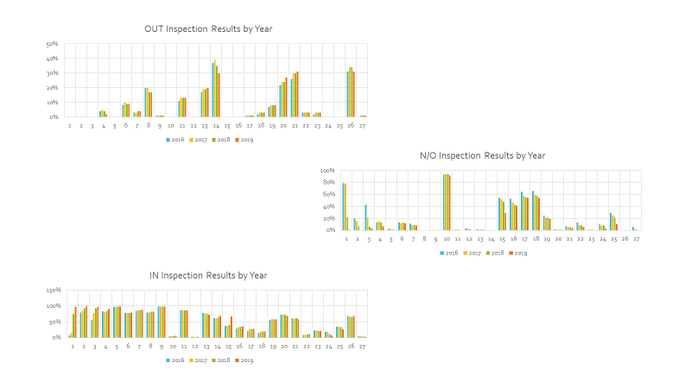

Slide 26
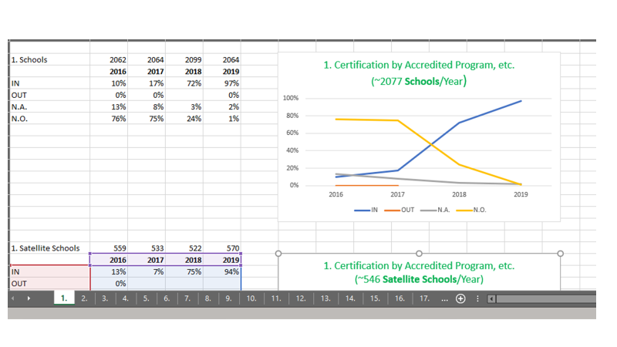

Slide 27
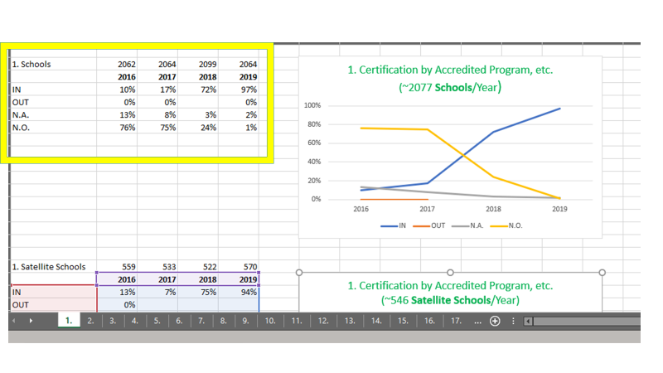

Slide 28
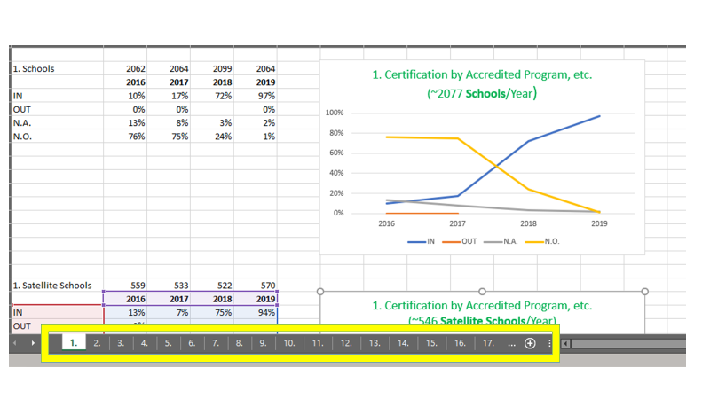

Slide 29
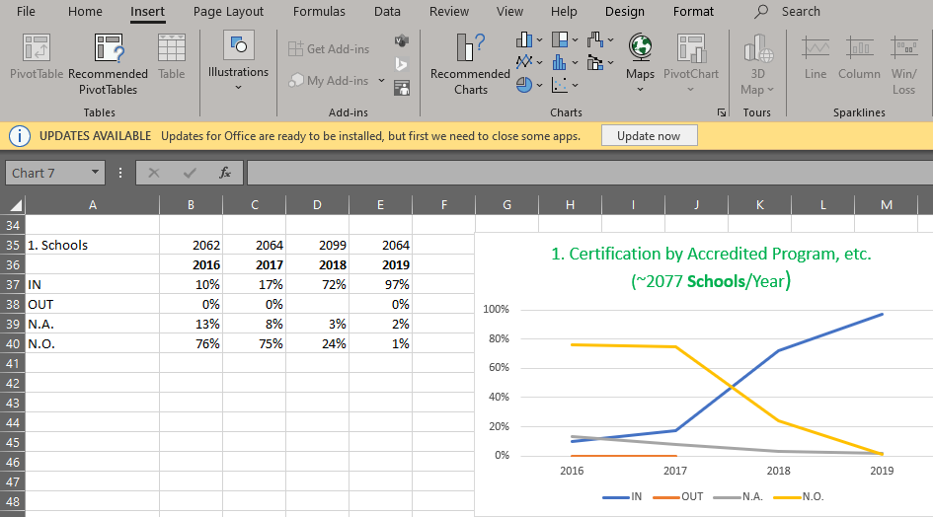

Slide 30


Slide 31
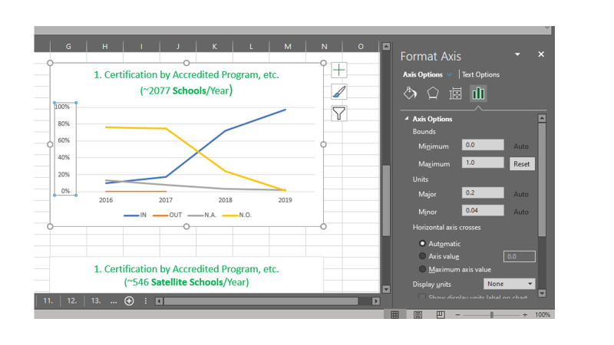

Slide 32
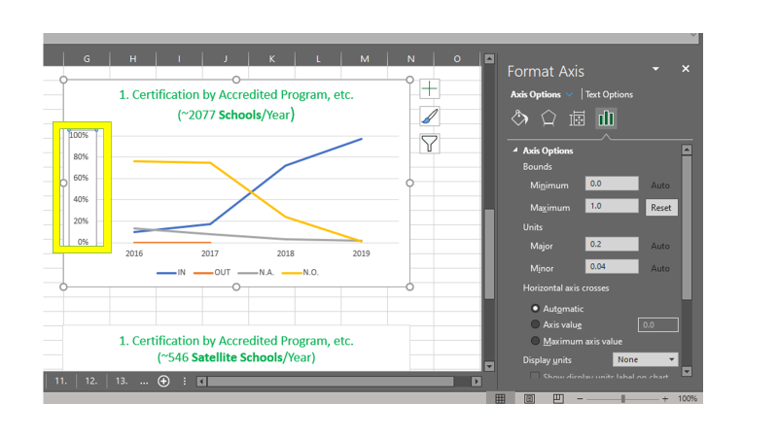

Slide 33
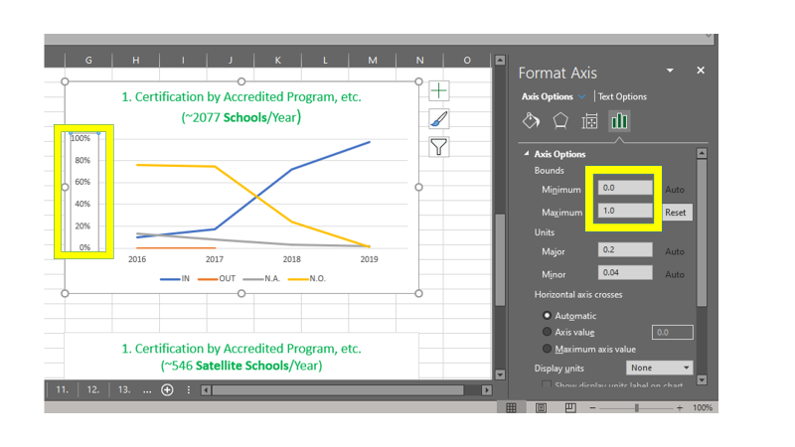

Slide 35


Slide 36


Slide 37
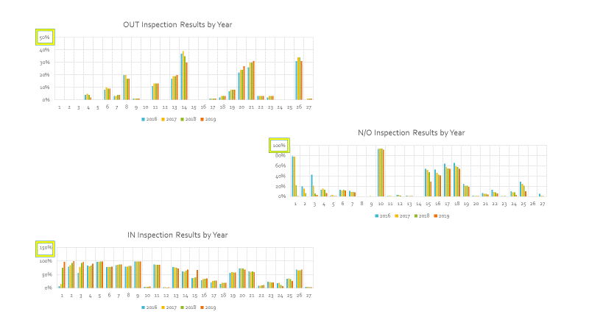

Slide 38
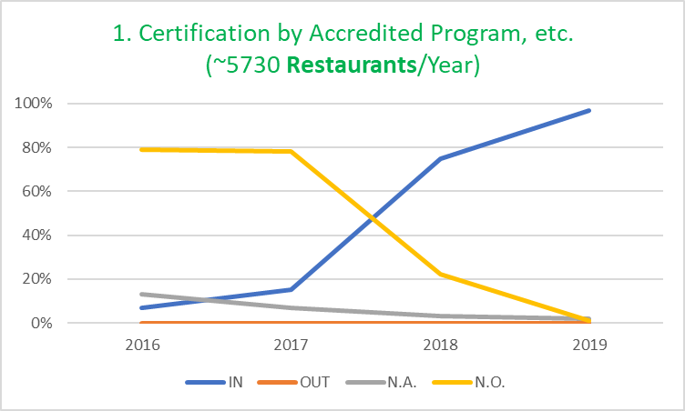

Slide 39
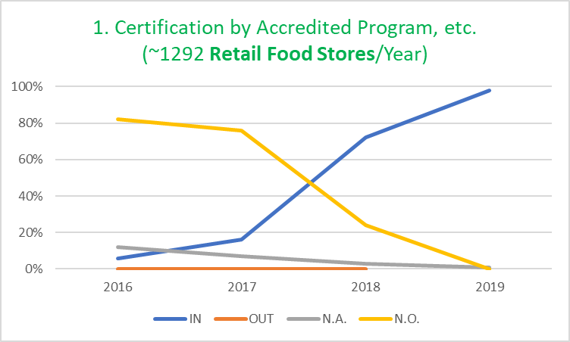

Slide 40
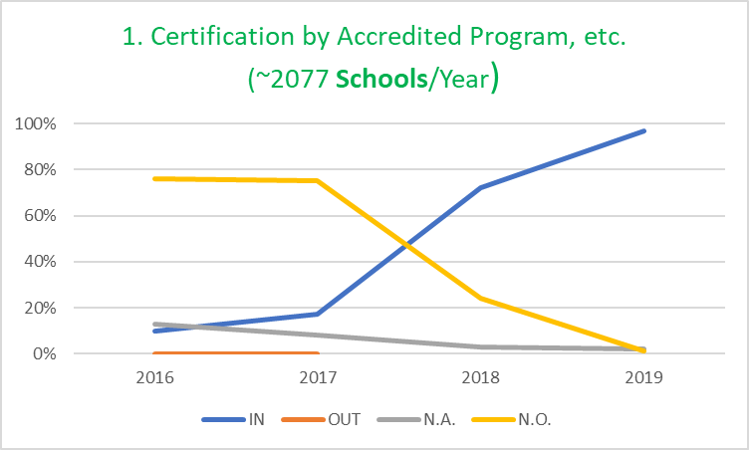

Slide 41
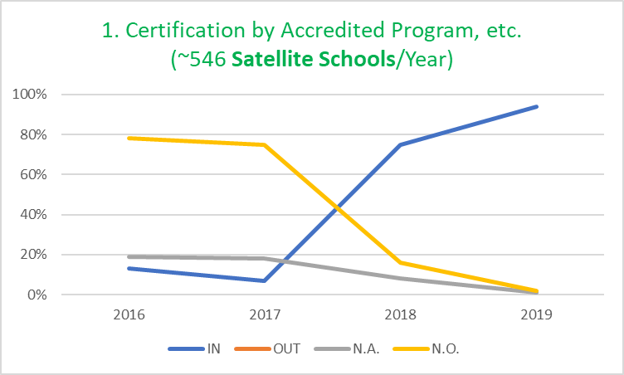

Slide 42
3. Proper Use of Reporting, Restriction & Exclusion

Slide 43
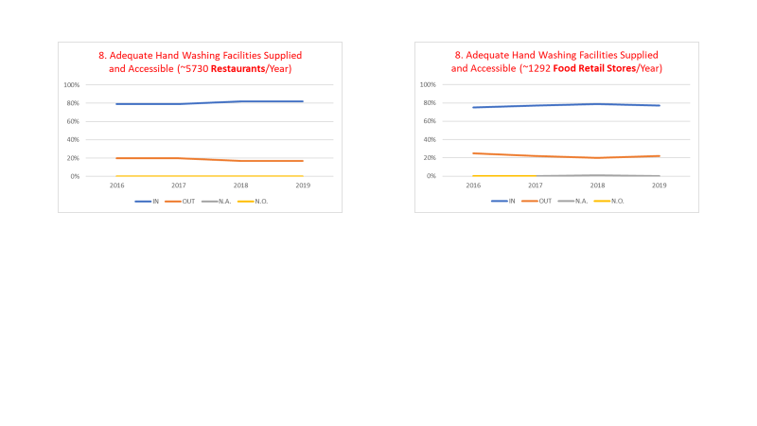

Slide 44
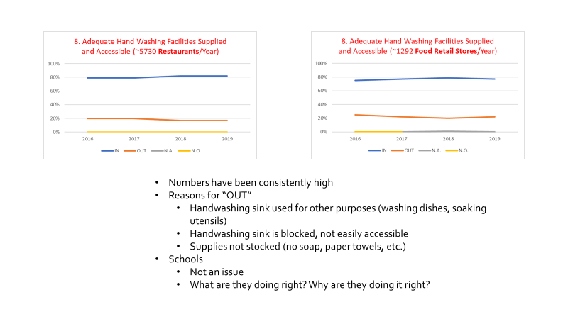

Slide 45
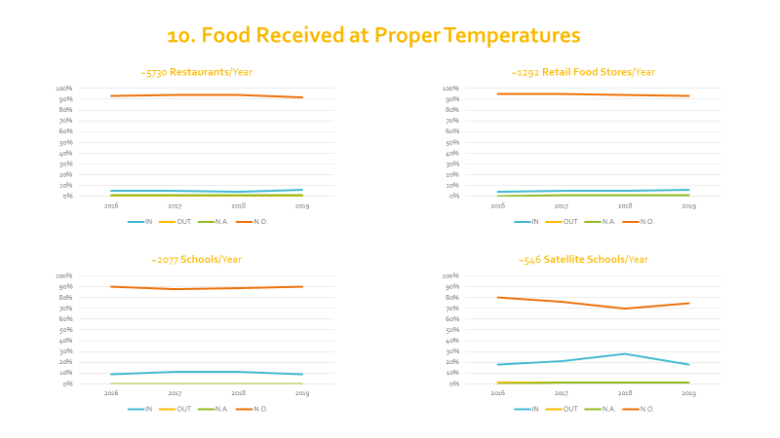

Slide 46
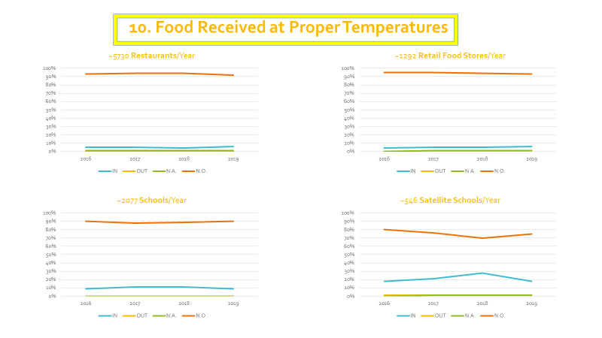

Slide 47
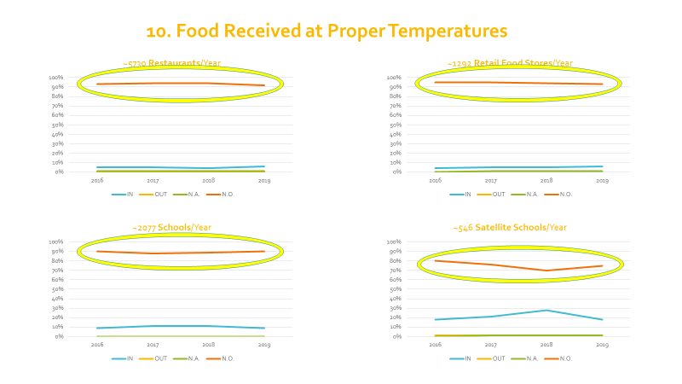

Slide 48
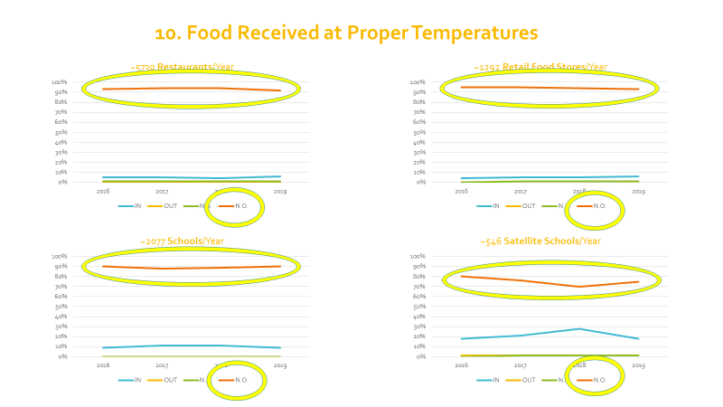

Slide 49

10. Food Received at Proper Temperatures
Receiving safe food is first step is ensuring food is safe
Understandable that inspections and receiving times don’t always line up
But…this activity consistently unobserved—over 90% each year for restaurants, retail and schools

Slide 50
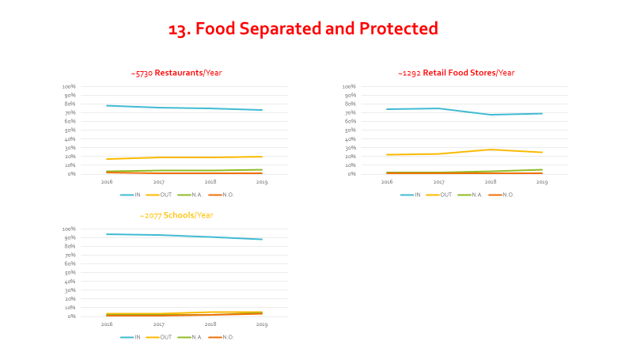

Slide 51
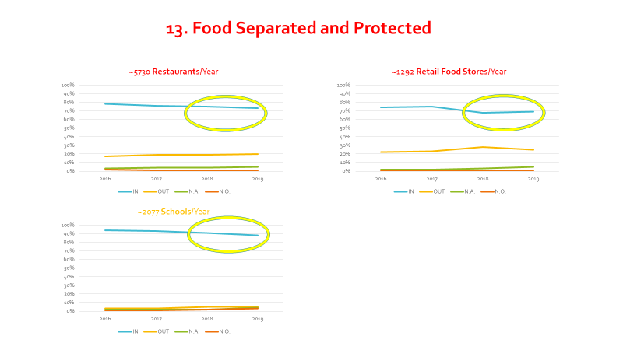

Slide 52
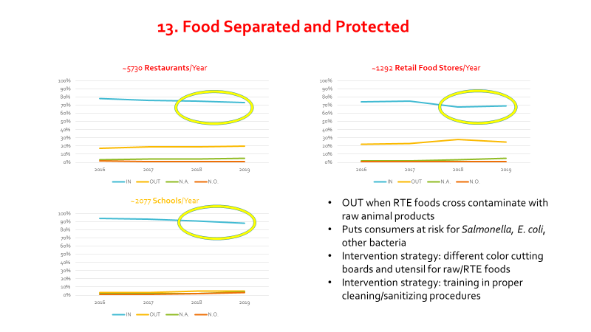

Slide 53
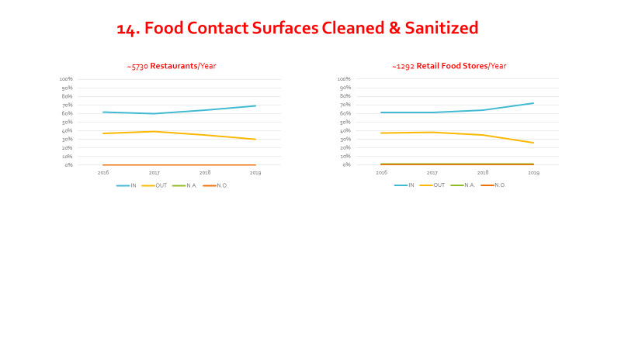

Slide 54
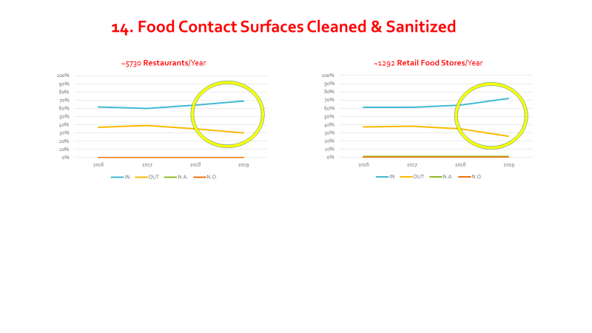

Slide 55
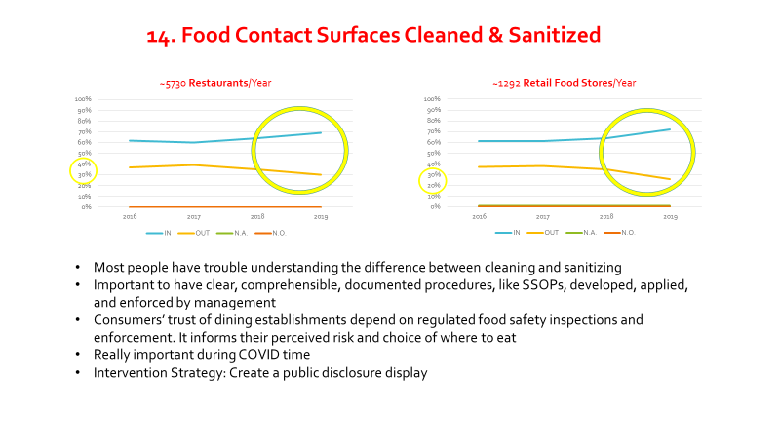
Most people have trouble understanding the difference between cleaning and sanitizing
Really important during COVID TIME
Intervention Strategy: training, developing and implementing clear, comprehensible, documented procedures that are enforced by management

Slide 56
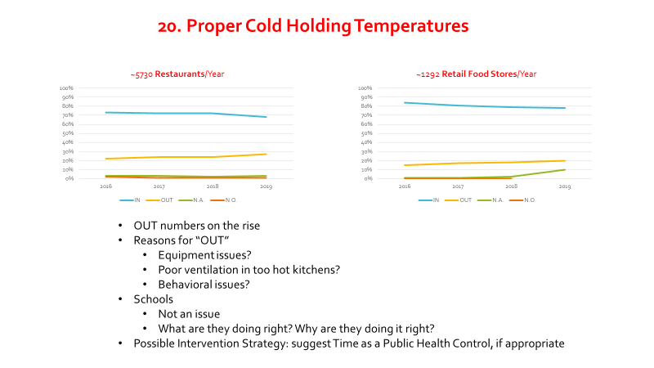

Slide 57
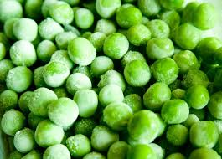
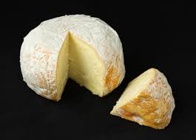
Why is “Cold Holding” Important?
Keep hot foods hot and cold foods cold
Cold foods should be kept at 41ᵒF or below
Listeria monocytogenes bacteria very hardy and thrives at cool temperatures
Very prolific in the environment
Does not mind salty, low pH and low water environments
Very severe foodborne illness for young, pregnant, fetus—high mortality rate
https://pixabay.com/photos/peas-green-vegetables-food-organic-390679/
https://en.wikipedia.org/wiki/Cheese

Slide 58
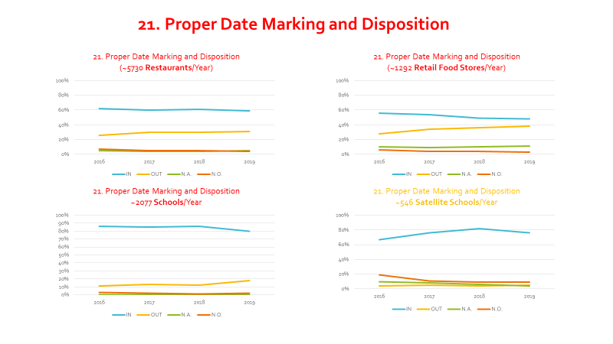

Slide 59
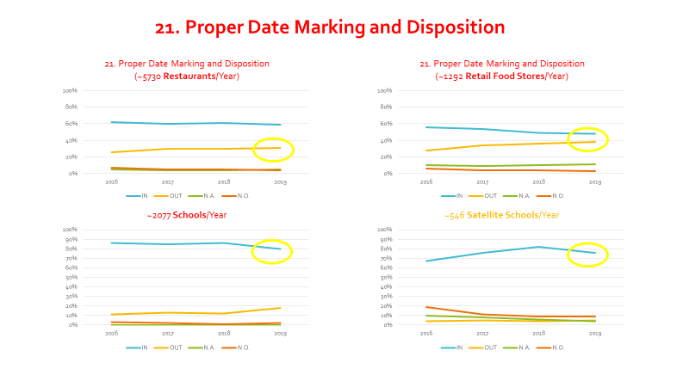

Slide 60
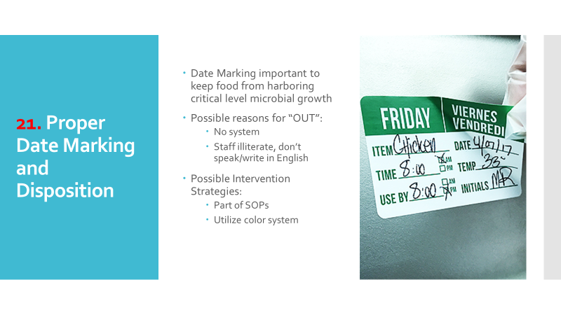

Slide 61
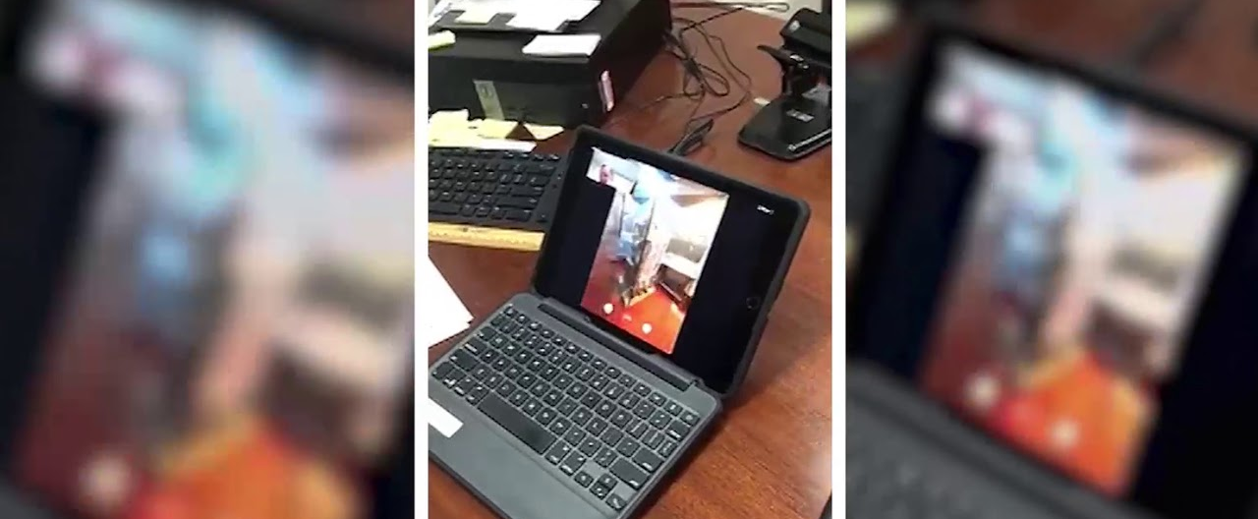
Virtual Food Inspections

Slide 62
MPH Course Contributions
FDSCI 600 – Food Microbiology
FDSCI 690 – Principles of HACCP and HARPC
MPH 701 – Fundamental Methods of Biostatistics
FDSCI 730 – Food Safety/Security
FDSCI 731 – Food Protection and Defense
MPH 701 – Introduction to Epidemiology
AAI 801 – Interdisciplinary Process
DMP 815 – Multidisciplinary Thought/Presentation

Slide 63
Competencies: Evidence-Based Approaches to Public Health
Quantitative & Qualitative Data Collection Methods
  Inspection Data Sheet
  Inspection Analysis Report
  Standard 9 Report
  Standard 9 PowerPoint Presentation

Slide 64
Competencies: Evidence-Based Approaches to Public Health
Interpret results of data analysis for public health research
  Inspection Data Sheet
  Inspection Analysis Report
  Standard 9 Report
  Standard 9 PowerPoint Presentation

Slide 65
Competencies: Communication
Communicate audience-appropriate public health content, both in writing and through oral presentation
  Inspection Data Sheet
  Standard 9 Report
  Standard 9 PowerPoint Presentation

Slide 66
Competencies: Interprofessional Practice
Perform effectively on interprofessional teams
  Inspection Data Sheet
  Standard 9 Report

Slide 67
Competencies: Systems Thinking
Apply systems thinking tools to a public health issue
  Inspection Data Sheet
  Inspection Analysis Report
  Standard 9 Report
  Standard 9 PowerPoint Presentation

Slide 68


