Slide 1
Half-Baked AI
Copyright Cookies
Originally by Gwendolyn Sibley
CC-BY-NC

Slide 2
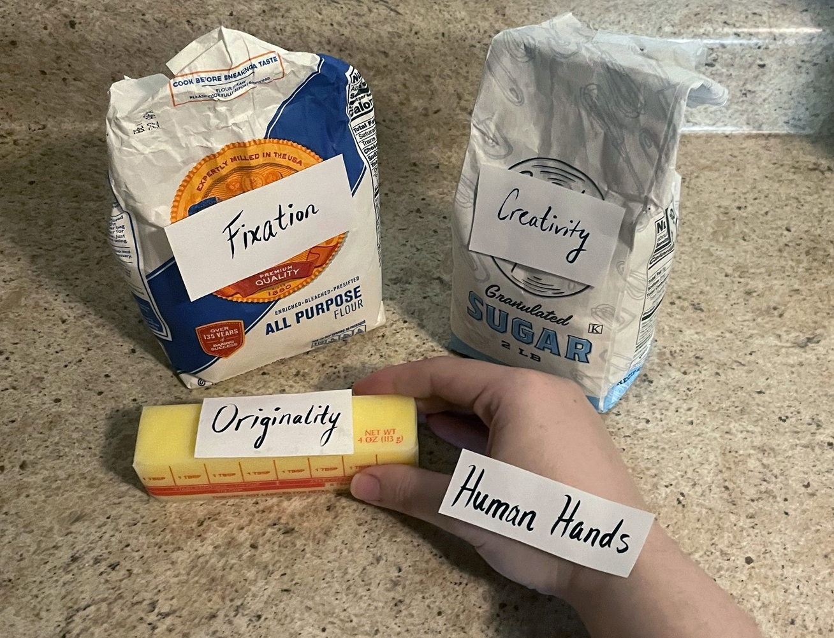
Copyright Cookie Basics:
© is granted automatically when works have:
Creativity;
Originality;
Fixation in a Tangible format;
And be Human Made
(Naruto vs Slater).
Notes:
Copyright (17 U.S. Code Chapter 1) requires specific ingredients to qualify under the law. Because of the Berne Convention (See WIPO in references) copyright is now available as an instant mix in the United States. This mix includes:
Creativity;
Originality;
Fixation in a Tangible format;
And be Human Made (Naruto vs Slater Court Case).
Making traditional copyright is not complex; simply mix the above ingredients. When qualified ingredients are mixed, copyright is granted automatically!

Slide 3
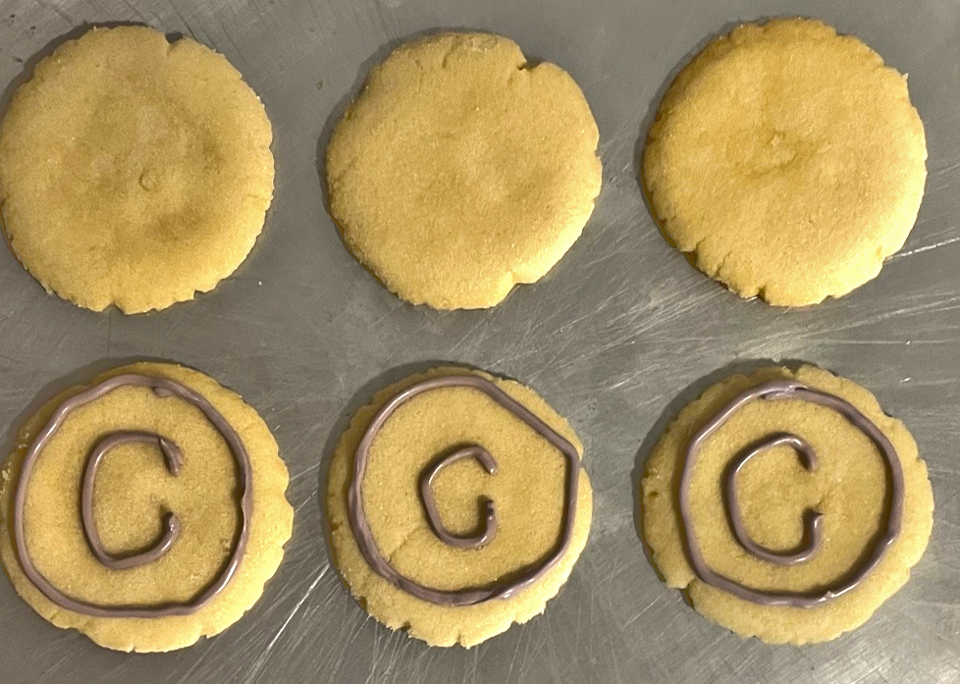
Copyright Cookie Basics:
Once Copyrighted:
Works have protection for the life of the creator +70 years.
Formal registration is not required, but may be for a fee.
Notes:
Creators used to have to package their copyrightable works by registering with the U.S. copyright office and adding a copyright symbol (see section 1.11), but now that is optional. Copyrighted works will have protection whether or not they are formally registered, and this protection will last for the duration of the creators’ life plus 70 years after their death.
After a copyrightable work is created, a creator may choose to submit their work for official copyright registration from the U.S. Copyright office. This is not required to receive protection, however, if a creator wants to sue or is being sued for copyright infringement, they will need to formally register their work. Each copyright formal registration has a fee, but some copyright holders consider the cost to be a lesser evil. This is because if anyone infringes their work, the creator will be able to take the infringer to court.

Slide 4
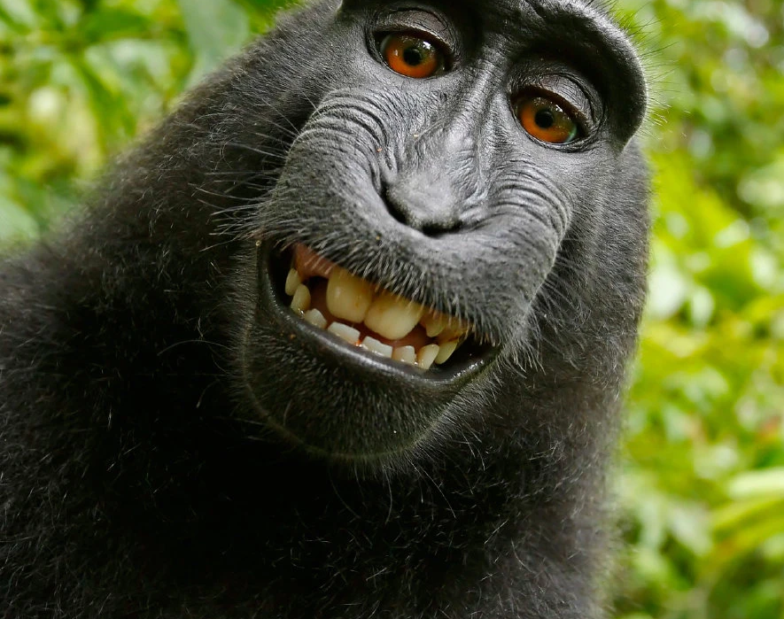
Copyright Cookie Basics:
Uncopyrightable works:
Facts & Data
Ideas
Names & Slogans
Useful Articles
Non-Human Creations
Naruto v. Slater, No. 16-15469 (9th Cir. 2018) :: Justia
A selfie taken in 2011 by Naruto, a monkey in Indonesia.
Credit...David Slaters/Caters News
Notes:
Many users of the internet often make the mistake of confusing access and copyrightability. Just because a person or AI tool may access a work, it does not mean that person or tool have rights to that work. Conversely, even if a work is inaccessible, that does not mean it is copyrightable. Having control and having legal rights do not always go hand-in-hand.
(Naruto vs Slater) This case is based on a monkey (Naruto) taking a selfie with a camera. It was decided that the monkey could not hold copyright in the photo because he is not human, setting the precedent that only humans can receive copyright protection.

Slide 5
Is it “Copy-Right-Able?”
Take your best educated guess!

Slide 6
Simple Math Equation?
a² + b² = c²
Notes:
No, simple math is based in fact.

Slide 7
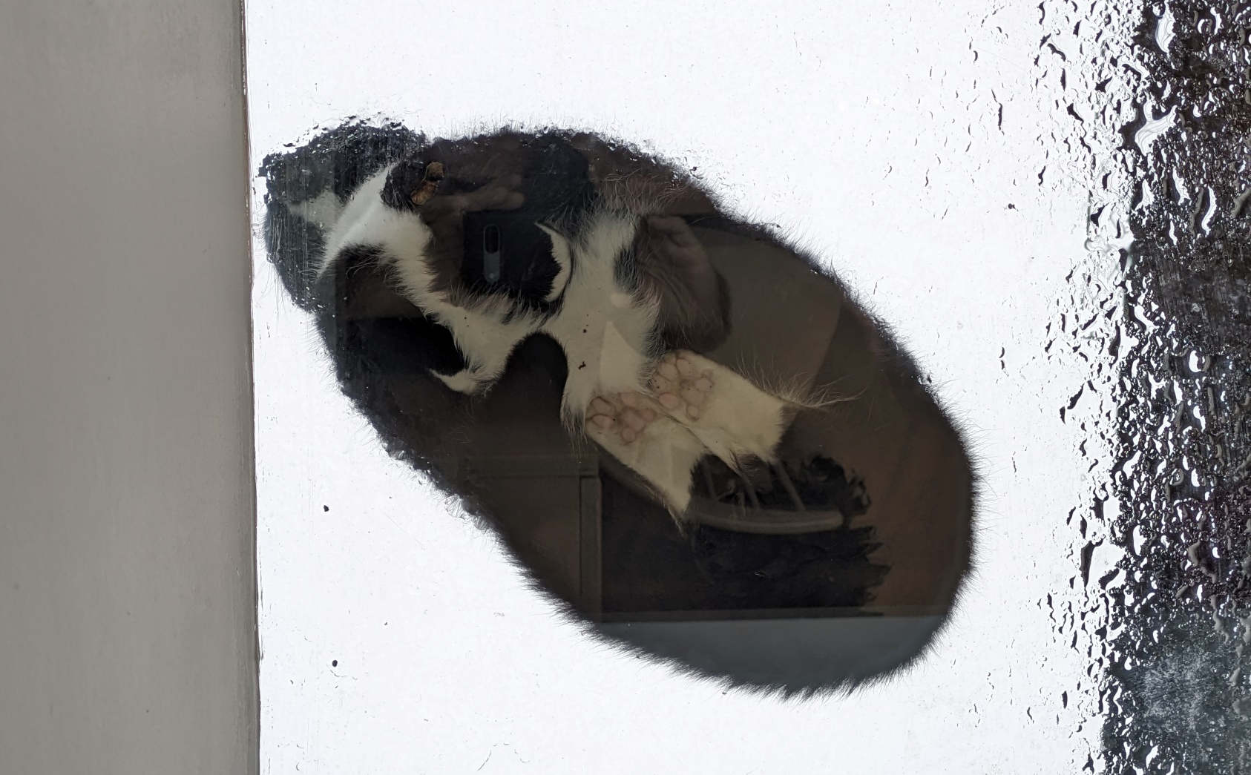
A Cat Picture?
Notes:
This work is in the public domain for the purpose of reproduction in the PowerPoint. Typically, photography is copyright protected.

Slide 8
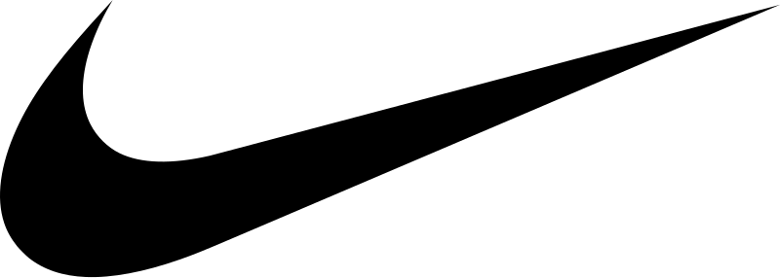
Well-Known Logo?
Notes:
Names and Slogans are a part of Trademark Law, and are not copyrightable.

Slide 9
A Joke?
*Knock* *Knock*
Notes:
Common joke phrases such as “knock, knock” or “so-and-so walks into a bar” are considered too common for copyrightability. But, creative jokes are copyrightable.

Slide 10
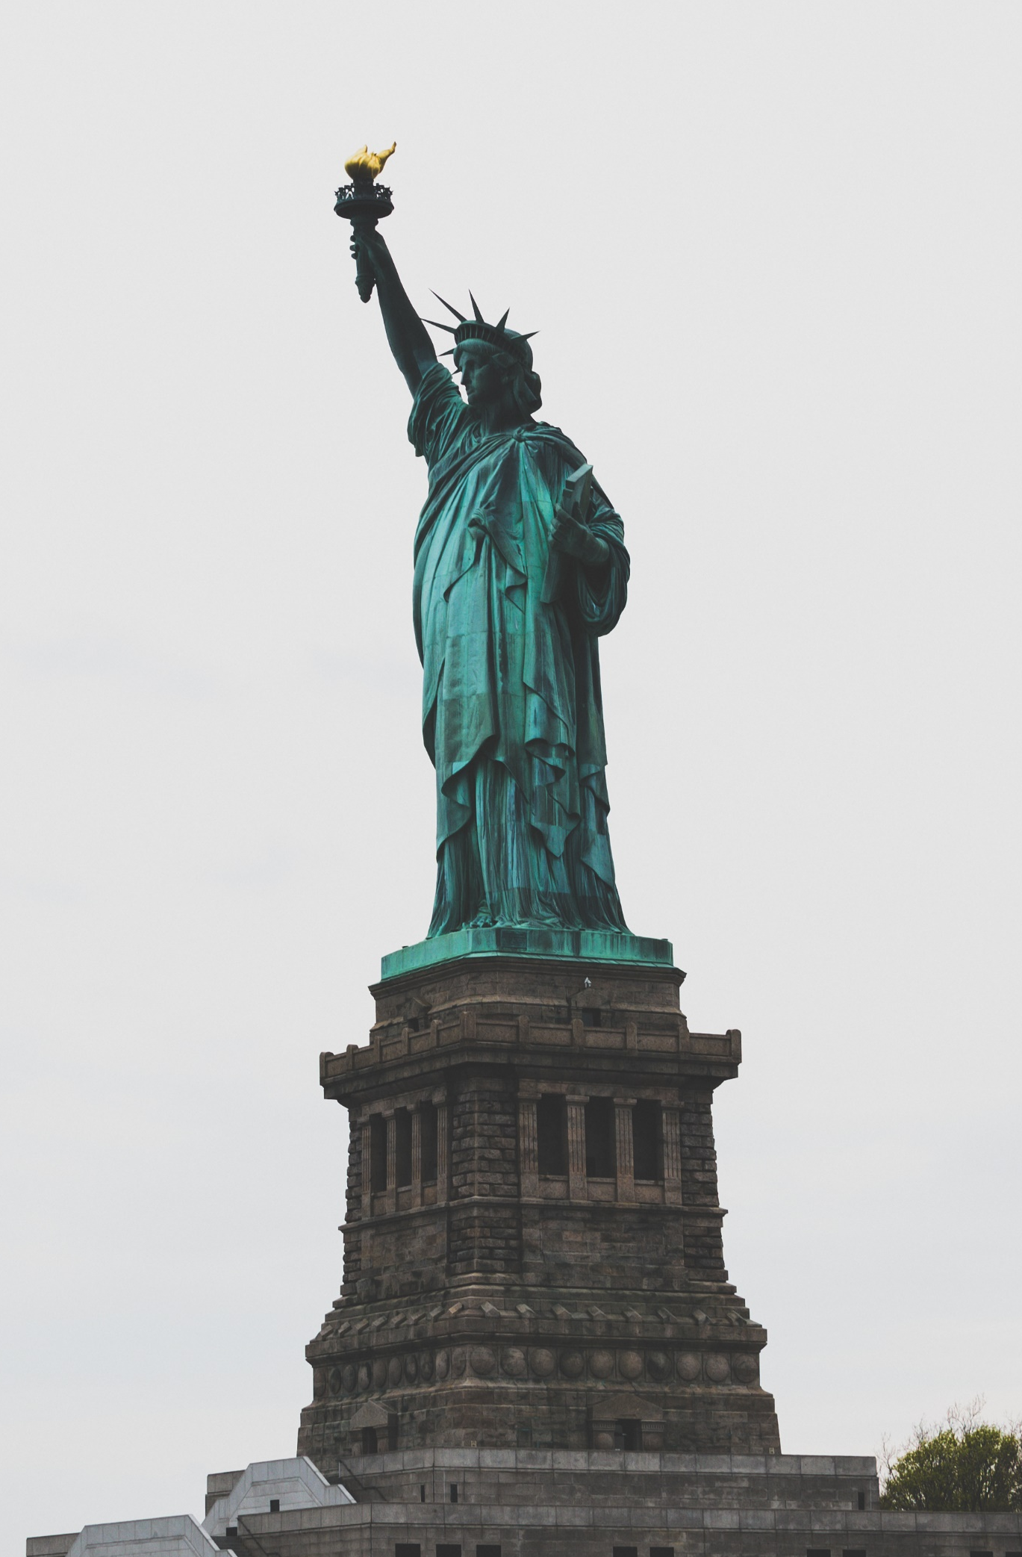
Two Pictures?
Notes:
The work on the left is from about 1910, and is in the public domain. The work on the right was taken in 2010, by James Pond and has been placed in the Public Domain by the creator. Although the images are of the same subject, and look nearly identical, both would qualify for copyright protection individually if they weren’t in the public domain.

Slide 11
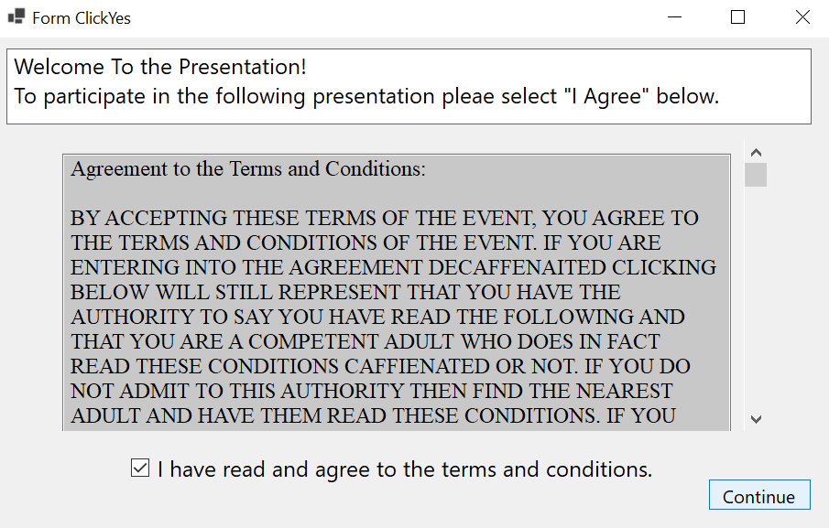
Licenses and Agreements
Notes:
Although it is possible to qualify for copyright with just the above ingredients, this does not mean a work will be used by others in ways the creator dictates. Licensing agreements are used to make stipulations between the owner of the copyright and any potential users of that copyright. Licensing is how most copyrighted works are distributed today, as it often serves as a legal avenue control how works are used even with exceptions provided by copyright (Rub, 2017).

Slide 12
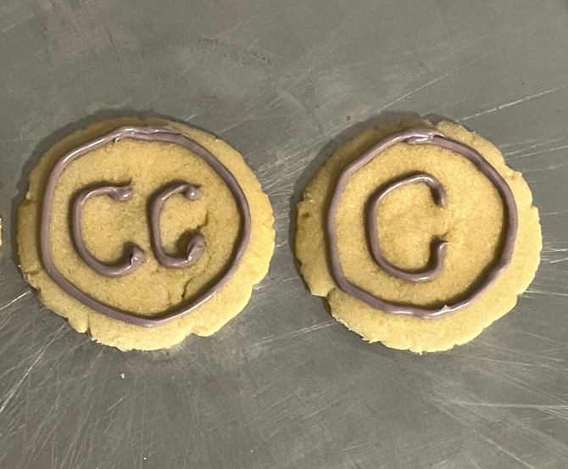
Licenses and Agreements
These are contracts that specify:
Whether something may use the work;
The length of time use is permitted;
What audiences the work may be distributed to;
Whether data may be collected while using the work;
and whether a user is allowed to sue the creators in case of disagreement (called arbitration);
Notes:
License agreements can be simple, as demonstrated in open access creative commons licensing (Creative Commons, 2023). But licenses can quickly become complex when a work is distributed broadly. It is important that anyone using a work with licensing review all licensing agreements before agreeing to distribute or use that work.

Slide 13
Do you agree to the
Terms & Conditions?
Try not to get your data stolen!
https://termsandconditions.game/
Notes:
This part of the lesson will require information-gathering from students. Students may provide examples of entertainment services they use, such as apps for music or videos. They have most likely seen pop-ups detailing “cookies” that their favorite entertainment collects.
Accepting these “cookies” results in varying amounts of data collection, agreements to rights granted, and acceptance of privacy loss. Even as they are presented as pleasant, they are license agreements through and through.
Terms and Conditions Apply was created by @WKLondon, @Jonplackett, @AlexBellos and @iam_adam.
This game provides an entertaining way for a group of students to engage with cookies in ways which are meant to confuse them. If personal computers are available, have students run through this game themselves. Otherwise having one student model the game to the class is satisfactory.

Slide 14
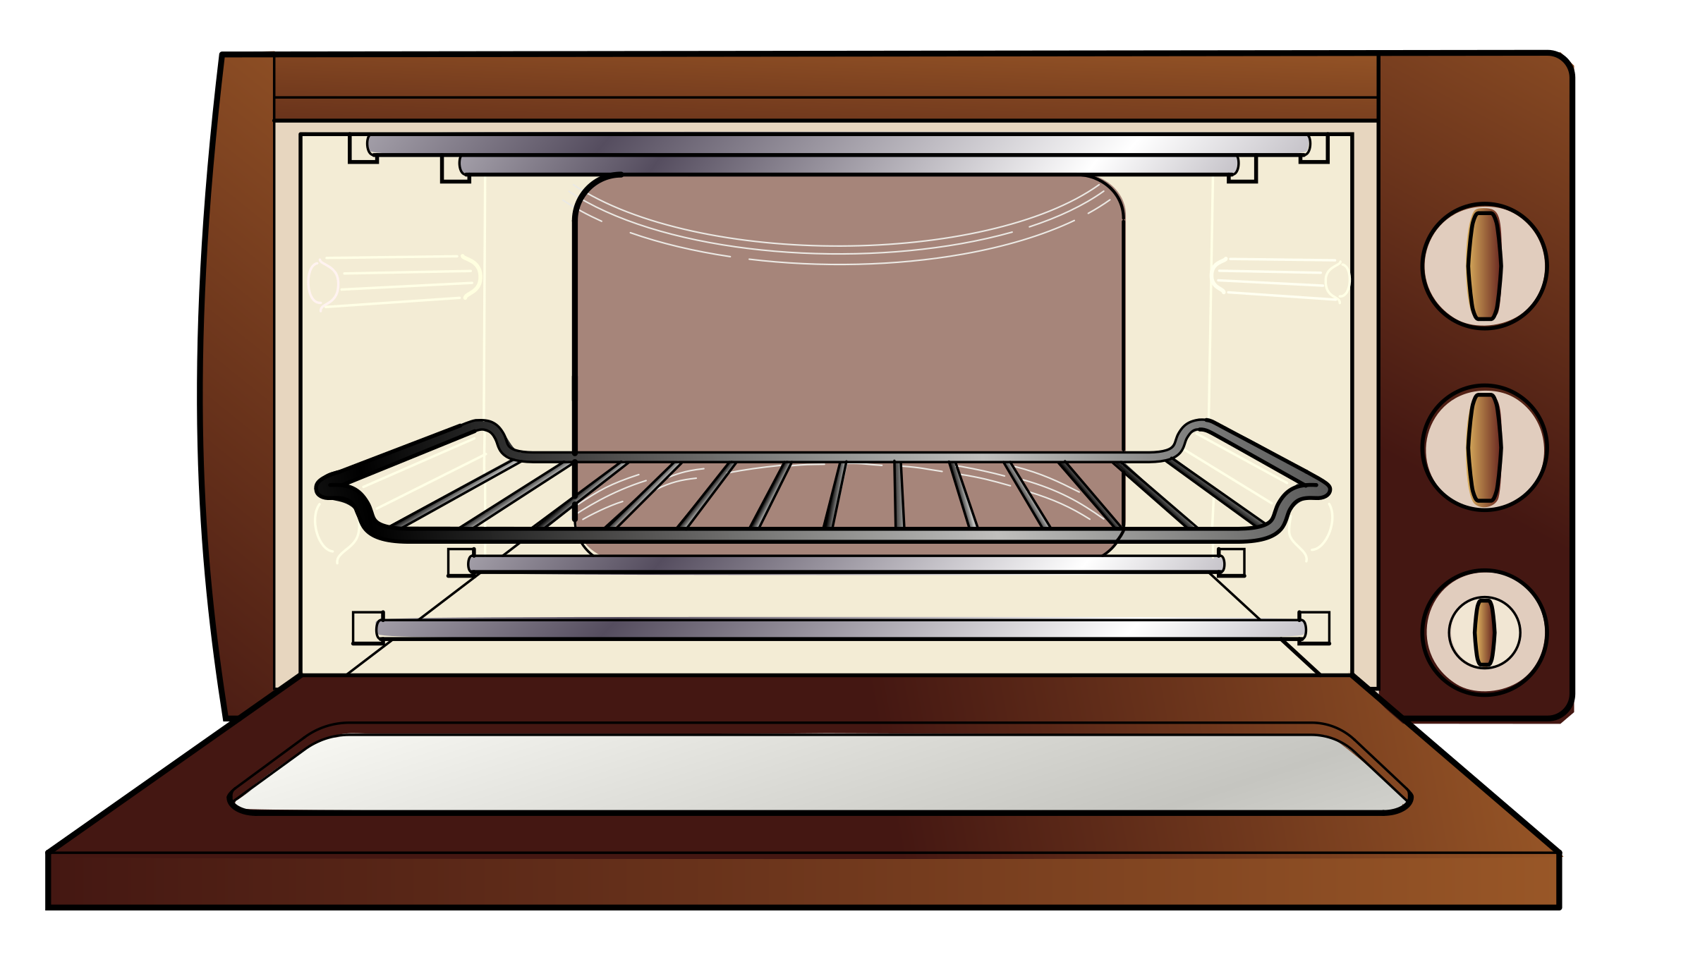

Conventional Publishing Ovens
Provide an agreement to sell your work for you.
Typically, all copyrights are transferred as the price for publishing formally.
The publishing entity takes on all protective roles for that copyright.
Notes:
Historically, the conventional method of distributing copyright is through authors publishing their works. They may choose to either use the skills of a traditional publisher or self-publish their works by posting online. Unpublished works have different copyright rules, so it is important to distinguish whether a work has been published in federally recognized formats or has been unpublished.
Conventional publishers offer the benefit of joining an organization that will bear the burden of licensing, cost of marketing, and risk of copyright infringement instead of the original creator. Usually, the price of this arrangement is the transfer of copyright from the creator to the publishing company. This is typically agreed upon in a written contract between parties involved.

Slide 15

Self-Publishing Online
Typically keeps all copyrights with the original creator
Subject to the terms of online publishing platforms
Defense of copyright remains the duty of the original creator.
©

Slide 16
Copyright Exemption: Fair Use
Fair use allows for use without permission with 4 considerations:
The purpose and character of the use, including whether such use is of commercial nature or is for nonprofit educational purposes.
The nature of the copyrighted work.
The amount and substantiality of the portion used relative to the whole copyrighted work.
The effect of the use upon the potential market for, or value of, the copyrighted work.
Notes:
U.S. law specifies uses outside of standard copyright law, known as “exemptions.” Exemptions allow for use of a work without permission of the creator. These exemptions are dictated specifically under the law in sections 107-122 (Cornell Law School, 2024).
The most widely used exemption (and best to talk about in this lesson) is known as Section 107 “Fair Use.” Fair use is often confusing to employ, as the process is not easy for beginners. In its most basic form, Fair use addresses four factors for a work to be used without permission.
Fair use is an exception that is determined on a case-by-case basis. This means that whether a use is “fair” can only be decided in a court of law, and up until the point judge makes a decision in court, any fair use analysis is nebulous. It is best addressed by a lawyer if librarians or students have questions about whether a use is fair.

Slide 17
The AI Copyright Conundrum

Slide 18
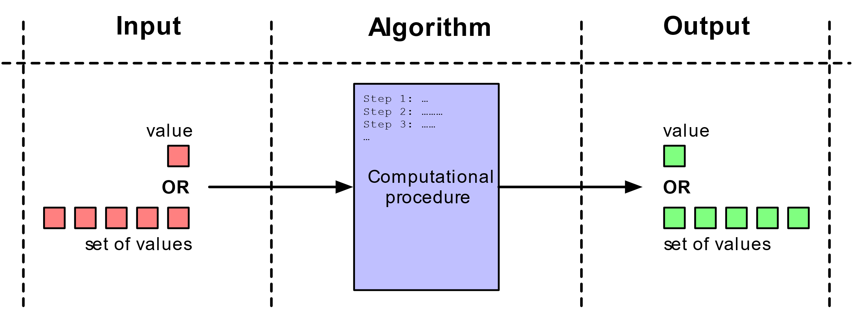
Artificial “Intelligence” Basics
This Photo by Unknown Author is licensed under CC BY-SA
Notes:
AI tools have the ability to consume multitudes of works, document them into datasets, process them into neural network algorithms, and output new works that at first glance appear to have copyright protection.
The “intelligent” part of artificial intelligence is based in algorithms. In an oversimplified sense, algorithms are extensive rules and instructions that when queried, solve specific problems. Generative AI oversimplified are multiples of algorithms that source through pre-made datasets in special ways when asked special questions.
However, much like a hypothesis for a paper, the rules created for generative AI tools have to be tested and revised to solve problems. If the problems become harder to solve, then the tool must have larger datasets to solve larger problems. It is then desire and need of creators of generative AI tools to have access to larger and more extensive datasets so that their tools remain relevant.

Slide 19
Tell me the Perfect Cookie?
Dataset of Perfect Cookies
Cookie flavor | Rating | Favorability
Oatmeal Raisin | 82 | 95
Sugar | 76 | 88
Chocolate Chip | 84 | 90
Query

Slide 20
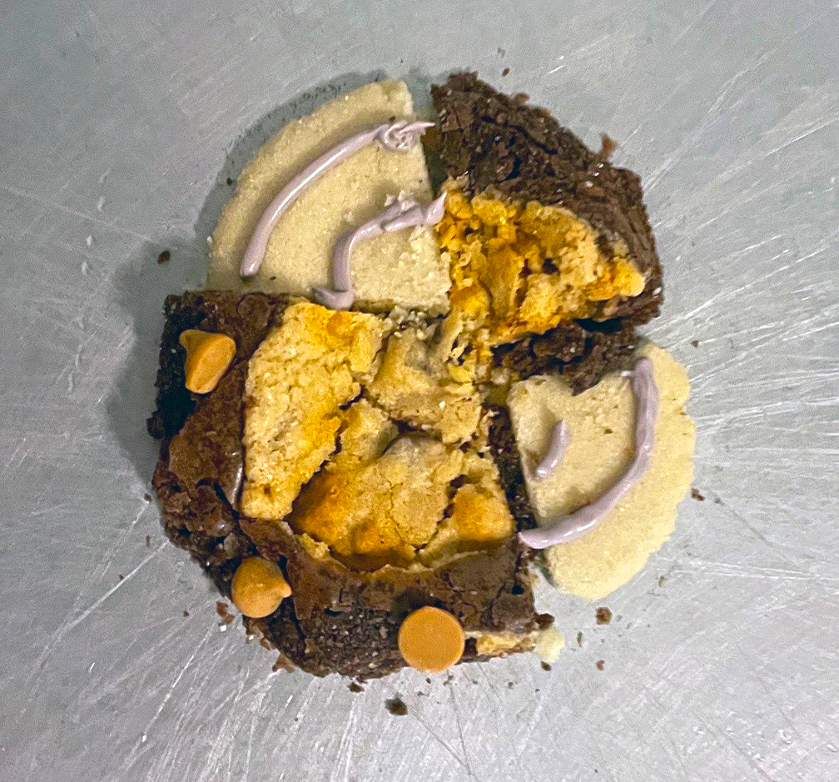
Tell me the Perfect Cookie?
A “Perfect” Cookie
Dataset of Perfect Cookies
Cookie flavor | Rating | Favorability
Oatmeal Raisin | 82 | 95
Sugar | 76 | 88
Chocolate Chip | 84 | 90
Prompt

Slide 21
Half-Baked AI Protection
Algorithms are Protected
But Output is not Protected
Technology using algorithms has found protection in Patent Law.
Only Humans can receive copyright protection for creative works.
Notes:
For generative AI tools, intellectual property rights can be considered “half-baked.” Since generative AI “creates” only with human data and input, protection cannot be awarded, as the “creator” is not human (Naruto v. Slater). The algorithm behind a tool’s interface may find protection in other parts of intellectual property, such as patent law. But what the tool’s algorithm outputs receives no protections.
(Naruto vs Slater) This case is based on a monkey (Naruto) taking a selfie with a camera. It was decided that the monkey could not hold copyright in the photo because he is not human, setting the precedent that only humans can receive copyright protection.

Slide 22
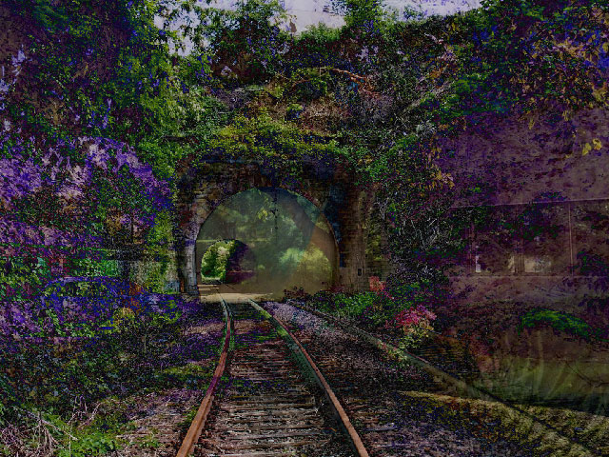
But what if I made the AI?
A Recent Entrance to Paradise
Stephen Thaler created the “Creativity Machine”
This system generated the artwork displayed
Upon disclosure to the copyright office, was denied protection.
Thaler sued and lost, cementing the ruling.
Notes:
But what if a human makes an AI? Would generative content be copyrightable then?
Through a decisive case study brought by Stephen Thaler (2023), it was decided by the U.S. copyright office that the creator of a generative AI algorithm could not receive protection for the works that AI algorithm generated. This case study originated when Thaler designed an AI system himself, called the “Creativity Machine” and attempted to formally register a generated image titled, “A Recent Entrance to Paradise” from that system with the U.S. copyright office. Upon disclosure, the copyright office denied Thaler copyright of the image.
Thaler’s defense sought to explain a creator’s effort of designing generative AI software, as well as the revisions and creativity of crafting a prompt for that AI, should constitute enough creativity to qualify for protection of the AI designer. This case study shows that creativity of this kind is not enough to extend copyright to a generative work.

Slide 23
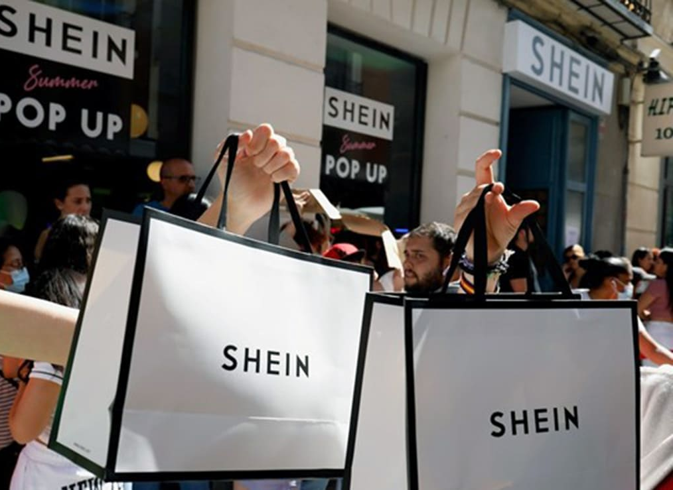
Comparison: Fast Fashion
Useful Articles
Under law, clothing is considered a useful article.
Many clothing designs of simple nature are uncopyrightable.
Dupes are made easily, but trends make copies undesirable
The industry survives, but small creators cannot protect their works, having them “stolen” by larger companies
This Photo by Unknown Author is licensed under CC BY-SA-NC
Notes:
There are other industries where protection is not granted for creations, yet business still thrives. Useful articles under the law are goods that hold a utilitarian or mechanical aspect, such as clothes, furniture, or machinery (U.S. Copyright Office).
The fashion industry offers a potential future for the AI industry. Fashion, being clothing, falls under useful article law. Simple designs such as shapes, letters or other common patterns do not receive copyright protection, and therefore much of fashion available is uncopyrightable. Clothes can be “duped” quickly, undermining an original creators’ business. Yet fashion continues to succeed due to the rapid replacement of fashion trends and designs, making any copies “out of style” and therefore undesirable.
This does not come without criticism. Clothing made by small designers often do not have the capability to produce rapidly. Any copying of a design by a major fast fashion company cannot be disputed, and could at best be demoralizing to creators and at worst result in their financial ruin. Many creators consider use of uncopyrightable designs as theft, even though the law may not. So, even though the industry as a whole survives, without protection small creators often no longer have an incentive to create new and innovate works (Huttner, 2022, 396). This arguably results in fashion that is unoriginal and lacking innovation, even as it remains “useful” to consumers.
Anna Huttner, “Overdressed & Underprotected: The Not-So Glamorous Side of the United States Fashion Industry Without Explicit Copyright Protection” Cleveland-Marshall College of Law. 70, no. 2 (2022): 363-398.

Slide 24
What Do you Think?
Are AI Datasets used in Training:
Fair Use or Theft?
Notes:
Larger generative AI models may still financially succeed, without the need for protection. As discussed earlier in this recipe, fair use is an exemption under the law that individuals and large corporations may claim. Generative AI has been divisive, as the training data used to create the algorithms was not always collected with permission by the creators. Therefore, much of the legal discourse expects generative AI cases like NYT vs Open AI (2023) have fair use as a defense (Murray, 2023). But, as discussed, fair use can only be determined by the law. At the date of this publication, suits filed against generative AI companies like OpenAI are still in the process of being decided.
The decision of fair use or not fair use will make great impact. On the side of not fair use, this would require AI companies to obtain permission or purchase licensing for each and every work they gather for a dataset. With the scale of information needed to create a functional AI, this decision could make generative AI bankrupt and therefore obsolete.
However, with the decision of fair use, copyright of works could be undermined. In the event an AI gathers data on a copyrighted work, it may reproduce a potentially suitable uncopyrightable alternative to the original copyrighted work. To put it simply, why would someone purchase a copyrightable object, when there is a substitute that does not require the complex formalities of copyright?

Slide 25

If you choose to us AI tools, always check:
Terms of Service
Privacy and Data Collection
Statements of Disclosure
If a tool is free to use, then the price is probably your information and your data!
This Photo by Unknown Author is licensed under CC BY-SA
Notes:
The devil’s advocate to half-baked copyright is implicit contracts (like pop-ups and cookies). The internet as a whole has challenged the idea of traditional publishing by providing an avenue for the individual user to edit and publish works through online platforms and software. When it comes to generative AI, companies create software that is available online and guides users to “create” new works. However, each of these platforms has implicit licensing to stipulate how a potential creator may use that Generative AI tool.
When choosing a Generative AI tool, creators should read any terms of service, privacy and data collection policies, statements of disclosure, and any other documentation that would inform them of how the AI works and whether the user is protected when using that AI.

Slide 26

Additional AI Exercise*
Input terms into AI
Terms and Agreements can be long and jargon heavy
Try putting a terms of service into a LLM AI model and ask it to summarize it for you.
Is it easier to understand?
This Photo by Unknown Author is licensed under CC BY
*Always keep in mind that AI is not a lawyer, doctor, or substitute for expert knowledge.
Notes:
*AI tools are not a substitute for a lawyer. This exercise should be used to help gain a general understanding of terms and agreements. Any specific legal questions should be directed to a lawyer!*
If time allows, exploring terms of service in person is a valuable lesson. However, these terms can be long and challenging to read as they are filled with technical legal language. Language-based generative AI tools specialize in explaining concepts to a variety of audience if prompted to do so. Guide students in reviewing complex terms of service by using the following steps:
Identify complex terms, disclosures or policies. (This may be the generative AI tool itself, or one from another service
Input sections of the manuals above to the generative AI platform of your choice
Prompt the AI to summarize the points of the complex work to a non-legal audience.
Excellent prompt engineering is not needed for this exercise, but it is helpful to prompt the AI to speak to a non-legal audience. Output that answers queries about an agreement’s favorability for a user or about data collection should be read with scrutiny. Ultimately, generative AI tools may generate valuable information, but without human input, that information will be questionable.

Slide 27

Rights & Disclaimer Statement
This slide-deck was created for informational purposes and is not intended to be legal advice.
All content created by Gwendolyn Sibley is licensed as
CC-BY-NC 4.0

Slide 28
Additional Resources
“17 U.S. Code Chapter 1 - Subject Matter and Scope of Copyright.” Legal Information Institute. Accessed December 9, 2024. https://www.law.cornell.edu/uscode/text/17/chapter-1.
“About CC Licenses.” Creative Commons, September 28, 2023. https://creativecommons.org/share-your-work/cclicenses/.
Anna Huttner, “Overdressed & Underprotected: The Not-So Glamorous Side of the United States Fashion Industry Without Explicit Copyright Protection” Cleveland-Marshall College of Law. 70, no. 2 (2022): 363-398.
“Berne Convention for the Protection of Literary and Artistic Works.” WIPO. Accessed December 9, 2024. https://www.wipo.int/treaties/en/ip/berne/.
“Chapter 1: Subject Matter and Scope of Copyright.” U.S. Copyright Office. Accessed December 9, 2024. https://www.copyright.gov/title17/92chap1.html.
Michael D. Murray, “Generative AI Art: Copyright Infringement and Fair Use” SMU Science and Technology Law Review” 26, no. 2 (2023): 259-315.
Naruto v. Slater, No. 16-15469 (9th Cir. 2018) https://law.justia.com/cases/federal/appellate-courts/ca9/16-15469/16-15469-2018-04-23.html.

Slide 29
Additional Resources
NYT v. Open AI, Case 1:23-cv-11195 (S.D.N.Y. 2023). https://nytco-assets.nytimes.com/2023/12/NYT_Complaint_Dec2023.pdf.
"A Recent Entrance to Paradise," Wikimedia Commons, (2016). https://commons.wikimedia.org/wiki/File:A_Recent_Entrance_to_Paradise.jpg.
Guy A. Rub, “Copyright survives: Rethinking the Copyright-Contract Conflict.” Virginia Law Review. 103, no. 6 (2017): 1141-1248.
Stephen Thaler v. Shira Perlmutter, Civil Action No. 22-1564 (D.D.C. 2023). https://www.copyright.gov/ai/docs/district-court-decision-affirming-refusal-of-registration.pdf
United States Copyright Office. “Copyright and Artificial Intelligence Part 2: Copyrightability” Accessed March 25, 2025. Copyright and Artificial Intelligence, Part 2 Copyrightability Report
@WKLondon, @Jonplackett, @AlexBellos and @iam_adam, “A Fun Mini-Game about Pop-Ups and the Deviousness of Websites and Apps.” Terms & Conditions Apply. Accessed December 9, 2024. https://termsandconditions.game/.

