Slide 1
Expanding “Communities and Collections” in the K-State Research Exchange (K-REx) to benefit the K-State Community and Beyond.
Emily Finch
Scholarly Communication and Copyright Librarian of K-State Libraries
Tara Coleman
Sunderland Foundation Innovation Lab Programing Services Coordinator and K-State First Book Coordinator

Slide 2


About Us
Emily G. Finch
Scholarly Communication and Copyright Librarian
Tara Coleman
Sunderland Foundation Innovation Lab Programing Services Coordinator and K-State First Book Coordinator
Provides reference, consultation, and information on: ​
Copyright, Licensing, and Open Access
Publishing​, Research, and Metrics ​
Scholarly Communication Movements​ and Best Practices
Other Library Projects:
K-State Open Access Publishing Fund​
Monograph and Special Publication Coordinator for New Prairie Press​
Open Alternative Textbook Initiative ​
Libraries: ​
Program Services Coordinator
Dow Center for Multicultural and Community Studies Coordinator
Kansas State University
Teach Honors Leadership Studies & Foundations of College Student Success
University Ombudsperson
K-State First Book Coordinator
Notes:
https://docs.google.com/presentation/d/e/2PACX-1vSKZ9fnQdo69taEpcvKlaaCx3Nu-TVknLN3tGeyZw-ezeEpmuRN6Ujnio4kI8GvyX5puFgnOo_SFtz9/pub?start=false&loop=false&delayms=3000

Slide 3
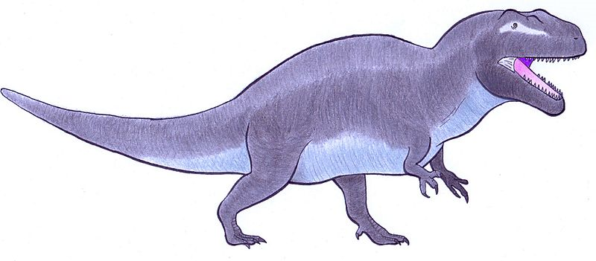
What is a KRE-x?
Mariomassone. English: Acrocanthosaurus Restoration. May 30, 2016. Own work. https://commons.wikimedia.org/wiki/File:Acrocanthosaurus_reconstruction.jpg.

Slide 4
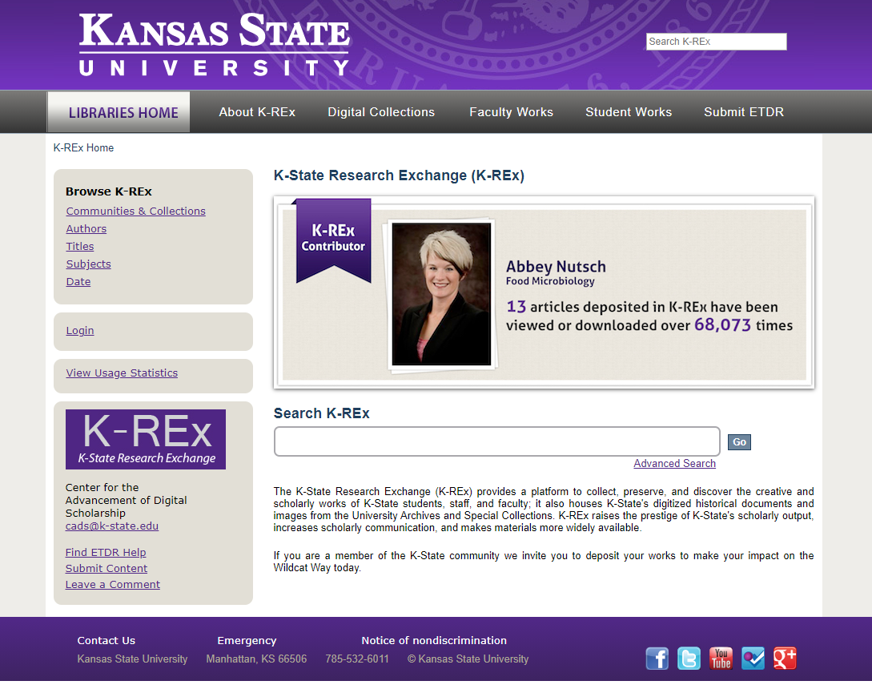
The K-State Research Exchange (KRE-x)
https://krex.k-state.edu/dspace/

Slide 5
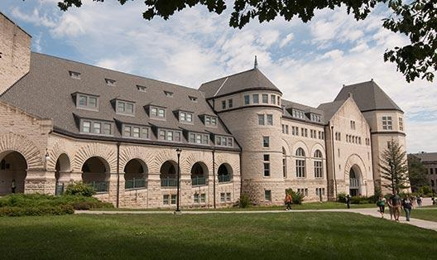

How did KSFB Start Using KRE-x?

Slide 6
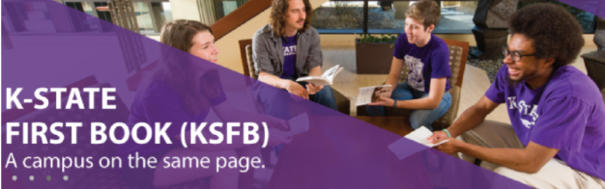

What is the K-State First Book?

Slide 7
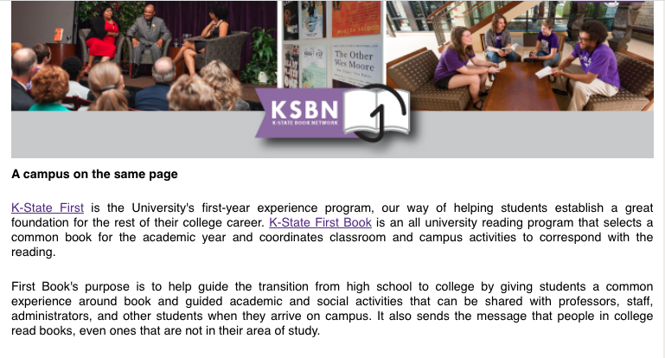
Why does K-State First Use KRE-x?
Central location for material
Access
Helps Us Meet our Land Grant Mission
Promotes Collaboration
Helps Build Relationships
Notes:
Why KRE-x vs other platforms
Tara Coleman explains what access considerations were of concern and if/how KREx meets them.
Tara Coleman explains who on campus and who off campus does or could find this material helpful.
Tara Coleman states where collaboration takes place with the program and how this tool facilitates collaboration and showcases it.

Slide 8
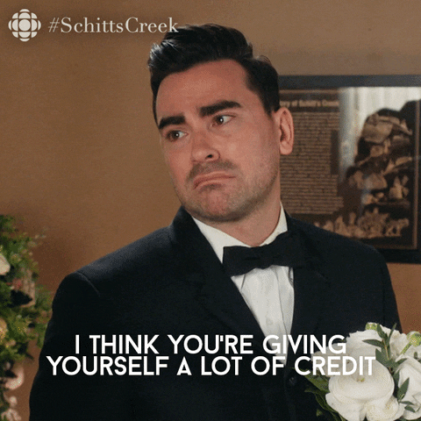
Relationships with Other Institutions
Notes:
...Tara Mentions problem with them not citing things

Slide 9
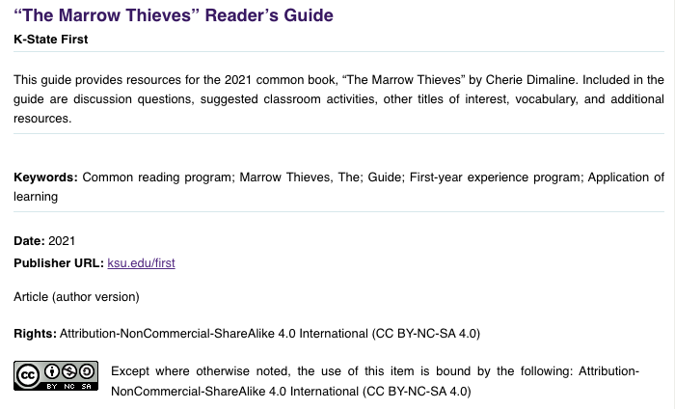
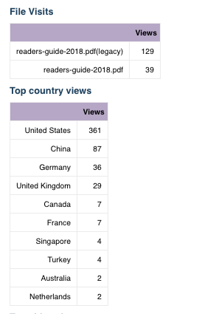
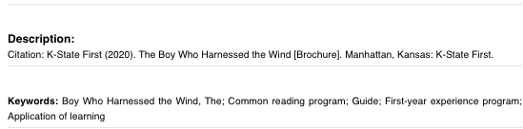
How can an Institutional Repository Help with This?

Slide 10
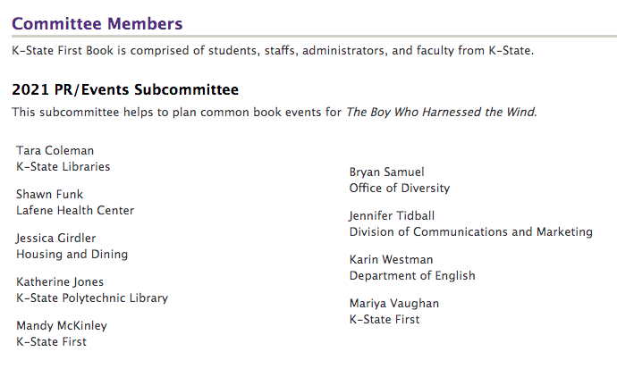
How Does K-State First Book Use KRE-x?
1) First Book Committee Selects a Book and Programming is Created.

Slide 11
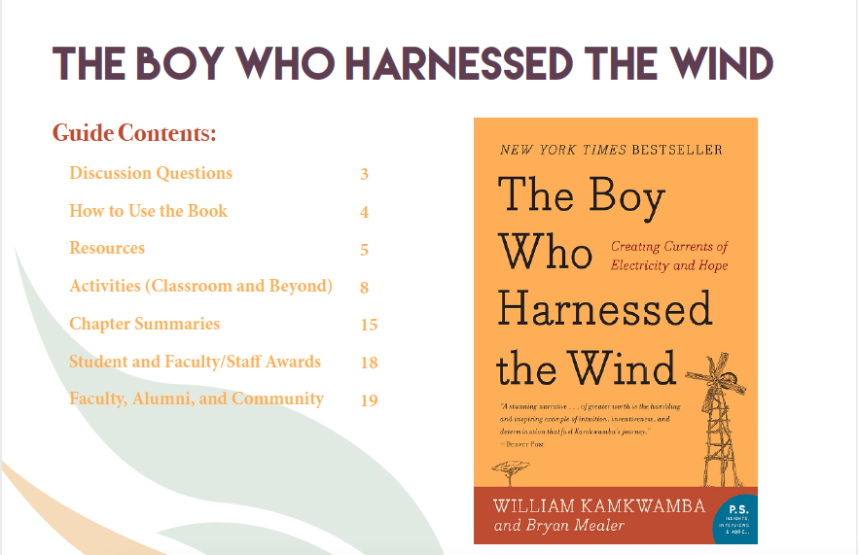
How Does K-State First Book Use KRE-x?
2)Program
Materials are Authored.

Slide 12
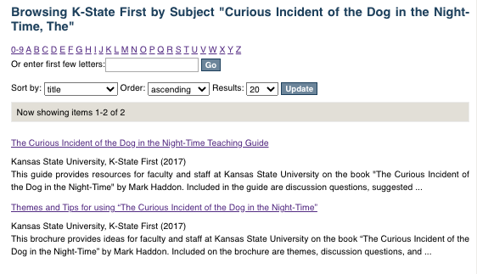
How Does K-State First Book Use KRE-x?
3)Material is Published and Ingested into KRE-x.

Slide 13
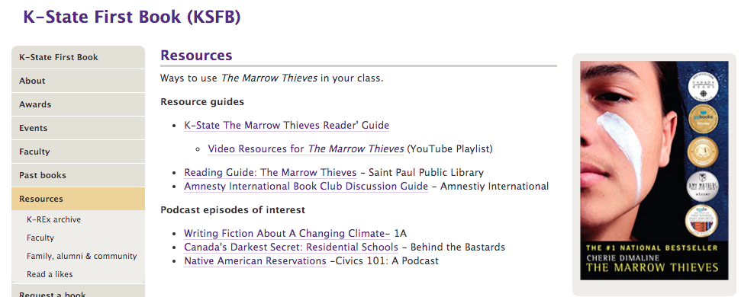
How Does K-State First Book Use KRE-x?
4)Material is Distributed and Made Accessible.

Slide 14
How Does K-State First Book Use KRE-x?
4)Material is Distributed and Made Accessible.

Slide 15
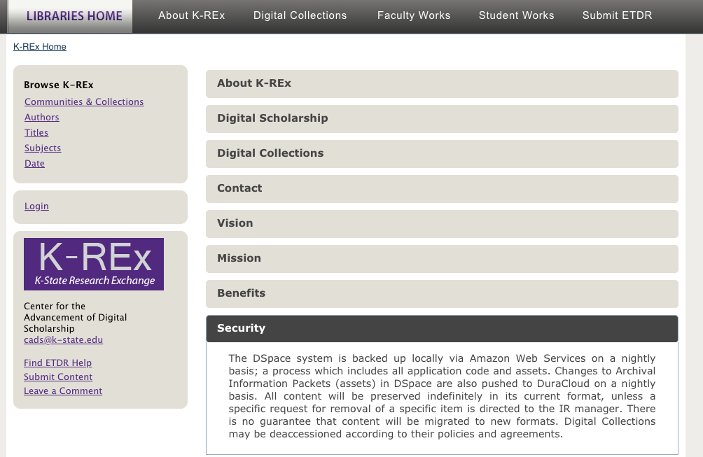
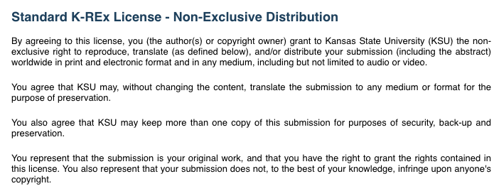
How Does K-State First Book Use KRE-x?
5) Material is Preserved.

Slide 16
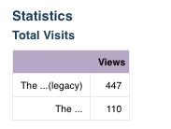
How Does K-State First Book Use KRE-x?
6) Material is Used and Reused.

Slide 17
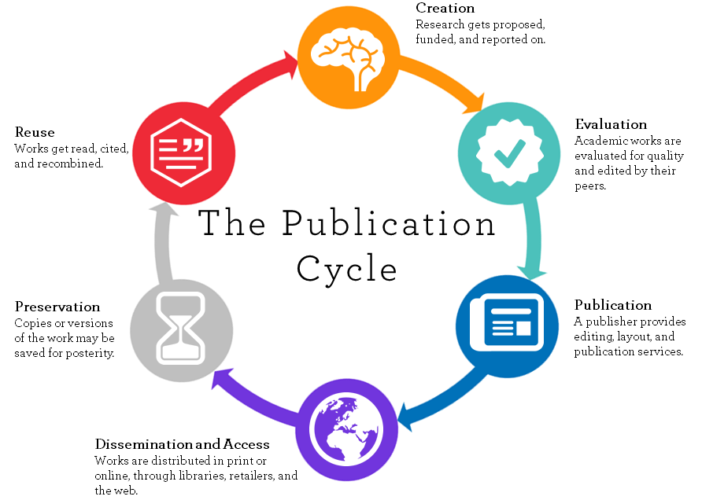

...Sound Familiar
https://library.uwinnipeg.ca/images/publication%20cycle%20v2.png

Slide 18
Research and Creation

Slide 19
Creation and Authorship

Slide 20
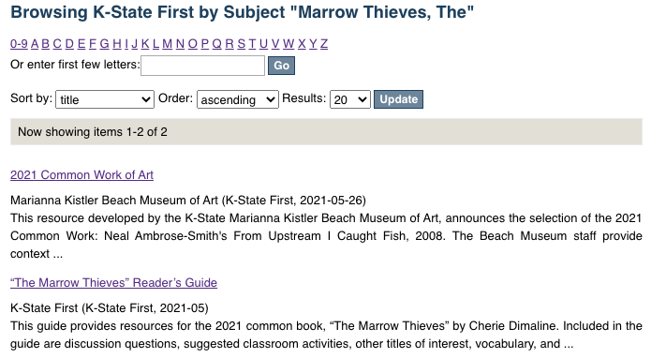
Publication

Slide 21
Dissemination

Slide 22
Access

Slide 23
Preservation

Slide 24
Use/Reuse

Slide 25

K-REx Helps Support KSFB
Mariomassone. English: Acrocanthosaurus Restoration. May 30, 2016. Own work. https://commons.wikimedia.org/wiki/File:Acrocanthosaurus_reconstruction.jpg.

Slide 26


...But KSFB is Helping KRE-x Too!
Digital Scholarship
What is institutionally significant?
What is “scholarship?”
Notes:
Challenge: These are big campus discussion that aren’t easy to meet on and define.
It takes small changes and pushes to expand our ideas on what we consider to be scholarship. To encourage people to think about how their work could be used/reused.

Slide 27

Does Scholarly Communication ...Effectively Communicate?
Where is campus evolving--where can my service grow?
What tools/resources do I need to develop/support to meet K-State’s needs?
Who do I need to talk to on campus to make new connections?
Notes:
Challenge: It takes time to build relationships that help expand this thinking since many don’t know they are looking for you.

Slide 28



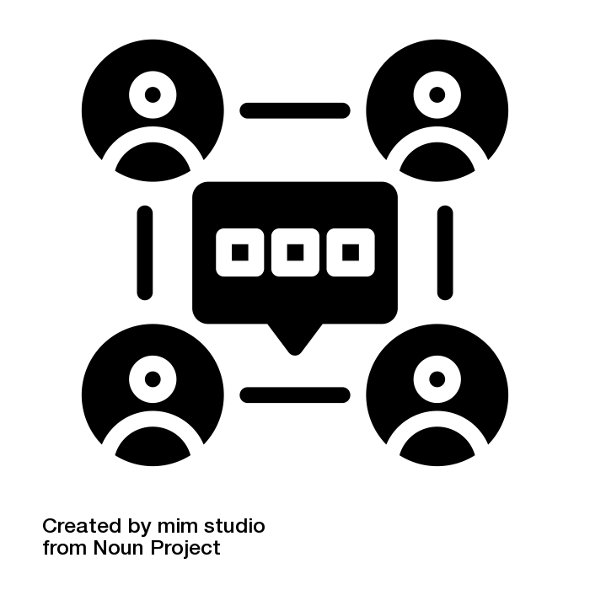

What is Institutionally Significant?
What belongs?
What is valuable?
What do we share?
How do we communicate this to campus?
Where do we store it?
How do we store it?
Images; “what” by DinosoftLab from the Noun Project; “valuable” by Adrien Coquet from the Noun Project; “lost” by Fabrice VAN NEER from the Noun Project; “Communication” by mim studio from the Noun Project
Notes:
What do institutions consider as “belonging” in their institutional repository?
What does your institution have that is valuable and worth sharing internally and externally?
Where on campus are there places to store important or relevant material?
Do campus stakeholders know where these places are? What they are specifically for?

Slide 29
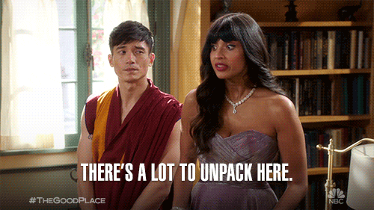
What is “Scholarship?”
Monographs + Journal Articles
Creative Works
Digital Humanities
Guides/Instructional Material
Campus Programming
Innovation?

Slide 30
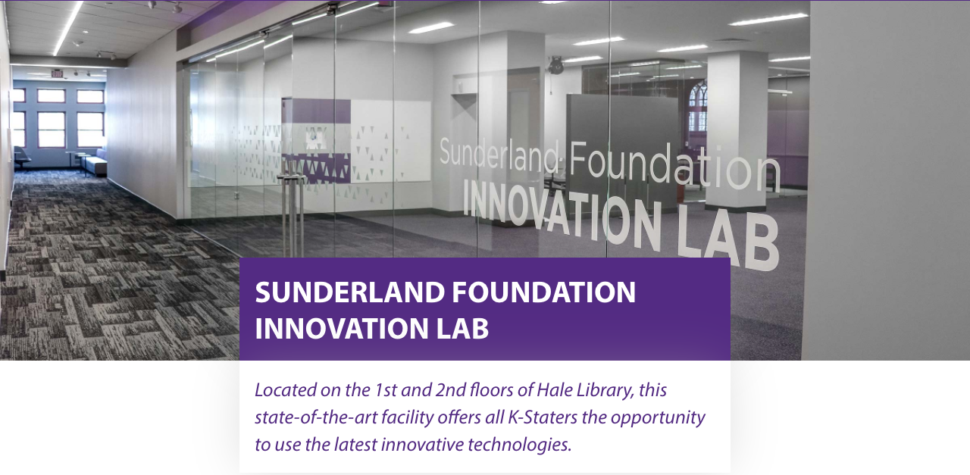

Slide 31
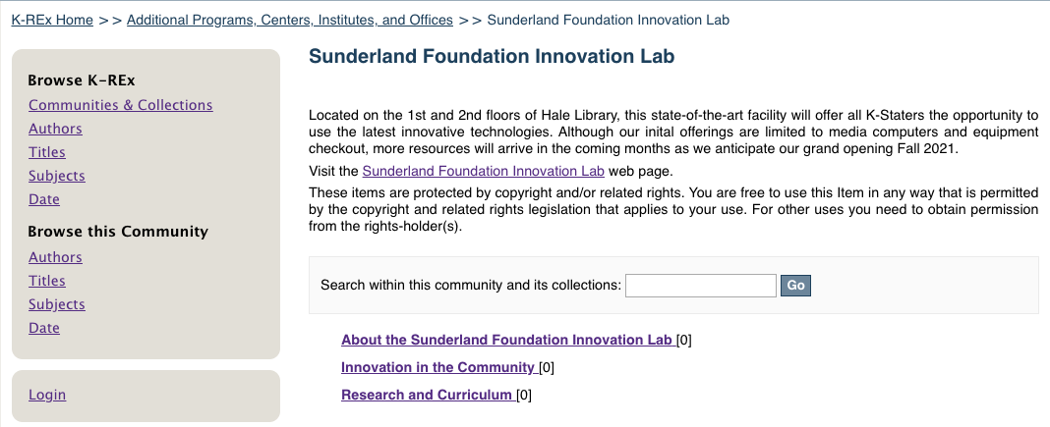
Using What we Learned From KSFB...

Slide 32
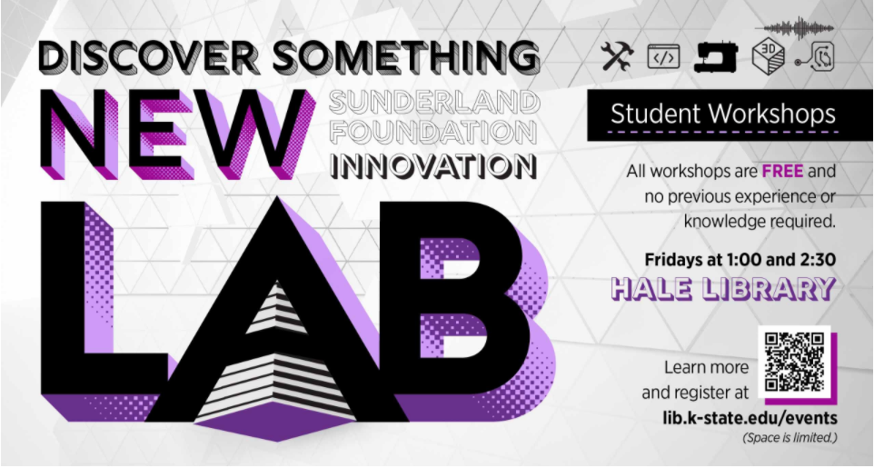
Opportunities
Project Manuals/Guides
Workshops
Digital Humanities Projects
Lessons/Course Instructions
Datasets
Design Files

Slide 33
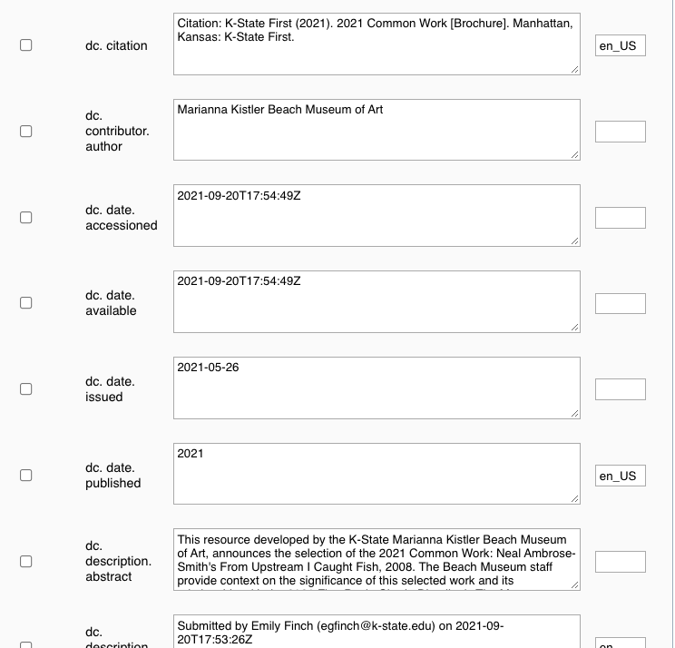
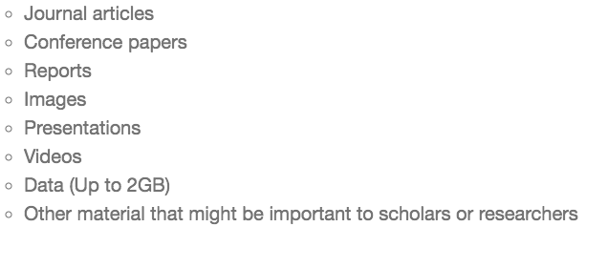
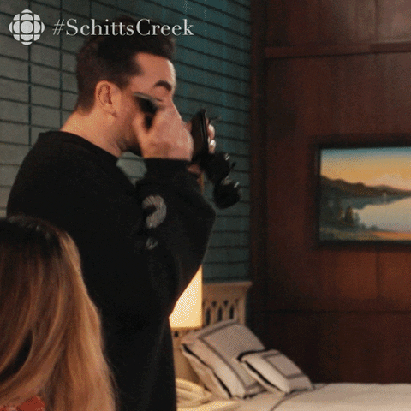
Challenges

Slide 34
Who are Your “Communities?”
&
What are you “Collecting?”

