Slide 1
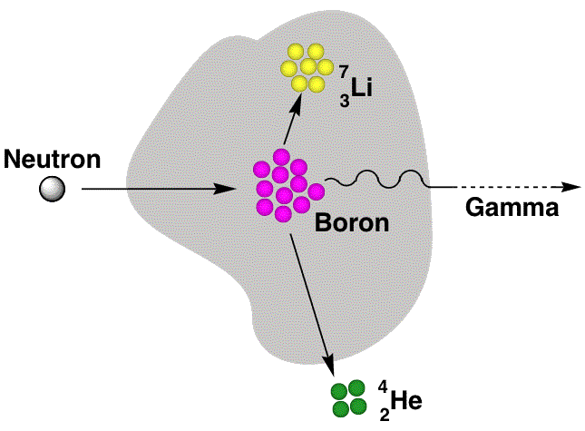
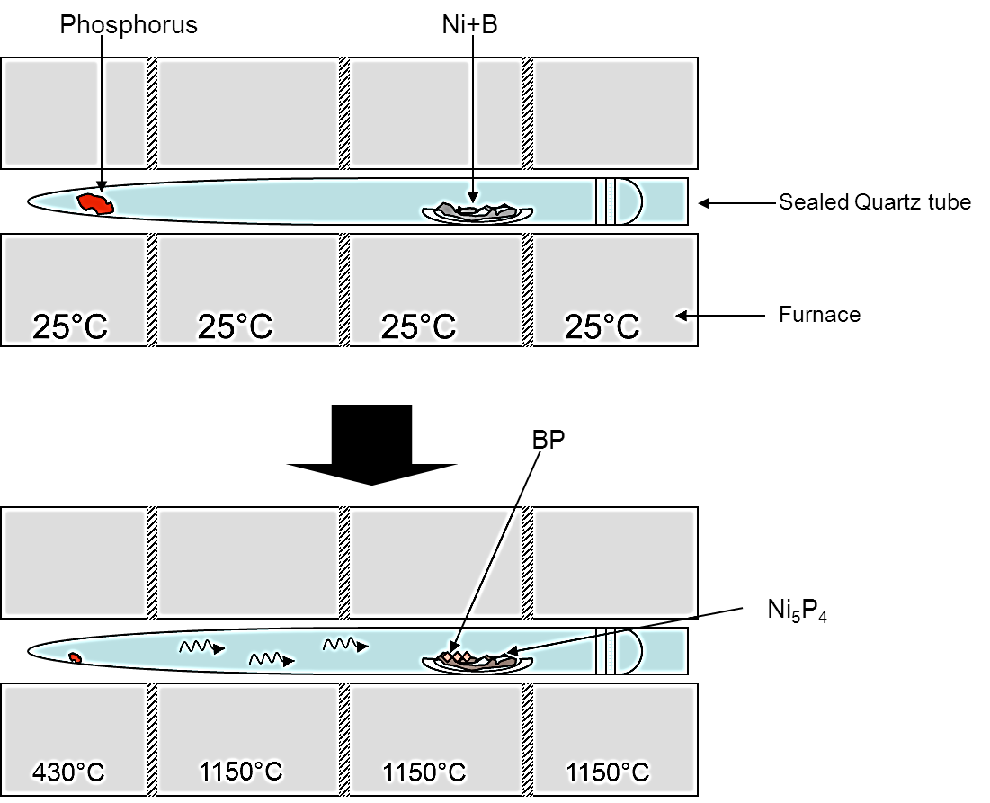
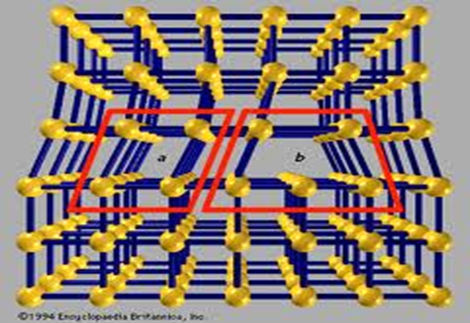
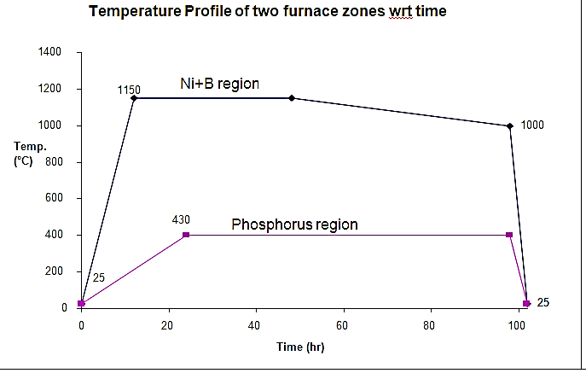
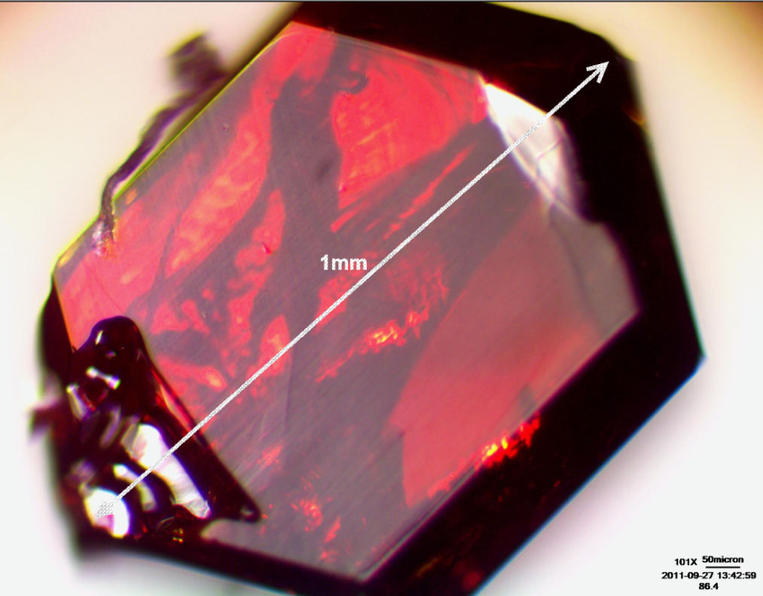
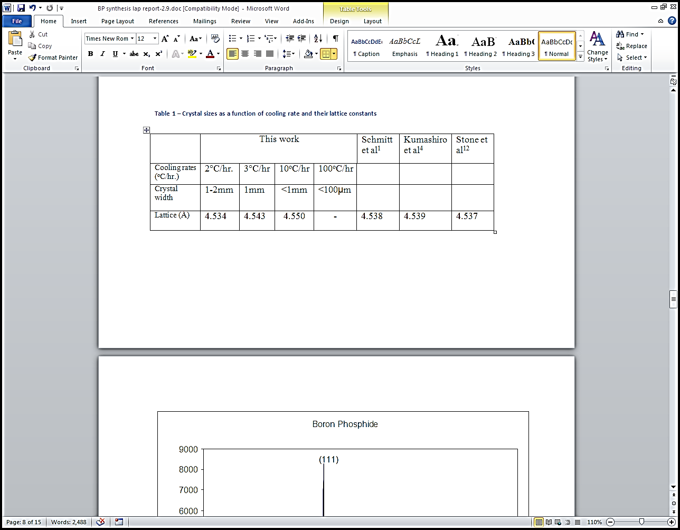
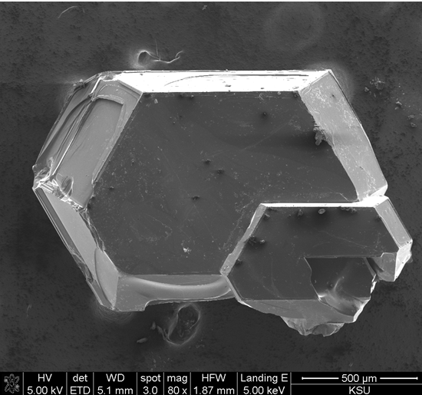
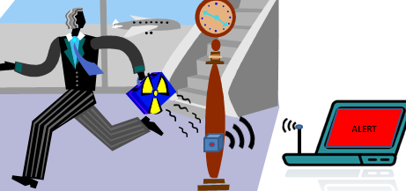
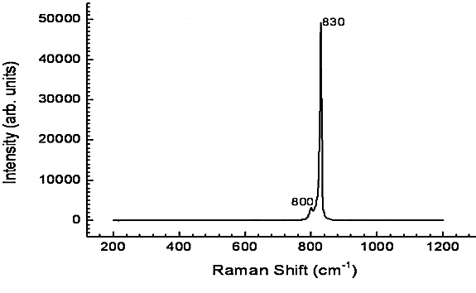
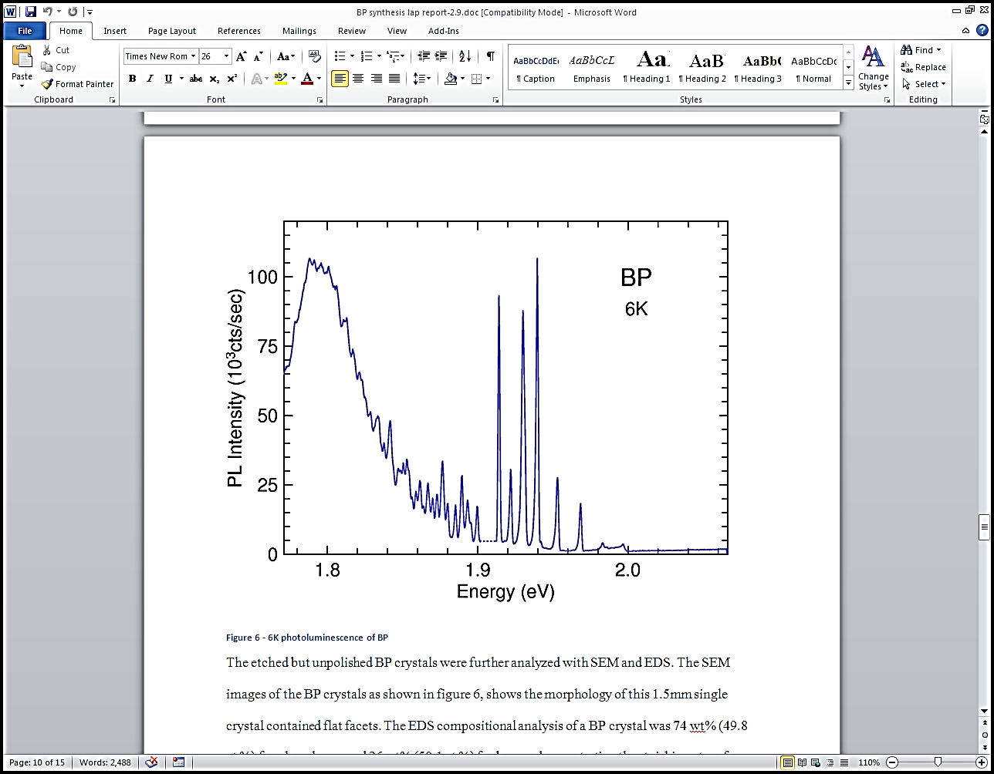
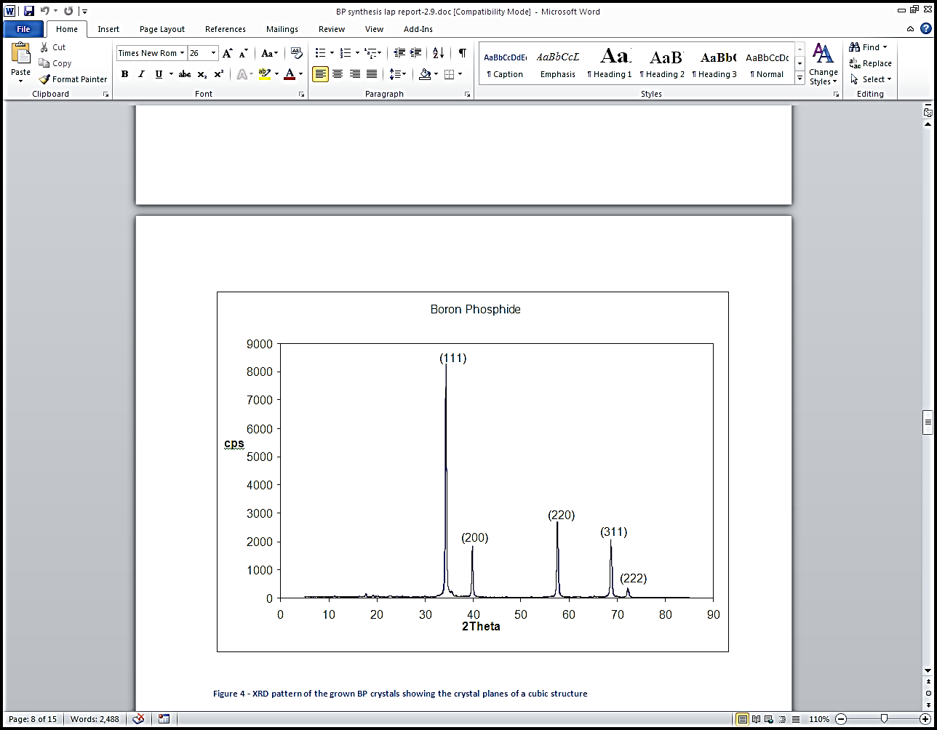
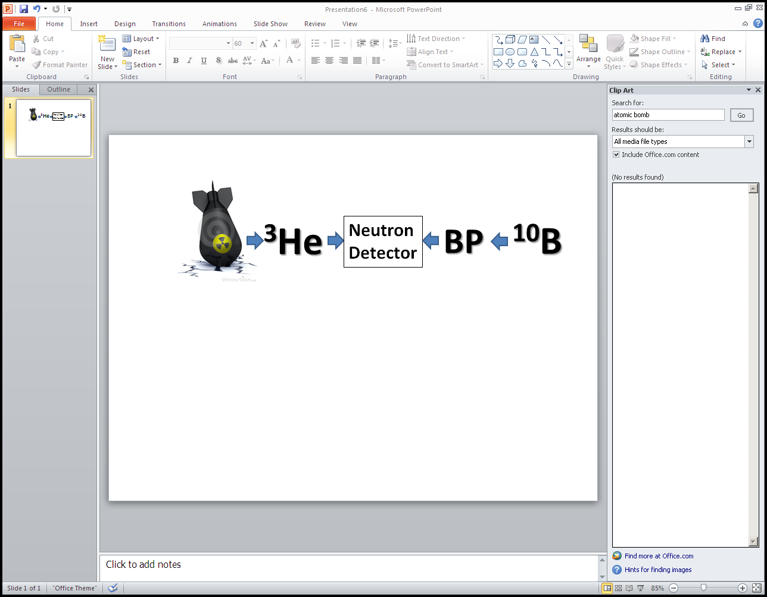
FLUX GROWTH OF CUBIC BORON PHOSPHIDE CRYSTALS FOR NUCLEAR WEAPON DETECTORS
Ugochukwu D. Nwagwu¹, James H. Edgar¹, Yinyan Gong², Martin Kuball²
¹Department of Chemical Engineering, College of Engineering; ²H. H. Wills Physics Laboratory, University of Bristol, Bristol, BS8 1TL United Kingdom
BACKGROUND
MATERIALS AND METHODS
CONCLUSION
Boron phosphide, BP, is a compound semiconductor potentially useful in solid state neutron detectors because of the large thermal neutron capture cross-section of the boron-10 isotope (3840 barns)¹.
Boron-10, an isotope of boron , undergoes nuclear reaction with neutrons to emit helium nuclei (alpha particles) and lithium nuclei².
The produced alpha particles can then be detected using electronic sensors.
CRYSTAL GROWTH
Flux Growth Method
Good bulk cubic BP crystals were produced via this technique at low temperature of 1150°C.
XRD and Raman shows that there are no other phases besides BP.
Although EDS did not detect any elements besides B and P, the Photoluminescence suggests there might be other elements present at low concentrations.
vacuum
The cooling rate of crystal growth was critical to crystal size , and it also affects the lattice constant (distance between unit cells in crystal lattice) of the crystals. This could be because of the increase in growth rate actually caused defects on the lattice.
Figure. 1
BP crystals precipitate from the nickel solution during cooling at rate of 3ºC per an hour. The nickel was then etched from the crystals using aqua regia (a mixture of nitric acid and hydrochloric acid, at volumetric ratio 1:3).
cooling
FUTURE DIRECTIONS
MOTIVATION
Figure. 2
Improve the technique to reduce impurity and defects
  Use high purity source materials
Larger BP crystals (~>1cm)
  Increase source materials
  Increase quartz tube reactor size
  Cooling at slower rates
Study electrical properties
  Current- voltage measurements
  Capacitance-voltage profiling
  Resistivity as a function of temperature
  Hall effect measurements for electro mobility
Fabricate a Neutron detecting device
  Construction
  Testing
The ability to intercept attempts to smuggle nuclear weapons into the United States is critically important for homeland security. New types of neutron detectors are especially needed, as current devices employ a rare helium isotope (³He), which was a byproduct of the production of hydrogen bombs.
The high thermal neutron capture cross-section of boron isotope in crystalline boron compounds like BP, BN, and B₁₂As₂ are under consideration as potential alternative for neutron detectors.
RESULTS
A
Table. 1
B
As the production of hydrogen bombs has largely ceased and the need for homeland security has grown, demand for ³He has greatly exceeded supply³
Table. 2
ELEMENT | WEIGHT % | ATOMIC % | RATIO
BORON | 74 | 49.8 | 1
PHOSPHORUS | 26 | 50.2 | 1
Figure 3: A - Image of a red BP crystal under a microscope revealing the color, shape and average size. B - SEM image showing the morphology of a 1.5mm single crystal with flat facets. Table 1: shows variation of crystal sizes at different cooling rates and lattice constants. Table 2: EDS results showing the stoichiometry ratio of BP
ACKNOWLEDGEMENTS
This project is supported by Department of Energy (DOE).
Photoluminescence spectra from Paul Klein is greatly appreciated.
BIBLIOGRAPHY
Figure. 4
Figure. 5
Figure. 6
(1) Lund, J. C.; Olschner, F.; Ahmed, F.; Shah, K. S. Boron Phosphide on Silicon for Radiation Detectors. MRS Proceedings 1989, 162.
(2) Crane, T. W.; Baker, M. P. Neutron Detectors; pp. 379-406.
(3) WALD, M. L. Shortage Slows a Program to Detect Nuclear Bombs http://www.nytimes.com/2009/11/23/us/23helium.html (accessed Feb 28, 2012).
(4) Norris, R. S.; Kristensen, H. M. Global nuclear stockpiles, 1945-2006. Bulletin of the Atomic Scientists 2006, 62, 64-66.
Figure 4: Raman spectrum showing typical characteristic band peaks of BP.
Figure 5: Photoluminescence energies of emission band peaks of BP crystals at 6ºK
Figure 6: XRD result depicting characteristic plane peaks for cubic BP crystal

