Slide 1
Bridging housing and health: A toolkit for local public health action
Anna Van Brunt
MPH Candidate
Spring, 2025

Slide 2
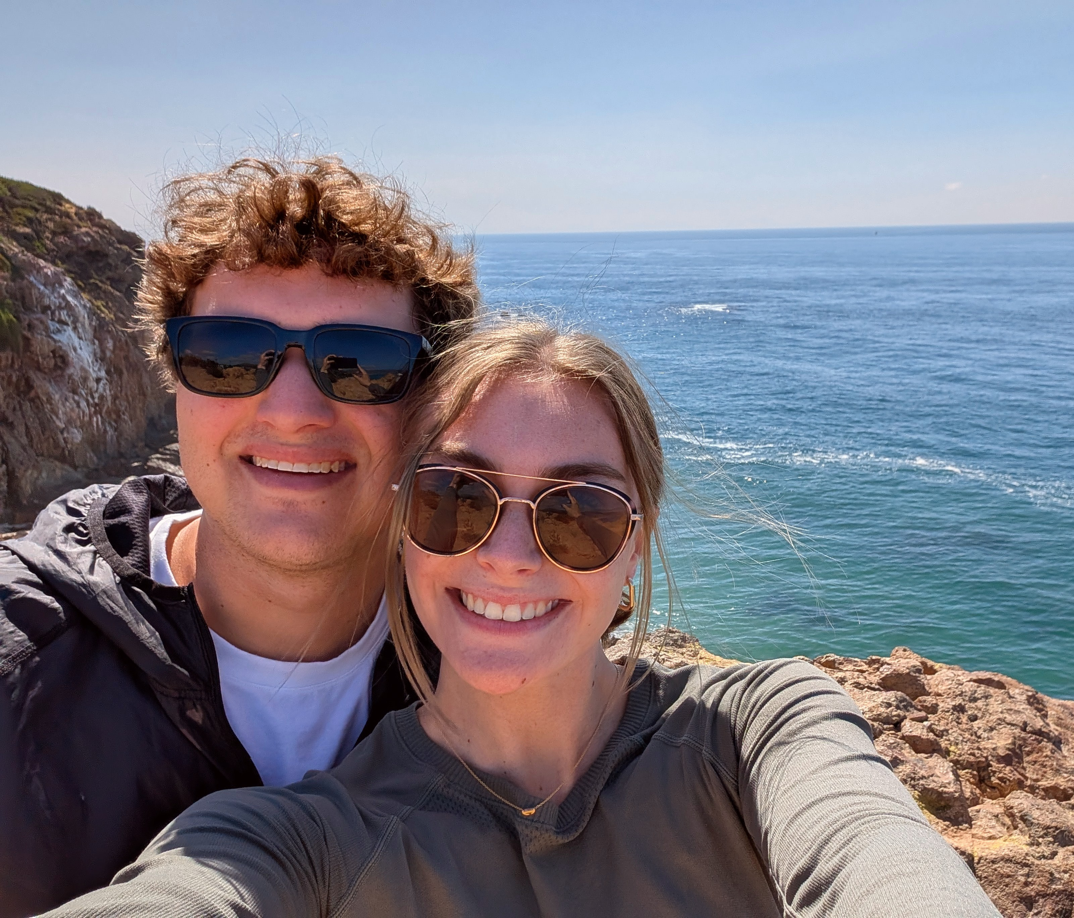
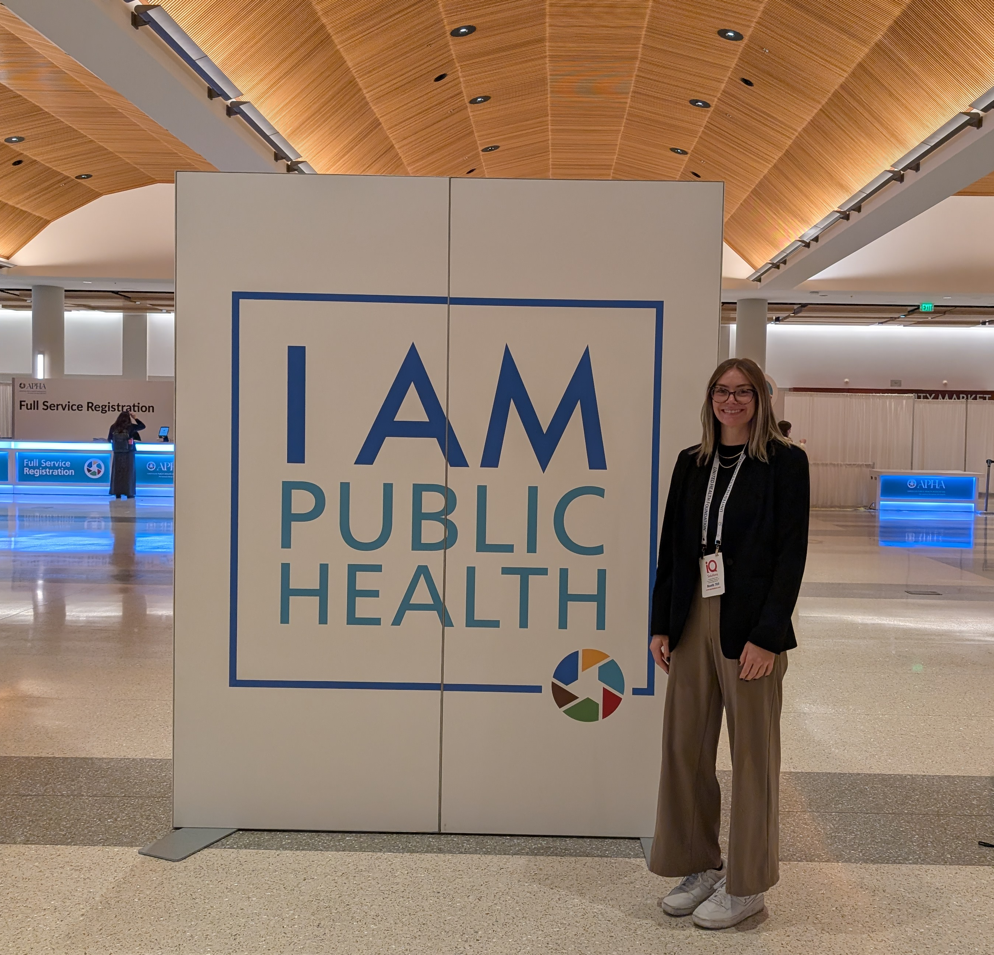
About me
Graduated with Bachelor of Science in Social Transformation Studies from K-State in 2023
Worked at a local health department in Missouri immediately after graduating
Currently work as the housing coordinator at Mid-America Regional Council
Notes:
When I first learned about public health during a career explorer class in high school, I was hooked.
I was interested in many different things at K-State but graduated with a B.S. in social transformation studies, and was able to apply a public health lens to my studies (mention Dr. Rensing here)
I also had a variety of internships throughout undergrad that helped build my interdisciplinary strengths (communication and business network).
Throughout my whole graduate degree I worked and it was extremely rewarding. Right out of undergrad I worked at Jackson County Public Health, a local health department in Missouri which taught me so much about public health functions. Talk about what I did in my role at JCPH It was really cool to be doing what I was learning about in classes.
Role at MARC, we will talk about this more in a minute

Slide 3
Overview
Applied Practice Experience at a Glance
APE Objectives
APE Products
  The role of public health in housing
Limitations and Opportunities for Future Research
MPH Competencies
Emphasis Area Competencies
Conclusion
Acknowledgements

Slide 4
Applied Practice Experience
Site: Mid-America Regional Council (MARC), Kansas City, Missouri
Site Preceptor: Marlene Nagel
APE Dates: 1/1/2025 – 04/04/2025

Slide 5
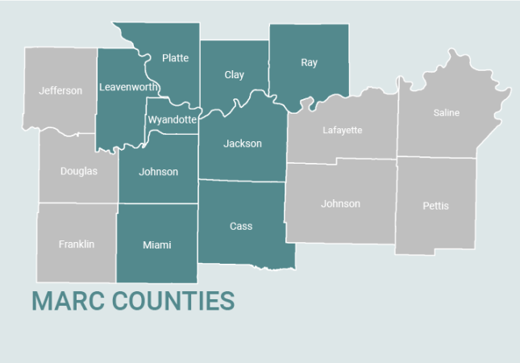
About MARC
MARC is the metropolitan planning organization and council of governments for the bi-state Kansas City region
Area Agency on Aging (AAA) for northwest MO
Head Start Grantee for three Missouri Counties
Programs across transportation, climate, aging, early learning, public health, public safety, housing, and services for local governments

Slide 6
My Role at MARC
Began as the housing specialist in early 2024, now serve as the housing coordinator
Coordinate partners to carry out the goals of the Regional Housing Partnership (RHP)
Work to expand the regional community land trust consortium, grant writing and project implementation

Slide 7
APE Objectives
Develop a working knowledge of the importance cross-sector partnerships between public health and housing, and learn to communicate this to stakeholder groups
Learn how to develop a guide or report from start to finish for public health professionals to help navigate housing issues relevant to their communities, specific to the Kansas City metro area
Expand applied information gathering skills through semi-structured interviews
Develop communication skills at the group and interpersonal level, including oral and written communication
Identify and foster a network of public health practitioners engaged in healthy and stable housing interventions in the Kansas City region

Slide 8
APE Products
Product 1:
  An index of the Community Health Assessment questions relating to housing and Community Health Improvement Plan priorities
Product 2:
  Bridging housing and health: a toolkit for local public health action
Product 3:
  Slides version of the toolkit for easier dissemination

Slide 9
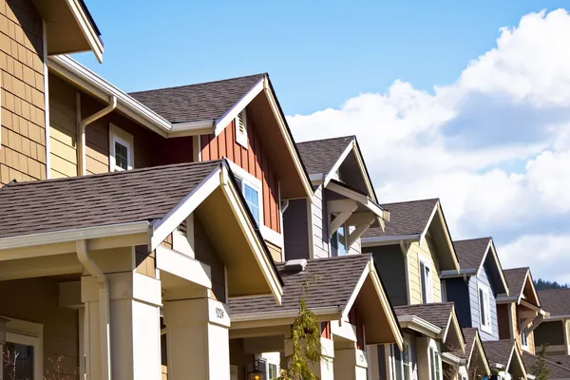
The role for public health in housing
Long recognized as a social driver of health, housing is foundational to creating both healthy individuals and communities
The COVID-19 pandemic highlighted the cost of health inequity and the impacts of social drivers of health
In the last decade, many public health thought leaders such as the have identified housing as a core health influencer that public health should address.
  APHA, Robert Wood Johnson Foundation, deBeaumont foundation, among others

Slide 10
Product 1 – CHA and CHIP Index
For a baseline, needed to know which health departments were working on housing
This created the list of individuals and organizations I needed to reach out to
Already involved in two area CHIPs

Slide 11
Product 2 – Public Health Action Toolkit
Conducted semi-structured interviews with local health department staff working on CHIPs with housing focus
Informed by experiences attending CHIP meetings
Conversations across MARC departments
Used these findings to produce a toolkit that aims to fill knowledge gaps identified through these means
Notes:
Also mention the IRB process

Slide 12
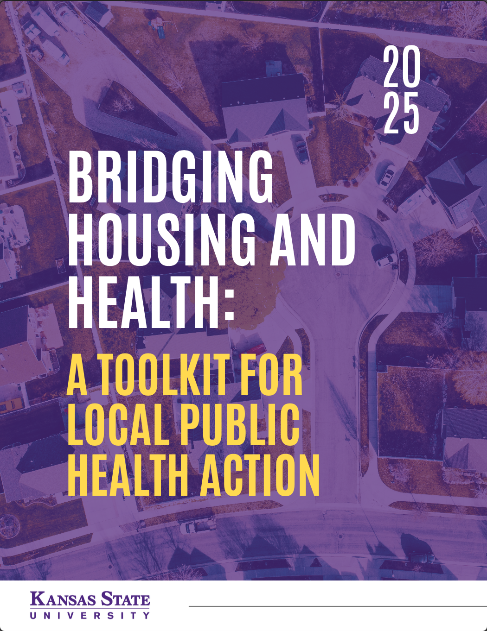
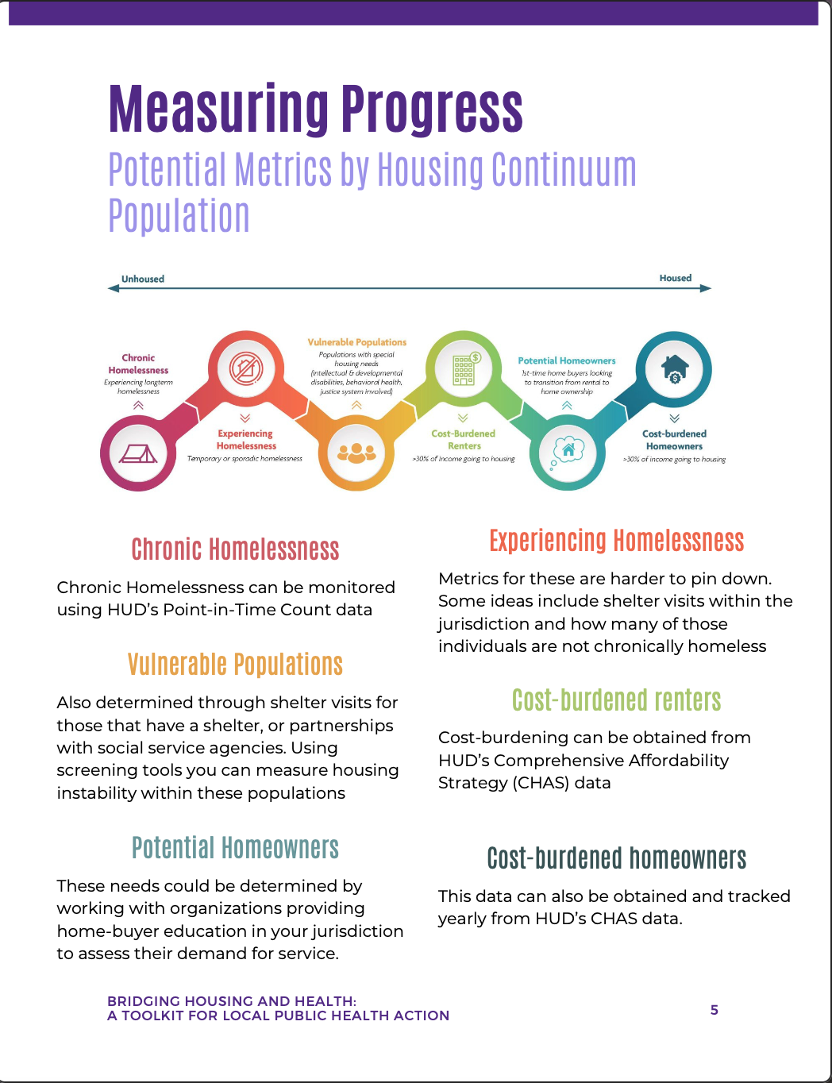
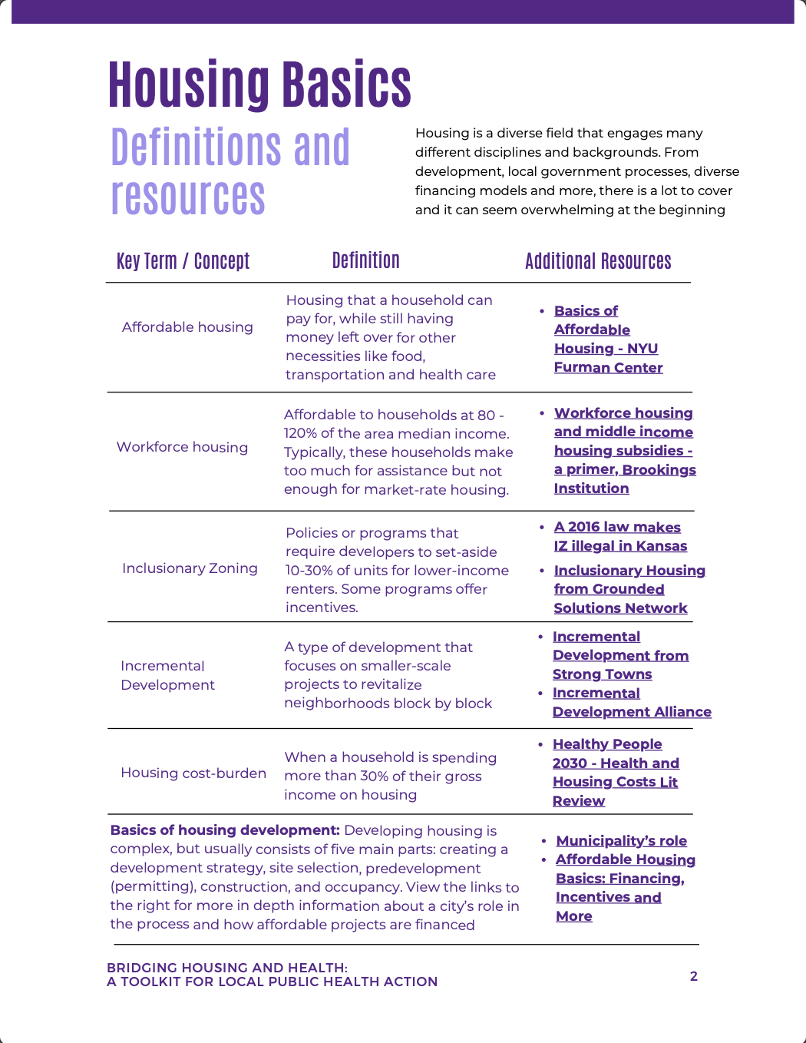
Product 2 – Public Health Action Toolkit
Notes:
Also mention the IRB process

Slide 13
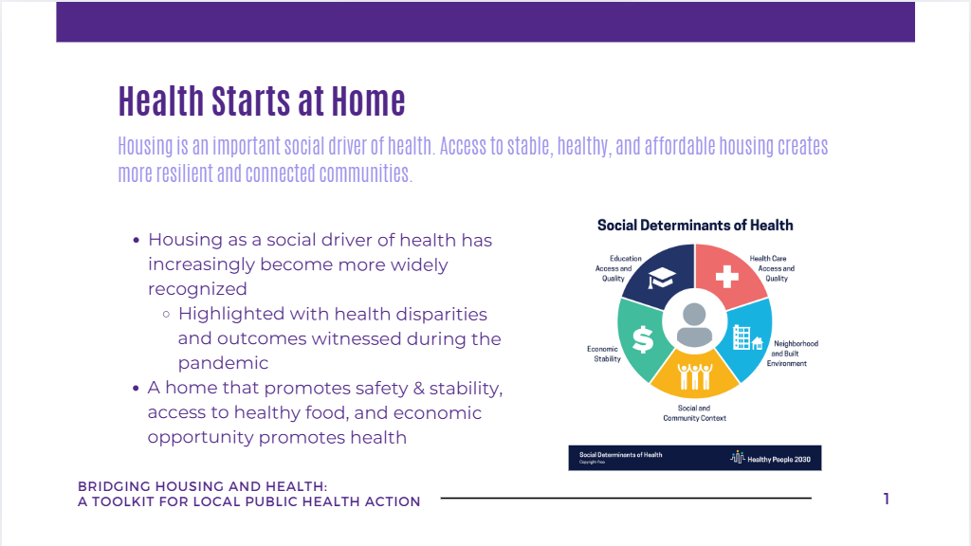
Product 3 – Slides version of toolkit
Feedback from interviews and guidance from site preceptor indicated there should be alternative ways of disseminating contents
Together we identified that a slide deck would be ideal for communicating to many people at one time

Slide 14

Limitations
Funding
Time
Limited research on more long-term effects of less tangible home impacts

Slide 15
Current Status and Future Opportunities
Identified gap could be addressed in future research
Convening of local public health professionals engaging in CHIP work
Importance as public health shifts further upstream, working at the systems level

Slide 16
Competency 5
Compare the organization, structure and function of health care, public health and regulatory systems across national and international settings
  I obtained this competency by looking at different Community Health Assessments and Community Health Improvement Plans throughout the Kansas City region. By doing this I investigated how different agencies organize their CHIP work, whether it is led by the agency or hospital system. I also learned about agencies outside the region when searching for promising practices and other work.
Notes:
I obtained this competency by looking at different Community Health Assessments and Community Health Improvement Plans throughout the Kansas City region. By doing this I investigated how different agencies organize their CHIP work, whether it is led by the agency or hospital system. I also learned about agencies outside the region when searching for promising practices and other work.

Slide 17
Competency 6
Discuss the means by which structural bias, social inequities and racism undermine health and create challenges to achieving health equity at organizational, community and systemic levels
  The Kansas City region has large racial inequities in its housing system from poverty and food access to homeownership rates. Essential to understand how historical practices are impacting outcomes in our community
Notes:
This knowledge has been foundational to all the work I have done throughout my role and APE. The Kansas City region has large inequities in its housing system from poverty and food access to homeownership rates. Our region has a fraught history of racist lending practices that still affect the health of our communities today.

Slide 18
Competency 7
Assess population needs, assets and capacities that affect communities’ health
  Obtained this competency handling housing data to determine community needs.
Notes:
This is work I do every day when handling housing data to determine community needs in affordability, housing types, and locations. I also have done work interpreting this for a broader audience through the writing of blogs posted on MARC.org.

Slide 19
Competency 12
Discuss multiple dimensions of the policy-making process, including the roles of ethics and evidence
  Learning about the legislative process and following important bills for housing and health this session has been transformative. Particularly as my experience fell during legislative session
Notes:
Talk about the experience in helping WyCo recognize one of their priorities was pre-empted, KHAN, and EJC advocacyI developed this competency through the work I have done at MARC to learn about the legislative process, particularly during the most recent session when housing and health topics have both been up for discussion frequently. I have learned the importance of using data to inform policy and included this within the guide I produced.

Slide 20
Competency 13
Propose strategies to identify stakeholders and build coalitions and partnerships for influencing public health outcomes
  Obtained directly through the production of my toolkit as I provided these recommendations
Notes:
This competency was achieved through the creation of my main APE product “Bridging Public Health and Housing”. In this toolkit I provided recommendations of ways public health agencies and practitioners can be
involved in housing solutions, particularly using convening and partnerships.

Slide 21
Competency 19
Communicate audience-appropriate (i.e., non-academic, non-peer audience) public health content, both in writing and through oral presentation
  I obtained this competency more through the creation of the slides version of the toolkit, but was developed through both products
Notes:
The presentation and guide I created were both tailored towards communicating with public health professionals about public health topics. I have also gained experience writing and presenting complex housing topics to general audiences during my APE through the creation of blogs.
involved in housing solutions, particularly using convening and partnerships.

Slide 22
Competency 21
Integrate perspectives from other sectors and/or professions to promote and advance population health
  Was able to practice and further develop these skills through my APE. Got loads of experience building relationships, connecting with external partners, and learning about the intersections of our work
Notes:
These are skills I began honing early in my career but was especially able to put into practice during my APE. During my experience, I took more leadership and ownership of my work and was more involved in collaborating across MARC’s departments and with external partners. I have received feedback that I achieved the goal of performing well in these team environments and taking leadership roles

Slide 23
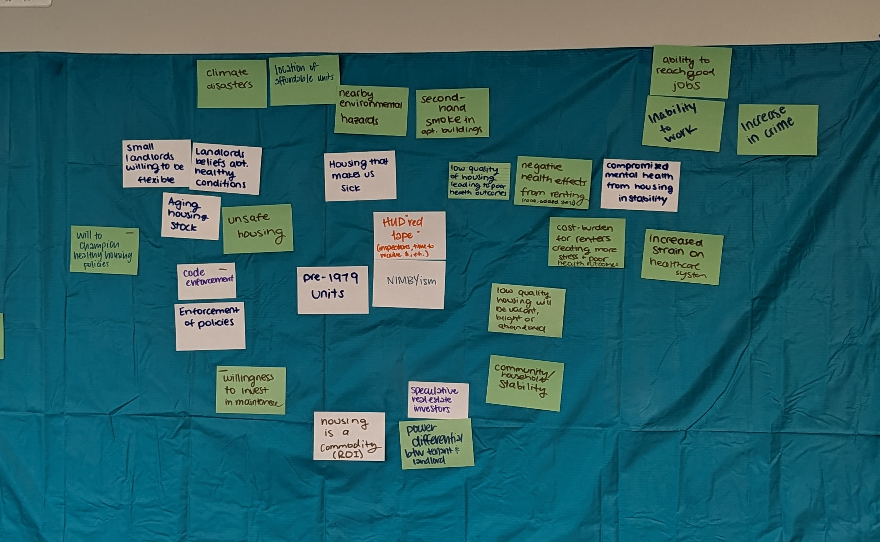
Competency 22
Apply a systems thinking tool to visually represent a public health issue in a format other than a standard narrative
Notes:
Causal loop diagrams and HiAP framework and This is largely the work of housing and public health as most of the interventions that need to happen are at the systems level. Many of the housing solutions needed in our region require policy interventions, live in institutions, and have been perpetuated by practice. The toolkit I created looks at the systems level to create more effective partnerships.

Slide 24
Emphasis Area Competency 1
Inform public health practice through analysis of evidence-based policy, systems, and environmental change.
  This was also spread throughout my experience but the work of aligning public health and housing is a systems level intervention
Notes:
The competencies listed in Table 5.3 below have been essential in my time at MARC,
both in being able to better understand our scope of work and how our programming impacts
the region.
.

Slide 25
Emphasis Area Competency 2
Examine chronic disease surveillance, policy, program planning and evaluation, and program management, in the context of public health nutrition.
Notes:
MARC has multiple programs and funding sources that ensure our communities
have access to safe and nutritious food and integrates this work across a variety of knowledge
areas. Because our organization has worked to ensure residents have access to safe and
healthy food across our work outside of just nutrition, I have been able to apply the skills I
learned, particularly in my Public Health Nutrition class, to understand how this access creates

Slide 26
Emphasis Area Competency 3
Critically examine population-based nutrition programs.
  Gained this competency in FNDH 600 (Public Health Nutrition) but got to see this first hand both while engaging in CHIPs and at MARC
Notes:
Similarly, I have been able to embed these principles in conversations I
have with our staff to help bridge the gap between their work and mine and demonstrate the
importance of housing in work around food acces

Slide 27
Emphasis Area Competency 4
Examine epidemiological concepts of human nutrition to improve population health and reduce disease risk.
  Gained this competency in FNDH 844 (Nutritional Epidemiology) but got to look directly at data on this when exploring CHAs.
Notes:
FNDH 844, Nutritional Epidemiology, has
been particularly helpful to me throughout the development of my ILE in understanding how the
health of populations is all connected. To create healthier communities, we must be working at
the system level to ensure base-level community needs are met, like food and shelter, before
we can work on areas like saving for the future or buying a home.

Slide 28
Emphasis Area Competency 5
Describe criteria for validity in nutritional epidemiological methodology.
  Developed this through my emphasis area coursework but can clearly see this connection when looking at CHA data and priorities of CHIPs that are looking both at healthy food access and population health
Notes:
All my emphasis area courses
were pivotal in helping me understand the far-reaching impacts social drivers of health have on
our lives.

Slide 29
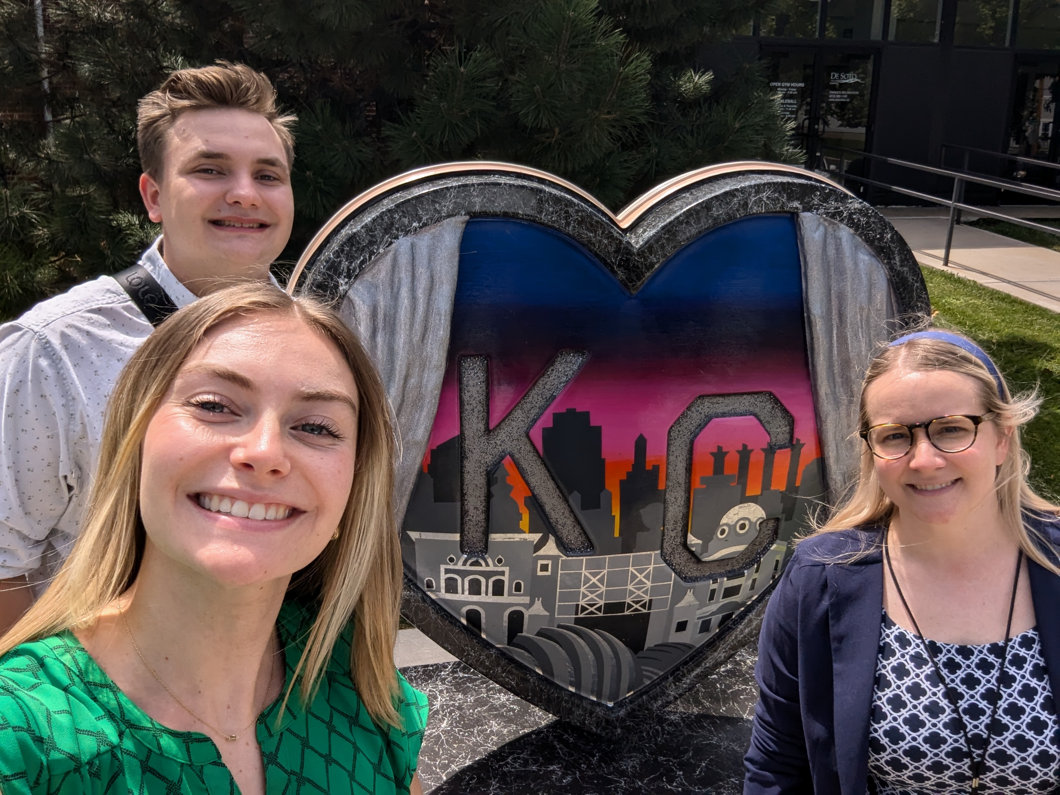
Conclusion
This applied practice experience was extremely rewarding and allowed me the opportunity to work on my passions
The products I created in my time spent on my APE and in my role at MARC help to create connections across public health advocates and break down silos in communities across Kansas City

Slide 30
Thank you!
MPH Committee
  Dr. Elaine Johannes (major professor), Dr. Susan Rensing, Dr. Jennifer Hanson
Site preceptor
  Marlene Nagel
Toolkit contributors
  Interviewees and meeting participants
MARC Colleagues
Day-1-Ready Public Health Workforce for Kansas and Beyond Program

Slide 31
Thank you!
Questions?

Slide 32
References
[1] Magesh, S., John, D., Li, W. T., Li, Y., Mattingly-App, A., Jain, S., Chang, E. Y., & Ongkeko, W. M. (2021). Disparities in COVID-19 Outcomes by Race, Ethnicity, and Socioeconomic Status: A Systematic-Review and Meta-analysis. JAMA network open, 4(11), e2134147. https://doi.org/10.1001/jamanetworkopen.2021.34147
[2] Krieger, J., & Higgins, D. L. (2002). Housing and health: time again for public health action. American journal of public health, 92(5), 758–768. https://doi.org/10.2105/ajph.92.5.758
Local Housing Solutions. (n.d.). Housing 101: The Basics. https://localhousingsolutions.org/housing-101-the-basics/
Massachusetts Housing Partnership. (n.d.). Development Process. https://www.housingtoolbox.org/development-process
Office of Disease Prevention and Health Promotion. (n.d.). Housing Instability https://odphp.health.gov/healthypeople/priority-areas/social-determinants-health/literature-summaries/housing-instability
Incremental Development Alliance. (n.d.). Incremental Development Alliance. https://www.incrementaldevelopment.org/
Marohn, C. (2024, May 6). How to Start Strengthening Your Town with Incremental Development. Strong Towns. https://www.strongtowns.org/journal/2024/5/6/how-to-start-strengthening-your-town-with-incremental-development
Grounded Solutions Network. (n.d.). What Is Inclusionary Housing? https://inclusionaryhousing.org/inclusionary-housing-explained/what-is-inclusionary-housing/
Morris, K. (2019, February 26). Kansas Restricted the Rules Cities Can Make. That's Complicated Affordable Housing Efforts. KCUR. https://www.kcur.org/news/2019-02-26/kansas-restricted-the-rules-cities-can-make-thats-complicated-affordable-housing-efforts
Mid-America Regional Council. (n.d.). Demographics. MARC Housing Data Hub. https://experience.arcgis.com/experience/ff430550582544d587b764bd4601810e/page/Demographics/
Schuetz, J. (n.d.). Workforce Housing and Middle-Income Housing Subsidies: A Primer. Brookings Institution. https://www.brookings.edu/articles/workforce-housing-and-middle-income-housing-subsidies-a-primer/
Unified Government Public Health Department. (2023). Wyandotte County Community Health Assessment. https://www.wycokck.org/files/content/public/v/19/departments/health/community-health/community-health-assessment/cha-full-report.pdf
Local Housing Solutions. (n.d.). The Basics - Learn About Affordable Housing Policy. https://localhousingsolutions.org/housing-101-the-basics/
ChangeLab Solutions. (2018). Alameda County Case Study: The Health & Housing Starter Kit. https://www.changelabsolutions.org/sites/default/files/HealthHousingStarterKit-CaseStudy-AlamedaCounty-FINAL-20180531_0.pdf
Payton Scally, C. et al, (2017). Boston: A City Takes Action: Emerging Strategies for Integrating Health and Housing. Urban Institute. https://www.urban.org/sites/default/files/publication/91971/2001420_boston_case_study_3.pdf
Jackson County Public Health. (2023). Community Health Assessment 2023. https://jcph.org/wp-content/uploads/2024/02/JCPH_2023-CHA_DigitalCopy.pdf
Northland Health Alliance. (n.d.). Reports and Plans. https://northlandkchealthalliance.org/reports-plans/;
Health Happens Here. (2024). Our Story 2024 Rework. https://dashboards.mysidewalk.com/healthhappenshere/our-story-2024-rework-25aaa71c5596
Johnson County Department of Health and Environment. (2023-2024). Community Health Assessment. https://www.jocogov.org/sites/default/files/files/2025-02/2023-24%20Community%20Health%20Assessment%20DHE.pdf
Cass County Health Department. (2023). Cass County Community Health Assessment 2023.
https://casscounty.com/DocumentCenter/View/3659/Cass-County-Community-Health-Assessment-2023?bidId=
National Center for Healthy Housing. (2023). Health Departments Making an Impact Using Health in All Policies Strategies. https://nchh.org/2023/01/health-departments-making-an-impact-using-health-in-all-policies-strategies/
Maguire, M., Atkeson, A., & Wilkniss, S. (2021). Health and Housing: Introduction to Cross-Sector Collaboration. National Academy for State Health Policy.
https://nashp.org/health-and-housing-introduction-to-cross-sector-collaboration/;
American Association of Medical Colleges. (n.d.). To Improve Health, Hospitals Partner to Provide Housing. https://www.aamc.org/news/improve-health-hospitals-partner-provide-housing;
Illinois Housing Development Authority. (n.d.). Healthy Housing, Healthy Communities (H3C) Partnership Initiative. https://www.ihda.org/developers/h3c/

