Slide 1
March 2024 – October 2024
Preceptor: Alyson Dalrymple
Kansas Department of Health and Environment – Bureau of Family Health
Division of Public Health
Applied Practice Experience:
Addressing Maternal Mortality in Kansas
A COMPREHENSIVE ANALYSIS OF HEALTH DISPARITIES AND STATE INITIATIVES
ANNA GREGORY - MPH CANDIDATE - 2024

Slide 2

About Me
From Manhattan, Kansas
Bachelor of Science in Anthropology from Kansas State University in 2019
Bachelor of Science in Gender, Women, and Sexuality Studies from Kansas State University in 2022
Anticipated Master of Public Health from Kansas State University in 2024
  Area of Emphasis: Physical Activity

Slide 3
Outline
Overview
APE Objectives and Activities
Background
APE Products
MPH Competencies
Emphasis Area Competencies
Conclusion
Acknowledgements

Slide 4
aPE overview

Slide 5
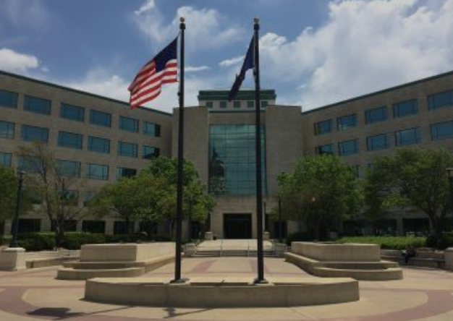
APPLIED PRACTICAL EXPERIENCE
APE Site: The Kansas Department of Health and Environment – Bureau of Family Health – Division of Public Health (Maternal and Child Health Team)
Topeka, Kansas
Dates: March 31, 2024 – October 11, 2024
Preceptor: Alyson Dalrymple
  Administration and Policy Director/Deputy Bureau Director for the Bureau of Family Health

Slide 6
APPLIED PRACTICAL EXPERIENCE
Kansas Department of Health and Environment – Bureau of Family Health’s - Maternal and Child Health Women and Maternal Program⁸
“The purpose of the MCH Program’s women and maternal services is to improve health outcomes for all women, including pregnancy outcomes for mothers, by decreasing the incidence of maternal complications, including maternal mortality and morbidity, and chronic disease.”

Slide 7
Ape objectives and activities

Slide 8
APE OBJECTIVES
Gain knowledge of current maternal health initiatives in Kansas and their impact on maternal health outcomes
Review and analyze the Kansas Maternal Mortality Review Committee’s (KMMRC) and Center for Disease Control and Prevention’s (CDC) Pregnancy Risk Assessment Monitoring System’s (PRAMS) data to identify trends and factors influencing maternal and child health.
Evaluate perceived barriers, challenges, and gaps in implementing maternal health initiatives within Kansas communities.
Create informative materials, such as infographics and surveys, to communicate findings and recommendations regarding maternal health issues to various audiences.
Notes:
My ape objective included:
Understand current Kansas maternal health initiatives and their outcomes
Analyzing KMMRC and CDC PRAMS data for maternal health trends and factors
Assessing barrier and gaps in implementing maternal health programs
And developing materials to communicate findings and recommendation on maternal health issues

Slide 9
APE ACTIVITIES
Attended Kansas Maternal and Child Health Council meeting and Kansas Maternal Health Innovation Task Force (KMHITF) meeting
Reviewed the KMMRC’s recommendations and the health initiatives the KDHE and the Kansas Perinatal Quality Collaborative (KPQC) have to address them.
Developed infographics surrounding pregnancy-related deaths and the CDC PRAMS data for Kansas to be used for information sharing at KMHITF meetings and published in the KMMRC report.
Created a survey for MHITF members to assess their perceived barriers, challenges, gaps, and achievements of Kansas maternal health initiatives.
Notes:
My activites included:
Participating in Kansas MCH Council and KMITF meetings
Examining KMMRC recommendation and related KDHE/KPQC initiatives
Creating infographics on pregnancy-related deaths and Kansas PRAMS data
And Developing a survey to assess perceived barriers in maternal health initiatives

Slide 10
APE TIMELINE
March 2024
Began practice experience
April 2024
Reviewed KMMRC recommendations and attended the KMCH Council Meeting
July 2024
Change in preceptors
August 2024
Attended MHTF meeting and began survey and infographics discussion
September 2024
Finished Pregnancy-related deaths infographic and received feedback for PRAMS infographic and survey drafts
October 2024
Finished PRAMS infographic, completed final survey draft, conducted survey analysis and MPH defense

Slide 11
Background
Notes:
Next some necessary background regarding the national and state level maternal landscape

Slide 12
BACKGROUND – NATIONAL MATERNAL LANDSCAPE
Maternal mortality rates are the highest as compared to ten other developed countries around the globe¹⁷
17 maternal deaths for every 100,000 live births¹⁸
  More than double that of other high-income countries¹⁸
Notes:
As of 2020…
Maternal mortality rates are the highest for the U.S as compared to ten other developed countries around the globe with 17 maternal deaths for every 100,000 live births
DOUBLE that of other high income countries

Slide 13
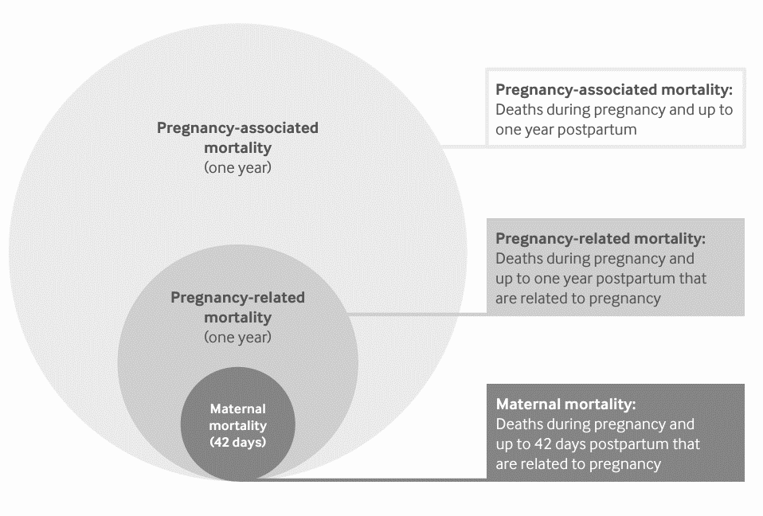
BACKGROUND – NATIONAL MATERNAL LANDSCAPE
Standard measures of maternal deaths in the U.S. ³
Notes:
There are three standard measures of maternal death:
Pregnancy-associated mortality consisting of deaths during pregnancy and up to one year postpartum.
Example: dying in a car crash and also happens to be pregnant
Pregnancy related deaths: a death during pregnancy or within 1 year of the end of a pregnancy from a pregnancy complication, a chain of events initiated by the pregnancy, or the aggravation of an unrelated condition by the physiologic effects of pregnancy
And Maternal mortality, measured of pregnancy-related deaths during pregnancy and up to 42 days postpartum, of which is used for international comparison

Slide 14
BACKGROUND – NATIONAL MATERNAL LANDSCAPE
More than 80% of pregnancy-related deaths are preventable ¹⁸
A death is considered preventable if reasonable modifications to various factors – including those related to the patient, family, healthcare providers, medical facilities, healthcare systems, or community – could have potentially averted the outcome.
Notes:
The latest data cites that more than 80% of pregnancy related deaths have been found to be preventable
A death is considered preventable if reasonable changes could have been made to potentially avoid the outcome.

Slide 15
BACKGROUND – KANSAS MATERNAL LANDSCAPE
As of 2022, Kansas ranks 18th nationally with a maternal mortality rate of 22.8 deaths per 100,000 live births, slightly higher than the national average⁶
The latest published report by the KMMRC (2016-2020) reveals that of the 105 pregnancy-associated deaths, 29 were pregnancy-related, and of those pregnancy-related deaths, 23 were preventable.
  During the annual review, 103 contributing factors to preventable pregnancy-related deaths were identified
Notes:
As of 2022 Kansas ranks 18th in the nation with a maternal mortality rate of 22.8 deaths per 100,000 live births
Of 105 pregnancy-associated deaths found between 2016-2020, 29 were found to be pregnancy-related, and 23 of those pregnancy-related death were found to be preventable.

Slide 16
BACKGROUND – KMMRC RECOMMENDATIONS (2016-2020)
The key KMMRC recommendations based on the 23 preventable pregnancy-related deaths are as follows: ⁹
Screen, provide brief intervention, and referrals for
  Comorbidities and chronic illness
  Intimate partner violence
  Pregnancy intention
  Mental health conditions (including postpartum anxiety and depression)
  Substance use disorder
Better communication and multi-disciplinary collaboration between providers, including referrals
Patient education and empowerment
Notes:
The KMMRC made these key recommendations based on the 23 preventable pregnancy-related deaths.
They include screening, providing various interventions and referrals for various health disparities.
As well as better communication and multi-disciplinary collaboration and improved patient education and empowerment.

Slide 17
BACKGROUND – HEALTH DISPARITIES AND HOW KDHE IS ADDRESSING THE KMMRC RECOMMENDATIONS
Comorbidities and chronic illness:
Leading cause of maternal mortality in the U.S¹¹
Of the leading causes of pregnancy-related deaths in Kansas, obesity was found to be the leading circumstance contributing to two out of three deaths⁸
Providers should educate patients about maternal obesity risks and promote healthy lifestyles to reduce adverse health outcomes^{4,13}
The KPQC’s Fourth Trimester Initiative focuses on postpartum assessments and interventions to decrease maternal morbidity and mortality⁸
Enrolled birthing facilities receive free resources, training, and access to maternal health experts to improve maternal health outcomes⁸
Notes:
Taking a closer look at the associated health disparities:
Obesity is a leading contributor to maternal mortality in Kansas and the U.S
And provider education on obesity risks and promotion of healthy lifestyles is crucial
The Kansas Perinatal Quality Collaborative’s Fourth Trimester Initiative aims to improve these risks and outcomes through improved postpartum assessments and internventions

Slide 18
BACKGROUND – HEALTH DISPARITIES AND HOW KDHE IS ADDRESSING THE KMMRC RECOMMENDATIONS
Intimate Partner Violence: contributes to the three leading causes of pregnancy-associated deaths: homicide, suicide, and drug-related overdose/substance use¹
The Maternal Anti-Violence Intervention Screening Project, launched with KDHE partners, aims to reduce maternal deaths due to homicide and suicide through data collection and provider training
Suicide prevention includes perinatal depression screening, with Kansas adopting the Alliance for Innovation on Maternal Health (AIM) program’s safety bundle for better care coordination⁷
Substance use disorder contributed to 25% of pregnancy-related deaths in Kansas from 2016-2020, with 10.5% linked to overdoses⁹
The KDHE recommends the Alcohol, Smoking, and Substance Involvement Screening Test (ASSIT) tool for identifying women at risk for substance misuse in healthcare settings²⁰
Notes:
Intimate partner violence contributes to the leading pregnancy-associated deaths: homicide, suicide, and overdose
The MAVIS project aims to reduce these maternal deaths through improved data collection and provider training
Kansas also has adopted the AIM program’s safety bundle, an extension of the FTI, for perinatal depression screening in an effort to improve suicide rates.
Substance use disorder is linked to 25% of pregnancy-related deaths in Kansas, and the KDHE recommends the ASSIST tool for screening women at risk for substance misuse in healthcare settings.

Slide 19
BACKGROUND – HEALTH DISPARITIES AND HOW KDHE IS ADDRESSING THE KMMRC RECOMMENDATIONS
Pregnancy Intention: screening for pregnancy intention improves reproductive health outcomes and equity¹⁶
KDHE launched Well Woman Toolkits in 2020 for comprehensive care and pregnancy intention screening
One Key Question® tool asks: “Would you like to become pregnant in the next year?” ¹⁵
The Kansas MCH team provided One Key Question® training to over 100 professionals in 2020. ⁹
Consultation calls were organized to address implementation challenges and best practices.⁹
Notes:
Screening for pregnancy intentions has been shown to improve reproductive health outcomes and equity
To supplement this, KDHE has implemented the Well Woman Toolkits and the One Key Question tool for pregnancy intention screening
And over 100 Kansas professional received the One Key Question training in 2020

Slide 20
BACKGROUND – HEALTH DISPARITIES AND HOW KDHE IS ADDRESSING THE KMMRC RECOMMENDATIONS
Mental Health Conditions: 79.2% of pregnancy-related deaths influenced by mental health conditions and classified as pregnancy-associated.⁹
Depressive and anxiety symptoms often begin during or before pregnancy, but women are less likely to receive treatment during pregnancy compared to postpartum^{5,12,14,19}
Initiatives like the Fourth Trimester Initiative, MAVIS, and Kansas Connecting Communities are working to improve mental health screening and treatment for pregnant and postpartum women.⁹
The KCC offers free psychiatric consultation, resources, and training to healthcare providers to enhance screening and treatment practices¹⁰
Notes:
Mental health conditions influence 79.2% of pregnancy-related deaths in Kansas.
Kansas initiatives like the FTI, MAVIS, and the Kansas Connecting Communities) aim to improve mental health screening and treatment for pregnant women through the provision of free psychiatric consultations for providers and promote quality care during the transition from pregnancy to postpartum.

Slide 21
BACKGROUND – HEALTH DISPARITIES AND HOW KDHE IS ADDRESSING THE KMMRC RECOMMENDATIONS
Social Determinants of Health: The SDoH factors related to maternal mortality must be considered to understand what drives and sustains these health disparities²
Kansas tracks demographic characteristics of pregnancy-associated deaths to target interventions and resources effectively
The KPQC’s FTI trains providers to screen for SDoH and educates them about patient barriers and community resources.⁹
Providers receive assistance developing comprehensive resource guides and learning about warm hand-offs to improve patient care.⁹
These efforts aim to enhance provider education and patient care within the healthcare system.⁹
Notes:
Social determinants of health are crucial in understanding maternal mortality disparities
Kansas tracks demographic data of pregnancy-associated deaths to target interventions
And the KPQC’s FTI also trains providers on SDoH screening and community resources

Slide 22
APE Products
Notes:
Moving on with my APE products

Slide 23
APE PRODUCTS
Infographics
Pregnancy-related deaths
CDC PRAMS
Survey
MHITF survey
Notes:
I created 3 products including two infographics and a survey.

Slide 24
infographics
Notes:
Taking a closer look at my infographics

Slide 25
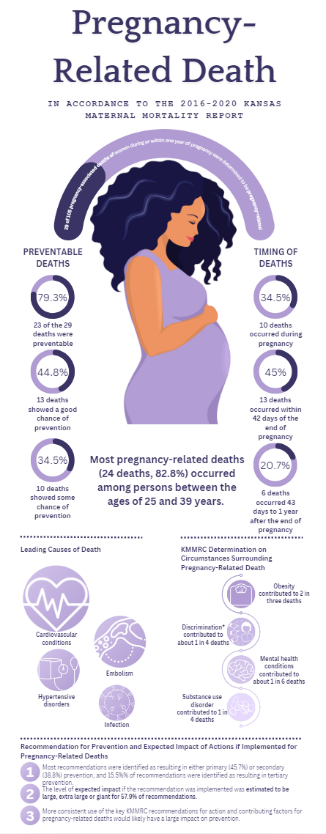
Pregnancy-related Deaths Infographic
Notes:
Focused on preventable pregnancy-related deaths, which as mentioned previously, comprise the majority of the pregnancy-related deaths in Kansas.
I included the data I felt was most important and attention-grabbing, taking factors such as:
Preventable deaths and
Timing of deaths
And breaking that down further
As well as other key data points such as age distribution, leading causes of death, and the circumstances surrounding deaths.
(I considered the SDoH and their impact on these outcomes when creating the infographic) – don’t say
As well as incorporated recommendations for prevention from previous infographics
Finally, I included updated information on potential impact if the key KMMRC recommendations are implemented
The first infographic focused specifically on bringing attention to preventable pregnancy-related deaths, as they make up the large majority of pregnancy-related deaths in Kansas, according to the latest published reports.
Considering previous infographics as examples, I included the data that I felt was most important and attention-grabbing, taking one factor such as preventable deaths and timing of deaths and breaking that down further. I also included age, and the leading causes of death and circumstances surrounding each death in consideration of how someone’s social determinants of health may affect these health outcomes.
Finally I also included the same recommendations for prevention and impact if implemented as used on previous infographics with updated information.

Slide 26
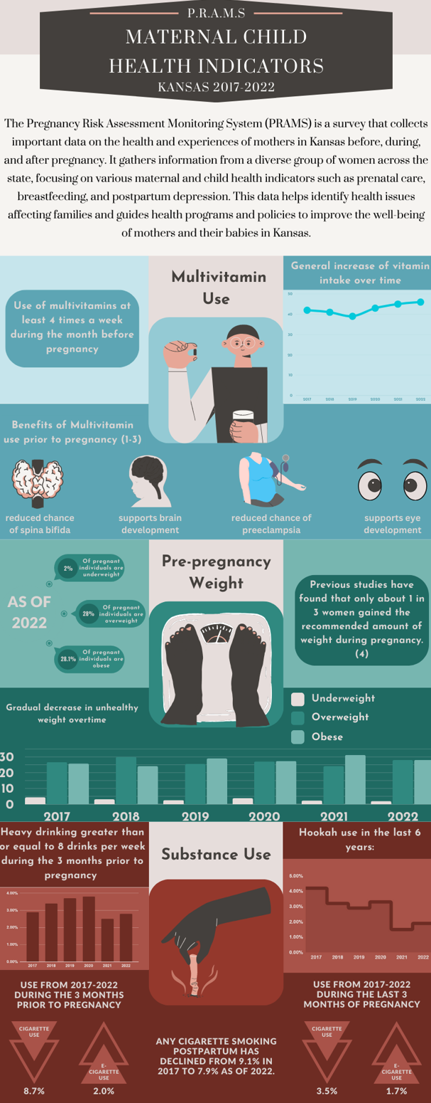
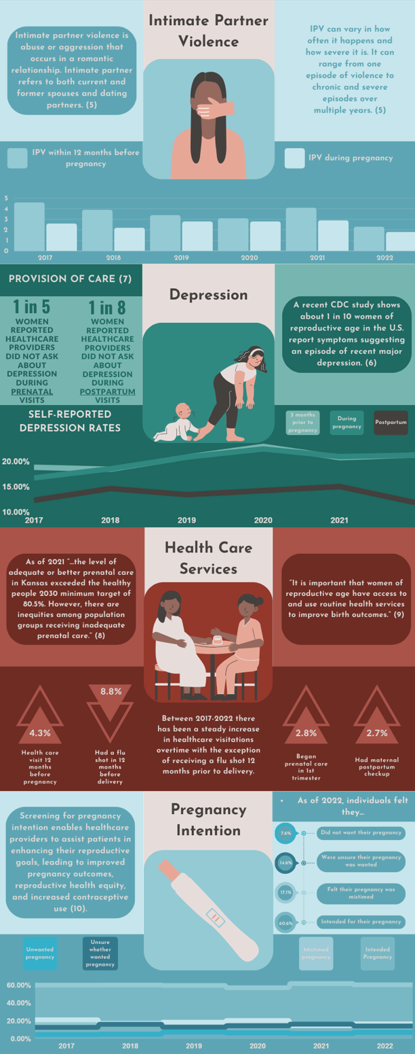
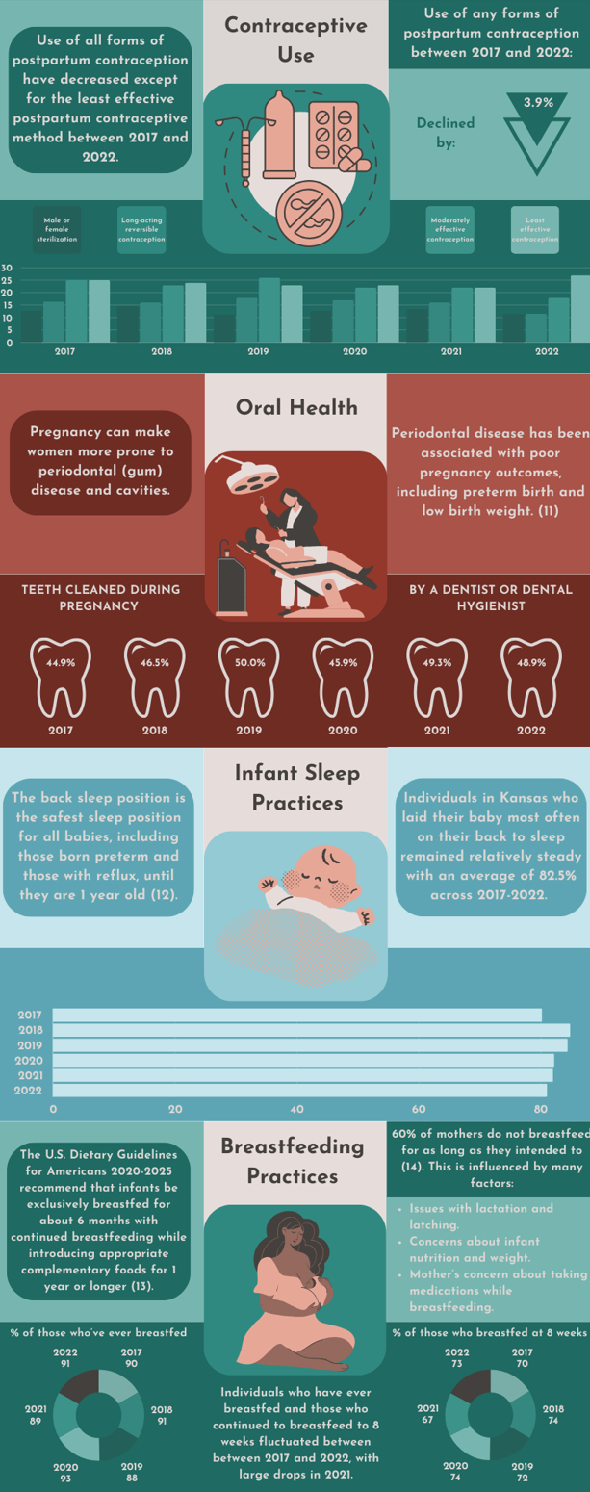
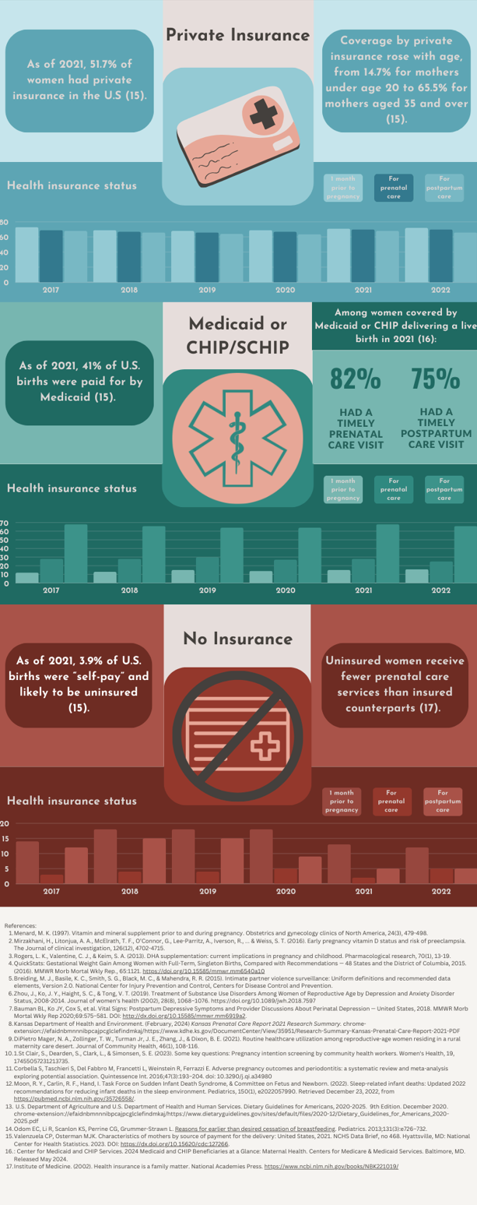
CDC PRAMS Infographic
Notes:
The second infographic I created was voluntary, however the most intricate.
Each section represents various maternal and child health indicators during pregnancy and after, as according to the CDC’s Pregnancy Risk Assessment Monitoring System for Kansas between 2017 and 2022.
The infographic is designed for flexible use as it can be presented as a whole or in each section can be used separately in various forms of media.
Each of these infographics are intended for information sharing at future MHITF meetings and the pregnancy-related deaths infographic is to be included in the future KMMRC report
The second infographic I created was voluntary, however the most intricate.
Each section represents various indicators of maternal and child health; during and after pregnancy; with data as collected by the Pregnancy Risk Assessment Monitoring System by the CDC for Kanas between 2017 and 2022.
Each section can be presented altogether or used separately in any form of media.
Both of the infographics are currently intended to be used for information sharing in future MHITF meetings and the pregnancy-related Deaths infographics will be used in the future KMMRC report.

Slide 27
SURVEY
Notes:
Moving forward, we’ll take a thorough look at my survey

Slide 28
SURVEY OBJECTIVES
The survey:
Evaluated MHITF members’ knowledge and perceptions of Kansas maternal health initiatives thus aiming to identify areas for improvement and collaboration to enhance maternal health outcomes across the state
Notes:
As mentioned previously, the survey aimed to evaluate MHITF members’ knowledge and perceptions of Kansas maternal health initiatives, identifying areas for improvement and collaboration to enhance maternal health outcomes statewide.

Slide 29
SURVEY RECRUITMENT
The following methods were taken to increase responses
Targeted email distribution
Verbal promotion of survey at KMHITF meeting
Notes:
Targeted email distribution for task force members and verbal promotion were used at MHITF meetings for survey recruitment

Slide 30
SURVEY questions
Notes:
The survey consisted mostly of 3-5 point likert scale questions, with the remaining being optional open-ended.

Slide 31
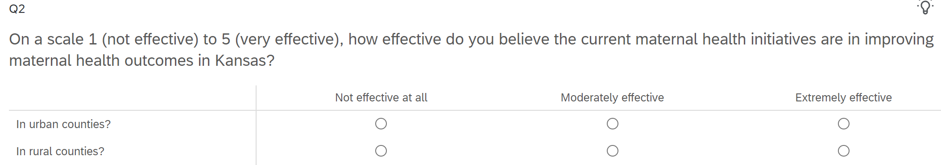
Effectiveness of Maternal Health Initiatives
Notes:
The survey assessed the perceived effectiveness of maternal health programs in Kansas, focusing on respondents’ ratings of these initiatives and their impact on maternal health in urban and rural counties.

Slide 32
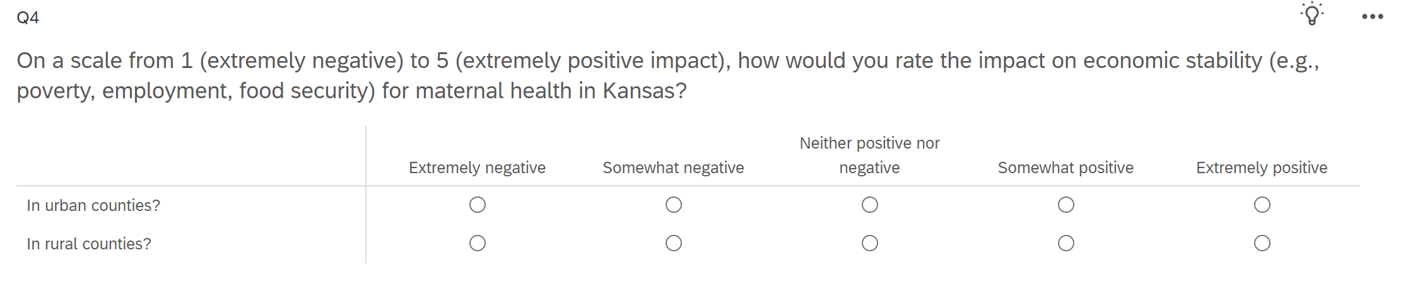
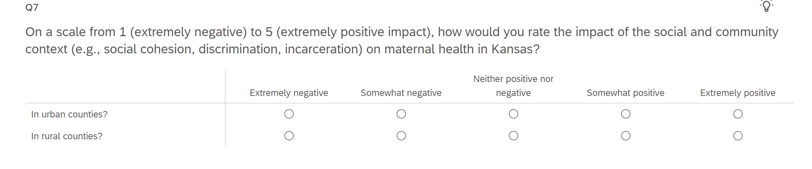
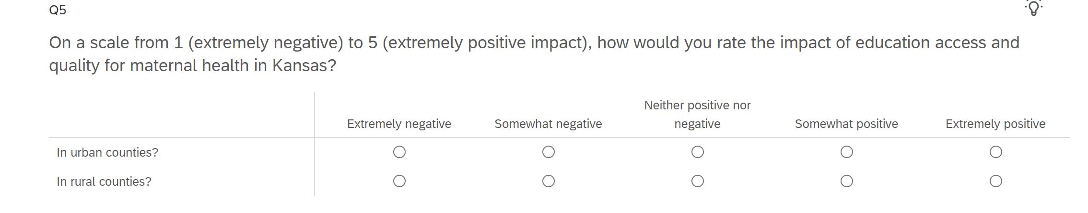
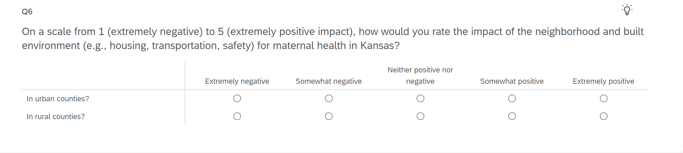
Social Determinants of Health
Notes:
Several questions addressed the impact of social and environmental factors on maternal health outcomes.
These included
economic stability
access to education
neighborhood conditions
and social context such as social cohesion, discrimination, and rates of incarceration,
Highlighting the survey’s focus on understanding broader social determinants of maternal health beyond just clinical care.

Slide 33
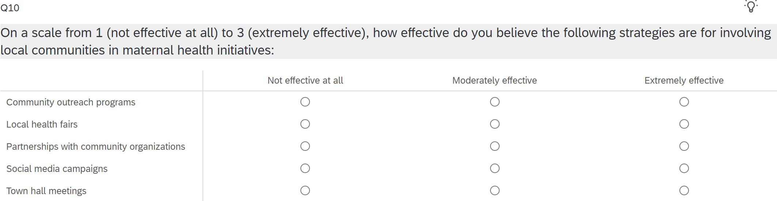
Community Involvement and Local Perspectives
Notes:
The survey also explored strategies for community involvement in maternal health initiatives. This particular question also included an optional-open ended question which assessed regional differences between urban and rural counties to understand specific needs and strengths.

Slide 34
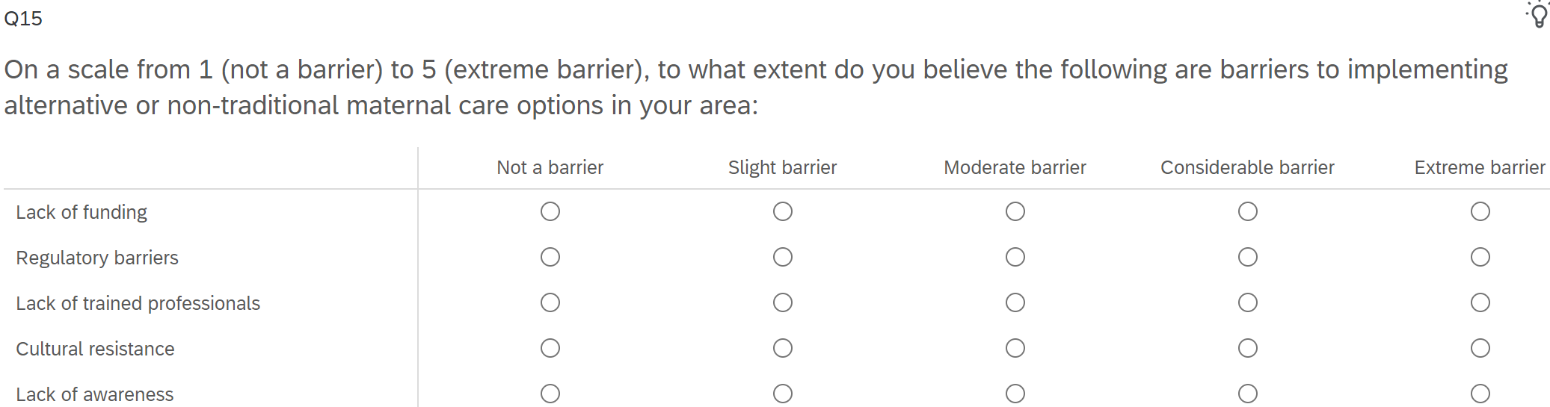
Policy and Implementation Barriers
Notes:
Supportive policies and barriers to alternative care options were also examined, aiming to understand the systemic factors affecting maternal healthcare improvement.

Slide 35
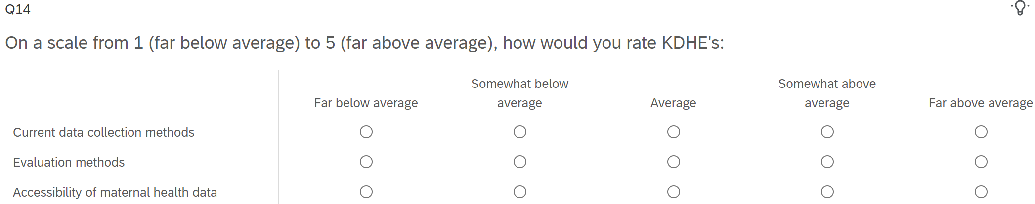
KDHE Performance Evaluation
Notes:
A specific section also evaluated the KDHE’s performance in various aspects related to maternal health.

Slide 36
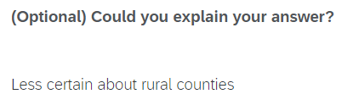
Survey Feedback
Notes:
The majority of the optional open-ended questions remained unanswered except for the consideration of specific gaps in urban and rural counties, citing urban communities receive more resources and options for providers as compared to their understanding of rural counties.
Community outreach was also mentioned as being vital for disseminating information, however the respondent felt policy change at the institutional and systems level was most impactful.

Slide 37
Future considerations

Slide 38
FUTURE CONSIDERATIONS
Current Plans
INFOGRAPHICS
  KMMRC 2016-2022 Report
  Information sharing at MHITF meetings
MHITF SURVEY
  Use for gaining an understanding of member’s knowledge of current health initiatives

Slide 39
FUTURE CONSIDERATIONS
Future potential
Infographics
  Use for the general public
    Social media posts
    KDHE?
    KDHE partners and associated clinics?
MHITF SURVEY
  Use for future members to gain their understanding of current Kansas maternal health initiatives

Slide 40
Mph Foundational Competencies

Slide 41
Foundational Competencies
#2: Select quantitative and qualitative data collection methods appropriate for a given public health context.
This competency was fulfilled by designing a survey that included qualitative and quantitative components. The survey would be provided to members of the MHITF through Qualtrics. My mentor, Kayla Stangis, suggested using this data collection method to account for timeliness and accuracy.
Notes:
The survey incorporated both quantitative (likert scale) and qualitative (open-ended) questions, fulfilling foundational competency #2 by collecting diverse data on task force members’ attitudes and opinions.
Designing the survey for the KMHITF using quantitative and qualitative data collection methods fulfilled foundational competency #2. The use of likert scale questions allow for quantitative data to be collected on members’ attitudes and opinions while the open-ended questions allow for qualitative understanding of the same.

Slide 42
Foundational Competencies
#4: Interpret results of data analysis for public health research, policy, or practice.
The data collected via the survey was analyzed to evaluate members' knowledge and perceptions of Kansas maternal health initiatives.
Notes:
Foundational Competency #4 was completed in the collection and analysis of the MHITF survey.

Slide 43
Foundational Competencies
#11: Select methods to evaluate public programs.
My mentors, Kayla Stangis and Jill Nelson, chose the survey as the best way to evaluate the MHITF members' perceptions of the effectiveness of the MCH initiatives in Kansas. Evaluating public health initiatives is crucial for creating and implementing efficient and beneficial programs for the target populations.
Notes:
My mentors; Kayla Stangis, the Maternal and Child Health Coordinator, and Jill Nelson, the maternal and perinatal initiatives consultant, suggested the survey as the best way to evaluate the MHITF members’ perceptions of the effectiveness of the MCH initiatives in Kansas.

Slide 44
Foundational Competencies
#14: Advocate for political, social, or economic policies and programs that will improve health in diverse populations.
The survey design advocated for improved maternal health policies by gathering diverse perspectives on current initiatives, identifying gaps in services, and soliciting suggestions for policy changes to address health disparities among different populations in Kansas.
The infographics function as potential advocacy tools. They visually present data on maternal health disparities and outcomes, highlight areas requiring policy attention, and inform stakeholders about the impact of social determinants on maternal health in various Kansas communities.
Notes:
The survey and infographics used data-driven advocacy to gather insights on maternal health initiatives,
presented complex information accessibly,
informed possible future stakeholders about specific challenges,
and promoted health equity by highlighting disparities and seeking solutions for diverse populations.

Slide 45
Foundational Competencies
#16: Apply principles of leadership, governance, and management, which include creating a vision, empowering others, fostering collaboration, and guiding decision-making.
Creating infographics for the KMHITF showcased leadership by envisioning data presentation and guiding decision-making through strategic data visualization.
Notes:
The infographics demonstrated leadership by presenting data effectively
Guiding future decision-making
And enables stakeholders to quickly understand key insights and trends in maternal health outcomes.

Slide 46
Mph Emphasis Area Competencies
Physical Activity
Notes:
Next focusing on my emphasis area competencies

Slide 47
POPULATION HEALTH
Investigate the impact of physical activity on population health and disease outcomes.
Course: KIN 616 (Obesity and Physical Activity: Behavioral, Environment, and Policy Influence)
APE project: The course KIN 616 provided insights into the complex relationship between physical activity, obesity, and environmental and policy factors, emphasizing a systems approach to address obesity disparities. This knowledge was applied to analyze how maternal obesity impacts pregnancy-related deaths in Kansas and how physical activity interventions could potentially reduce obesity-related complications in pregnant women.
Notes:
In KIN 616, I gained insight into
The correlation between PA and obesity
Examined environmental and policy factors contributing to weight gain
Applied systems thinking to obesity causes
And explored policy solutions for obesity disparities
I applied the knowledge gained about the impact of PA on population health to understand how maternal obesity, a leading factor in pregnancy-related deaths in Kansas, affects maternal health outcomes.
This allowed for a deeper analysis of how PA interventions could potentially reduce obesity-related complications in pregnant women.

Slide 48
SOCIAL, BEHAVIORAL, AND ENVIRONMENTAL INFLUENCES
Investigate social, behavioral, and environmental factors that contribute to participation in physical activity.
Courses: MPH 818 (Social and Behavioral Bases of Public Health), KIN 612 (Policy, Built Environment and Physical Activity)
APE project: Social and Behavioral Bases of Public Health (MPH 818) provided insights into how various factors impact population health, focusing on health behavior change and social structural influences. This knowledge was applied to analyze maternal health outcomes in Kansas, considering social determinants and behavioral patterns. Policy, Built Environment and Physical Activity (KIN 612) explored how active living policies and community design contribute to health, which was applied to understanding maternal health outcomes in Kansas, particularly regarding healthcare access and physical activity opportunities.
Notes:
In MPH 818 and KIN 612, I studied the
SDoH
health behavior change principles
and the impact of active living policies and built environment on PA and population health.
I applied the courses knowledge to
Analyze social determinants and behavioral factors affecting maternal health in Kansas
Developed health communication strategies
And examined the impact of build environment on maternal health outcomes and access to maternal healthcare opportunities.
In Social and Behavioral Bases of Public Health I…
Examined how behavioral, social, economic, and environmental factors influence health issues and disparities in populations
And focused on health behavior change principles and their application to public health challenges like mental health and smoking cessation
I applied this knowledge to my experience by
Analyzing social and behavioral factors influencing maternal health outcomes in Kansas
Exploring how social determinants and behavioral patterns contribute to maternal mortality rates
And developed strategies for health communication and community engagement
In Policy, Built Environment, and PA, I learned how active living policies and neighborhood and community design contribute to improved health.
I investigated how active living policies and community design affect PA levels across all age groups
And analyzed the role of the built environment in improving population health and its implications for maternal health outcomes
I applied this knowledge to maternal health in…
Considering the impact of the built environment on maternal health outcomes in Kansas
And analyzed access to healthcare facilities and PA opportunities during pregnancy and postpartum

Slide 49
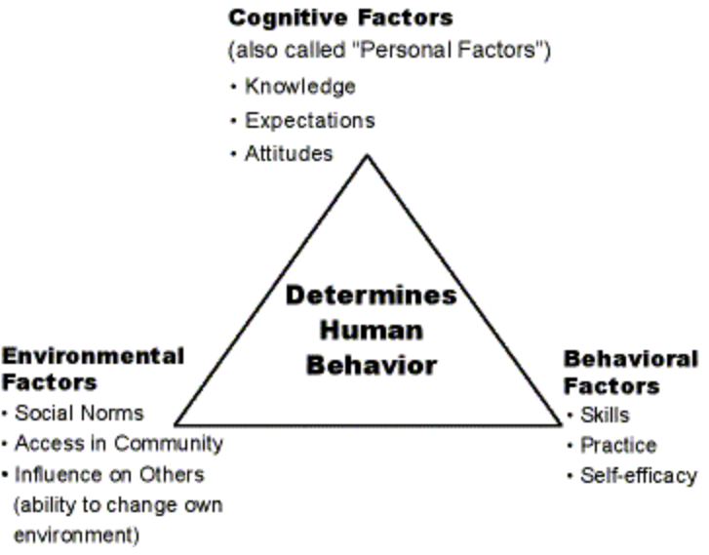
THEORY APPLICATION
Examine and select social and behavioral theories and frameworks for physical activity programs in community settings.
Course: KIN 805 (Physical Activity and Human Behavior)
APE project: Physical Activity and Human Behavior (KIN 805) explored psychological theories and research on factors influencing physical activity participation and exercise adherence. This knowledge can be applied to analyze the effectiveness of maternal health initiatives in Kansas, particularly in understanding the success or failure of interventions for mental health screening and substance use disorder treatment.
Notes:
In KIN 805 I learned of:
Psychological theories on motivation and behavior in PA
And social factors influencing exercise participation and adherence
I applied this knowledge to maternal health by
Analyzing effectiveness of maternal health initiatives in Kansas
And applied theories such as the social cognitive theory to explain the success of different maternal health interventions

Slide 50
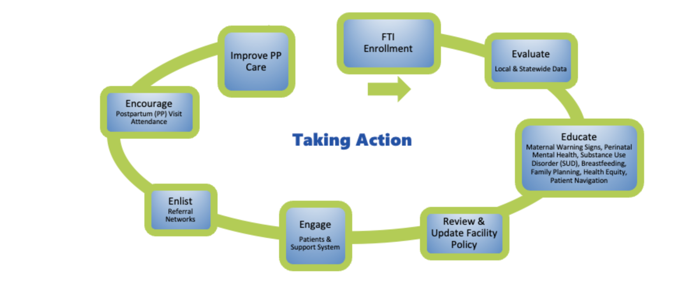
DEVELOPING AND EVALUATING PHYSICAL ACTIVITIES INTERVENTIONS
Examine and select social and behavioral theories and frameworks for physical activity programs in community settings.
Course: KIN 805 (Physical Activity and Human Behavior)
APE project: Physical Activity and Human Behavior (KIN 805) explored psychological theories and research on exercise motivation, including the development of a health intervention program for working mothers. The skills gained in designing and evaluating interventions can be applied to assess the effectiveness of various maternal health programs in Kansas, such as the Fourth Trimester Initiative and the MAVIS Project.
Notes:
I applied the KIN 805 skills in developing and evaluating health interventions to understand Kansas maternal health programs, particularly KPQC’s FT initiatives.
The FTI action plan featured is featured here, a framework used in the implementation of the program.
Kin 805 also applies to developing and evaluating interventions within my experience.
Within the class I developed a health intervention program for working mothers and created a framework for needs assessment, intervention design, and evaluation.
These skills transferred well in understanding the maternal health programs in Kansas, and is particularly applicable to the KPQC’s where behavioral theories and frameworks are used to intervene and improve maternal health outcomes.
As viewed by the FTI action plan:
Focusing on:
Enrollment and evaluation of data
Education to facilities including but not limited to directional coaching and support at no cost
Review and update of facility policy
Engagement of patients and their support systems
Enlisting in referral networks to provide mechanisms to assure timely referral and follow up
Encouraging postpartum visitation and improved postpartum care by
Identifying mother’s postpartum care team
Ensuring a personalized Patient Plan of Care (“mom plan”)
Providing reproductive health planning
And establishing ongoing insurance coverage
Free resources, training, and constant access to collaboration with maternal health leaders across Kansas to improve the prevalence of maternal chronic disease and more are also provided.

Slide 51
SUPPORT EVIDENCE-BASED PRACTICE
Create evidence-based strategies to promote physical activity and communicate them to community stakeholders.
Courses: KIN 610 (Program Planning and Evaluation), KIN 655 (Individual Physical Activity Promotion)
APE project: Program Planning and Evaluation (KIN 610) and Individual Physical Activity Promotion (KIN 655) provided comprehensive knowledge on developing, implementing, and evaluating health promotion programs, as well as individual-level behavior change strategies. This knowledge can be applied to analyze and evaluate the Kansas Maternal Mortality Review Committee's recommendations, assessing their potential impact and suggesting effective communication methods for healthcare providers and community stakeholders.
Notes:
KIN 610 and 655 taught health program planning, evaluation, and behavior change strategies.
The knowledge gained from these courses was most evident in
analyzing Kansas maternal health initiatives
Evaluating the KMMRC recommendations
And developing effective communication strategies for healthcare providers and stakeholders.

Slide 52
conclusion
Notes:
To conclude:

Slide 53
CONCLUSION
The maternal health landscape in Kansas reflects many of the challenges seen at the national level but with unique local considerations.
The state’s varied health initiatives and interventions including commitments to implementing evidence-based practices, improving education, and enhancing community engagement, demonstrate a proactive approach to reducing maternal mortality.
As Kansas continues to refine its strategies and adapt to emerging challenges, my work analyzing data, creating informative materials, and assessing perceived barriers will foster ongoing collaboration between healthcare providers, policymakers, and community organizations. This collaboration is essential in achieving better maternal health outcomes for all women across the state.
Notes:
Kansas faces maternal health challenges similar to national trends, with local nuances.
And the state’s initiatives focus on evidence-based practices, education, and community engagement to reduce maternal mortality.
My work in data analysis, information sharing, and barrier assessment supports ongoing collaboration among stakeholders to improve maternal health outcomes statewide.

Slide 54




ACKNOWLEDGMENTS
Alyson Dalrymple
Administration and Policy Director/Deputy Bureau Director for the Bureau of Family Health
Kayla Stangis MPH, CHES
Maternal Child Health Coordinator
Jill Nelson
Maternal and Perinatal Initiatives Consultant
Jamie Kim
KDHE Epidemiologist
Notes:
I’d like to acknowledge my preceptor Alyson Dalrymple as well as my mentors, Kayla Stangis, Jill Nelson, and Jamie Kim in supporting me my personal growth within the maternal and child health field.

Slide 55



ACKNOWLEDGMENTS
Peter Stoepker
Major Professor
Emily Mailey
Committee Member
Susan Rensing
Committee member
Notes:
I also want to thank my committee for boosting my confidence in my academic knowledge and for supporting me throughout my academic career.

Slide 56
REFERENCES
Campbell, J., Matoff-Stepp, S., Velez, M. L., Cox, H. H., & Laughon, K. (2021). Pregnancy-associated deaths from homicide, suicide, and drug overdose: review of research and the intersection with intimate partner violence. Journal of women's health, 30(2), 236-244.
Dagher, R. K., & Linares, D. E. (2022). A critical review on the complex interplay between social determinants of health and maternal and infant mortality. Children, 9(3), 394.
Declercq, E., & Zephyrin, L. (2020). Maternal mortality in the United States: a primer. Commonwealth Fund, 10.
Denison, F. C., Aedla, N. R., Keag, O., Hor, K., Reynolds, R. M., Milne, A., ... & Royal College of Obstetricians and Gynaecologists. (2019). Care of women with obesity in pregnancy: Green‐top guideline no. 72. BJOG: An International Journal of Obstetrics & Gynaecology, 126(3), e62-e106.
Howard, L. M., Molyneaux, E., Dennis, C. L., Rochat, T., Stein, A., & Milgrom, J. (2014). Non-psychotic mental disorders in the perinatal period. The Lancet, 384(9956), 1775-1788.
Hoyert, D. L. (2024). Maternal mortality rates in the United States, 2022. National Center for Health Statistics. https://www.cdc.gov/nchs/data/hestat/maternal-mortality-2022/maternal-mortality-2022.htm
Kansas Department of Health and Environment. (2021). KDHE Launches New Initiatives to Address Maternal Mortality. https://www.coronavirus.kdheks.gov/CivicAlerts.aspx?AID=86
Kansas Department of Health and Environment. (2023). Kansas Title V Maternal & Child Health Service Manual (Rev. ed.).
Kansas Department of Health and Environment. Kansas Maternal Mortality Report, 2016-2020. December 2023.
Kansas Maternal and Child Health. (2024). Psychiatric Consultation Care Coordination. https://www.kansasmch.org/psychiatric-consultation-care-coordination.asp
Katella, K. (2023). Maternal Mortality Is on the Rise: 8 Things to Know. Yale Medicine, Yale Medicine, 22.
Munk-Olsen, T., Maegbaek, M. L., Johannsen, B. M., Liu, X., Howard, L. M., Di Florio, A., ... & Meltzer-Brody, S. (2016). Perinatal psychiatric episodes: a population-based study on treatment incidence and prevalence. Translational Psychiatry, 6(10), e919-e919.
Norman, J. E., & Reynolds, R. (2011). The consequences of obesity and excess weight gain in pregnancy. Proceedings of the Nutrition Society, 70(4), 450-456.
Patton, G. C., Romaniuk, H., Spry, E., Coffey, C., Olsson, C., Doyle, L. W., ... & Brown, S. (2015). Prediction of perinatal depression from adolescence and before conception (VIHCS): 20-year prospective cohort study. The Lancet, 386(9996), 875-883.
Power to Decide. (2020). One Key Question Online. https://powertodecide.org/what-we-do/information/resource-library/one-key-question-online
St Clair, S., Dearden, S., Clark, L., & Simonsen, S. E. (2023). Some key questions: Pregnancy intention screening by community health workers. Women's Health, 19, 17455057231213735.
Tikkanen, R., Gunja, M. Z., FitzGerald, M., & Zephyrin, L. (2020). Maternal mortality and maternity care in the United States compared to 10 other developed countries. The Commonwealth Fund, 10, 22.
Trost, S., Beauregard, J., Chandra, G., Njie, F., Berry, J., Harvey, A., & Goodman, D. A. (2022). Pregnancy-related deaths: data from maternal mortality review committees in 36 US states, 2017–2019. Education, 45(10), 1-0.
Wisner, K. L., Sit, D. K., McShea, M. C., Rizzo, D. M., Zoretich, R. A., Hughes, C. L., ... & Hanusa, B. H. (2013). Onset timing, thoughts of self-harm, and diagnoses in postpartum women with screen-positive depression findings. JAMA psychiatry, 70(5), 490-498.
World Health Organization (WHO). (n.d.) ASSIST Project- Alcohol, Smoking, and Substance Involvement Screening Test. Retrieved from https://www.who.int/substance_abuse/activities/assist/en/

Slide 57
THANK YOU!
Any questions?

