Slide 1
Operationalizing Agricultural Security
Strengthening New Mexico’s Biosecurity and Emergency Readiness in Animal Agriculture
Presented by: Joshua Dise
Master of Public Health Candidate
Emphasis: Food Safety & Biosecurity

Slide 2
Portfolio Products
Portfolio Product | Description
New Mexico Planning Support | Contributed research, synthesis, and ~20% authored content and guidance for the Large Animal Mass Mortality Carcass Management Plan and Emergency FMD Vaccination Plan.
Biosecurity Commentary – Domestic Preparedness Journal (Practitioner forum) | Sole author of article on biosecurity planning for fairs and livestock exhibitions, with a focus on foreign animal disease (FAD) risks.
Agricultural Security Article – Domestic Preparedness Journal (Practitioner forum) | Co-author of systems-focused commentary on evolving threats to U.S. crop and livestock sectors.

Slide 3


Collaboration & Partnership
2021 National Animal Disease Preparedness and Response Program (NADPRP)
Protecting the Herd:
Enhancing NM’s response to a FAD event through vaccination planning and training
Southwest Border Food Protection and Emergency Preparedness Center

Slide 4
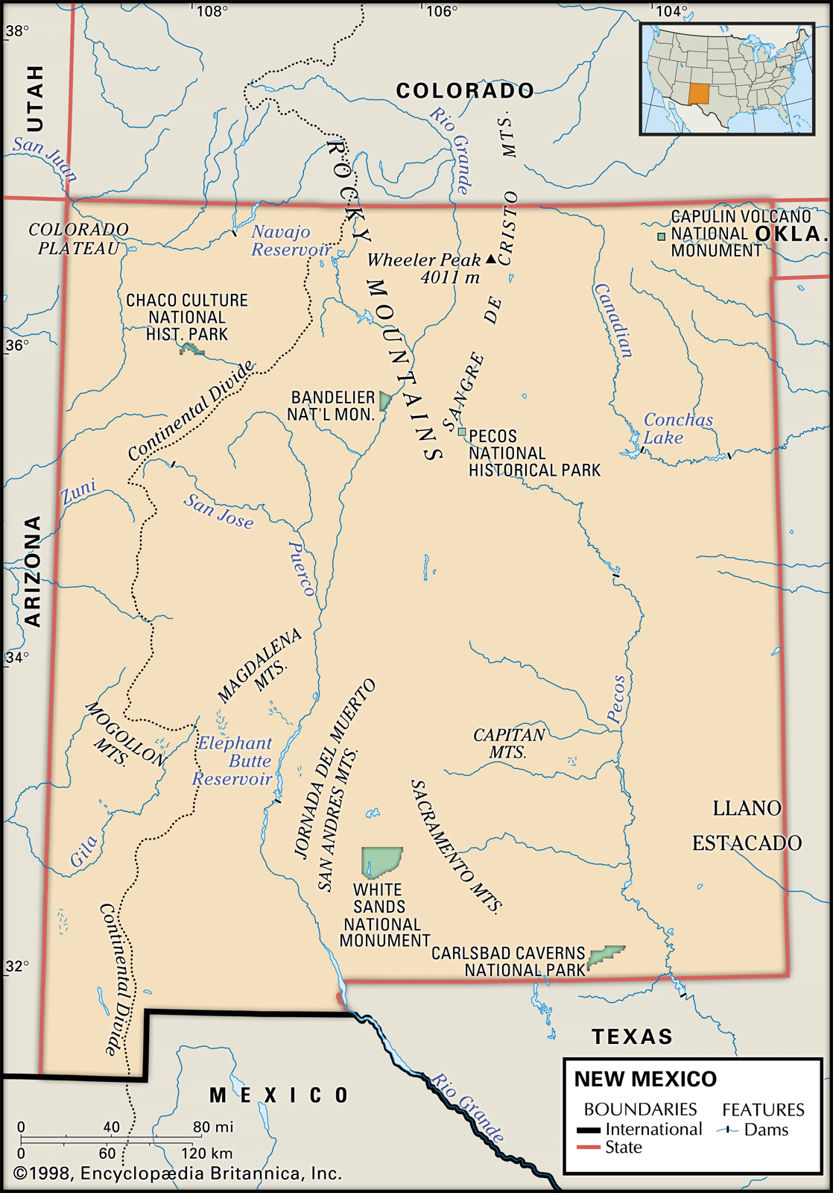
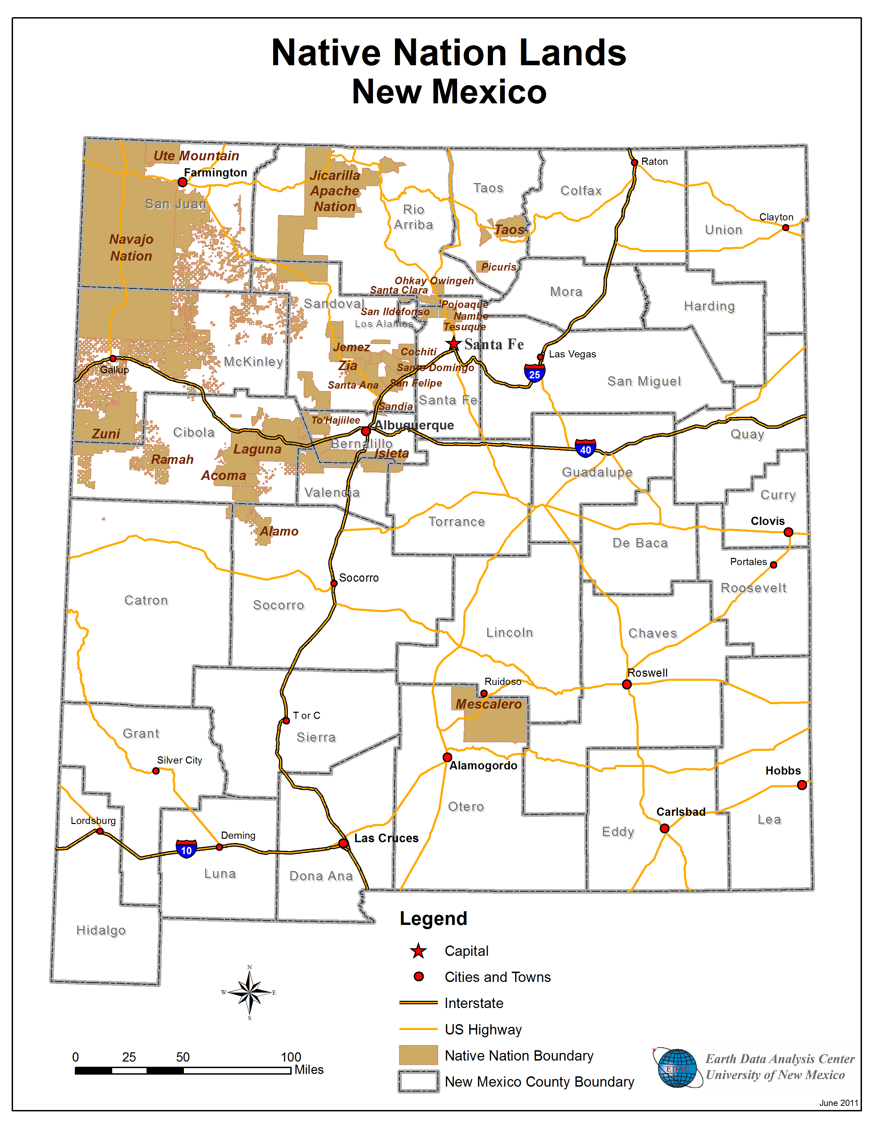
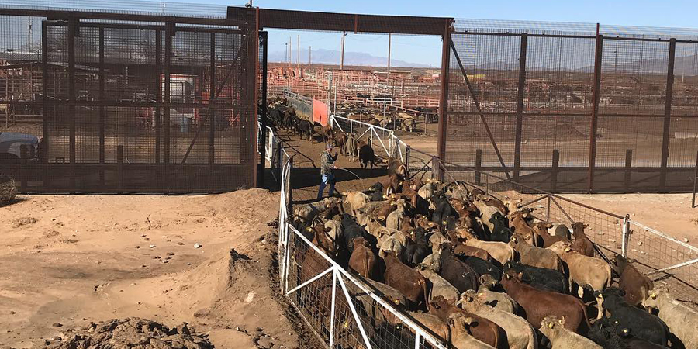
New Mexico’s Unique Risk Landscape
Major Livestock Entry Point
Santa Teresa: Largest U.S. livestock border crossing
~606,000 cattle and 13,000 horses annually, bound for up to 15 states
Geographic & Jurisdictional Complexity
Borders 5 states and includes 23 tribal nations
~21,000 farms/ranches across ~40 million acres (excluding tribal lands)
Dense Livestock Populations
~1.3 million cattle (incl. calves)
  ~450,000 beef
  ~240,000 dairy
84 dairies with the largest average herd size in the U.S. (~2,700)
~75,000 sheep, ~6,000 goats, and farmed cervids
Notes:
https://dairy.nmsu.edu/documents/dairy-status_mar25.pdf
https://www.nass.usda.gov/Quick_Stats/Ag_Overview/stateOverview.php?state=NEW%20MEXICO
17 yo when Kastner went to Santa Theresa

Slide 5
Learning Objectives
Assess Agricultural Risk Landscapes
  Analyze evolving biological, environmental, and technological threats to livestock and crop systems, with a focus on vulnerabilities unique to New Mexico’s agricultural sector.
Advance Strategic Emergency Planning
  Design scalable, evidence-based frameworks for large animal mortality and FAD vaccination planning, aligned with New Mexico’s operational, regulatory, and environmental context.
Integrate Systems-Based Approaches
  Apply systems thinking to connect biosecurity, emergency response, and infrastructure protection across the full agricultural production cycle.

Slide 6
Learning Objectives (Cont.)
Enhance Stakeholder Coordination
  Build government, industry, and academic partnerships to support cohesive planning, response, and continuity during high-impact animal health events.
Inform Practice Through Scholarship
  Contribute applied research and commentary on carcass management, livestock exhibition biosecurity, and agricultural risk to advance One Health and emergency preparedness practice.
Strengthen Livestock Resilience
  Promote proactive planning and adaptive biosecurity to protect livestock systems from transboundary diseases and cascading disruptions.

Slide 7
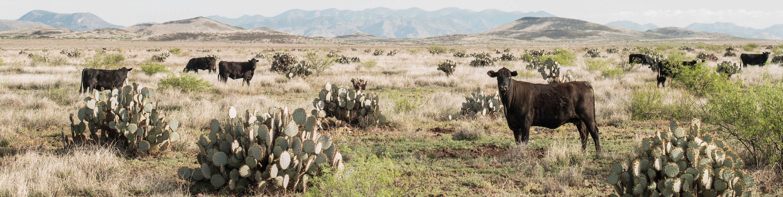
Purpose & Goal
Purpose of the Decision Support Tool
  Outlines the state’s strategic framework for prioritizing animal vaccinations.
  Develop a tool to inform and guide decision-making following the initial stamping out of livestock within the 10km (6.2mi) buffer of the State’s index case.
Goal of Vaccination Strategy
  Suppress virus replication in high-risk, susceptible animals by rapidly vaccinating a high proportion of the at-risk population, thereby arresting the spread of the disease.
Source: The Nature Conservancy

Slide 8
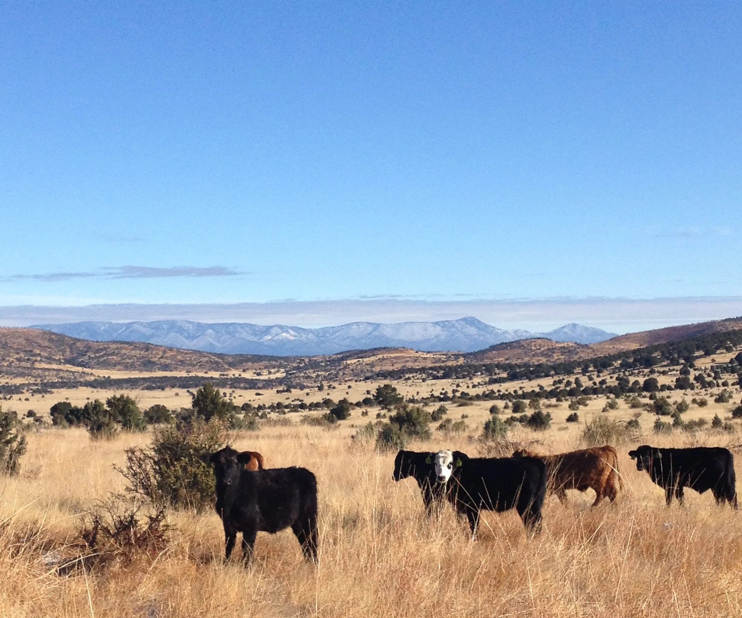
Context Setting – Assumptions
Index Case: New Mexico
Species Prioritization: Cattle, including calves, dairy, and feedlots (high-density operations) are prioritized.
Initial Stamp-Out: Animals within or near the index case (10km buffer) have been stamped-out. NMDA has shifted to modified response strategies.
Vaccine Scarcity: Vaccine availability may be limited depending on the outbreak's scale, potentially affecting at-risk animal populations.
Source: High Country News
Notes:
Species prioritization: cattle would be prioritized, including calves, dairy operations, and feed lots (i.e., high density).
Initial Stamp-Out: Animals within or near (e.g., 10km buffer) the index case/herd have been stamped-out and NMDA has transitioned to the modified response strategies (See Response Strategies).
Vaccine Scarcity: Depending on the severity of the outbreak (i.e., regional versus national outbreak), sufficient vaccine may not be available to vaccinate designated or at-risk animal populations.
Unified Command: Use of emergency vaccination will be determined by the Unified Incident Command, the State Animal Health Official(s), and the relevant USDA officers (e.g., Regional Emergency Coordinator, Veterinary Services Deputy Administrator/U.S. Chief Veterinary Officer).
Distribution: The State and responding agencies maintain the ability to efficiently transport vaccines (once received) throughout the state, preserving the cold chain (e.g., maintaining appropriate storage temperatures) and vaccine efficacy.
Participating Agencies: Roles and responsibilities of responding agencies may change depending on the severity/scale of the outbreak. Non-traditional partners/agencies may be leveraged to surge resource and support operational needs (e.g., transportation, distribution, administration, depopulation).

Slide 9
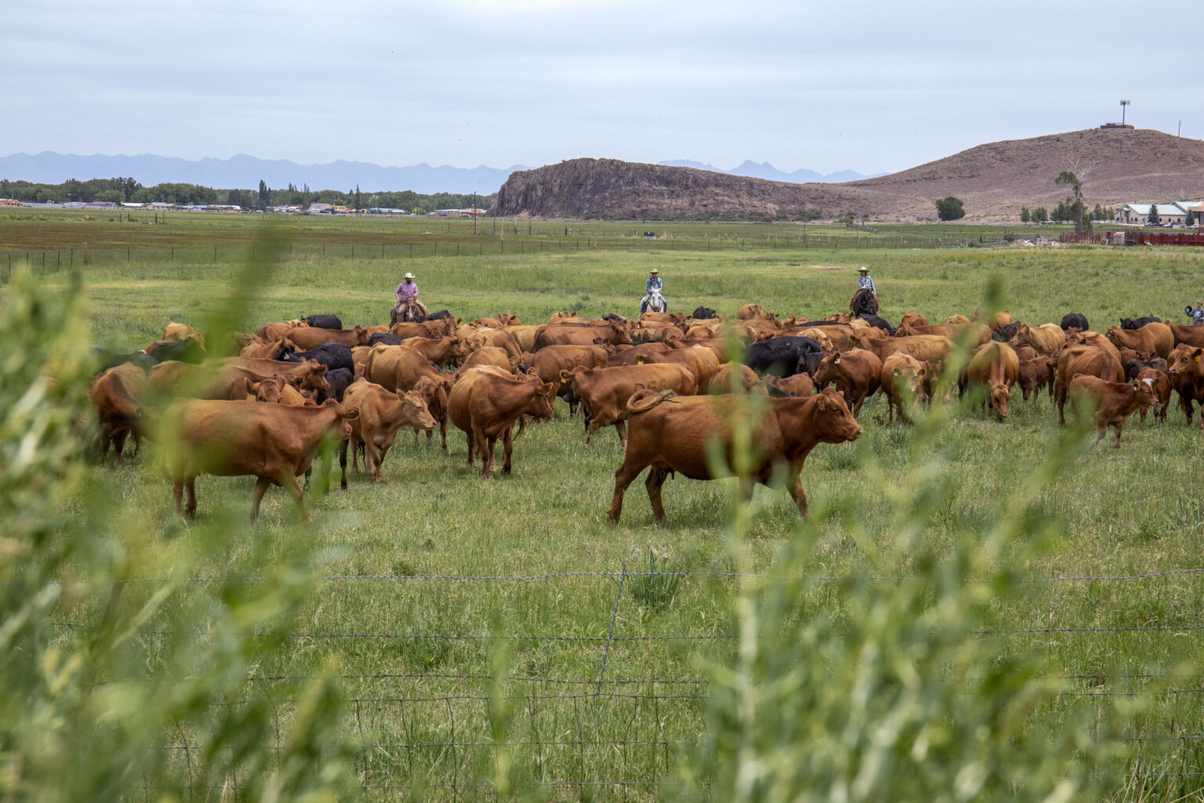
Context Setting – Assumptions (Cont.)
Unified Command: Emergency vaccination decisions are made by the Unified Command, State Animal Health, and relevant USDA officers (e.g., Regional Emergency Coordinator, Veterinary Services Deputy Administrator).
Distribution: Agencies are prepared to efficiently transport and store vaccines, maintaining cold chain integrity.
Participating Agencies: Roles may change based on outbreak scale; non-traditional partners may be involved to support resource and operational needs (e.g., transportation, distribution, depopulation).
Source: https://sourcenm.com/2024/06/25/nm-joins-three-states-begin-voluntary-testing-for-bird-flu-in-dairy-farm-milk-tanks/
Notes:
Species prioritization: cattle would be prioritized, including calves, dairy operations, and feed lots (i.e., high density).
Initial Stamp-Out: Animals within or near (e.g., 10km buffer) the index case/herd have been stamped-out and NMDA has transitioned to the modified response strategies (See Response Strategies).
Vaccine Scarcity: Depending on the severity of the outbreak (i.e., regional versus national outbreak), sufficient vaccine may not be available to vaccinate designated or at-risk animal populations.
Unified Command: Use of emergency vaccination will be determined by the Unified Incident Command, the State Animal Health Official(s), and the relevant USDA officers (e.g., Regional Emergency Coordinator, Veterinary Services Deputy Administrator/U.S. Chief Veterinary Officer).
Distribution: The State and responding agencies maintain the ability to efficiently transport vaccines (once received) throughout the state, preserving the cold chain (e.g., maintaining appropriate storage temperatures) and vaccine efficacy.
Participating Agencies: Roles and responsibilities of responding agencies may change depending on the severity/scale of the outbreak. Non-traditional partners/agencies may be leveraged to surge resource and support operational needs (e.g., transportation, distribution, administration, depopulation).

Slide 10
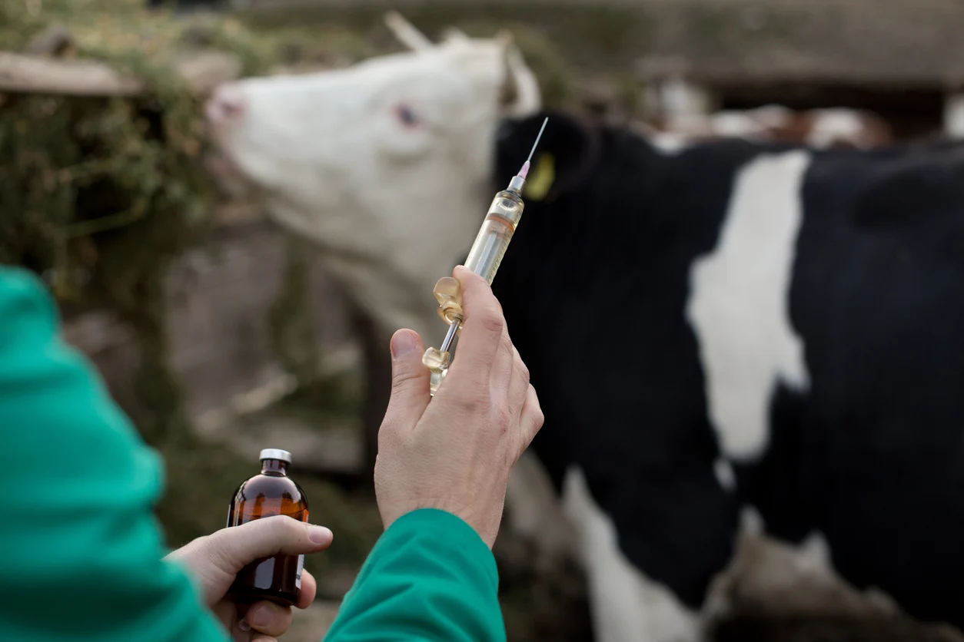
Vaccination Strategies Available
Vaccinate-to-Live
  Depopulation of clinically affected and in-contact susceptive animals and the vaccination of at-risk animals without subsequent depopulation or processing (i.e., not within 6 month of slaughter/harvest).
Vaccinate-to-Slaughter
  Depopulation of clinically affected and in-contact susceptive animals and the the vaccination of at-risk animals within 6 months of slaughter and processing.
Source: Ruminants Blog

Slide 11
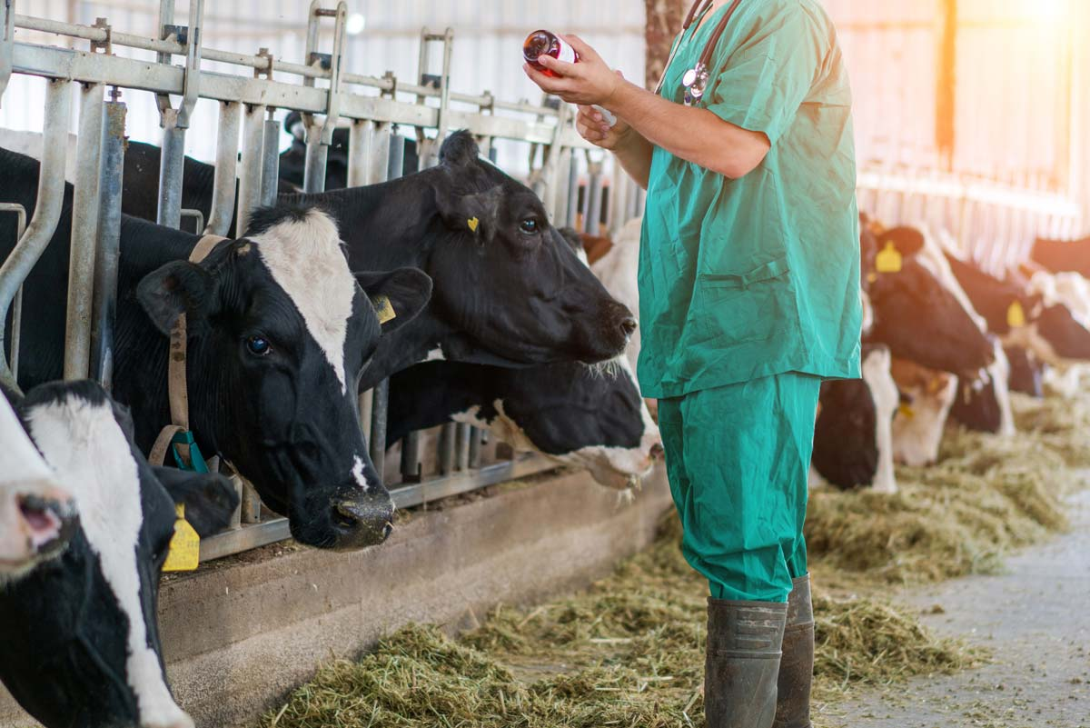
Vaccination Strategies Available
Vaccinate-to-Kill
  Depopulation of clinically affected and in-contact susceptible animals and vaccination of at-risk animals, with subsequent depopulation and disposal of vaccinated animals.
  Assumed limited to no depopulation or carcass management capacity and no processing capacity.
Depopulation (Without Vaccination)
  The rapid destruction of affected and in-contact susceptible animals and vaccinated at-risk animals.
  Assumed carcass management capacity, indemnity, and animals are not within 6 months of slaughter/processing.
Source: https://vet-advantage.com/vet-advantage/looking-beyond-the-antigen-in-livestock-vaccines-to-adjuvants/
Source: Ruminants Blog

Slide 12
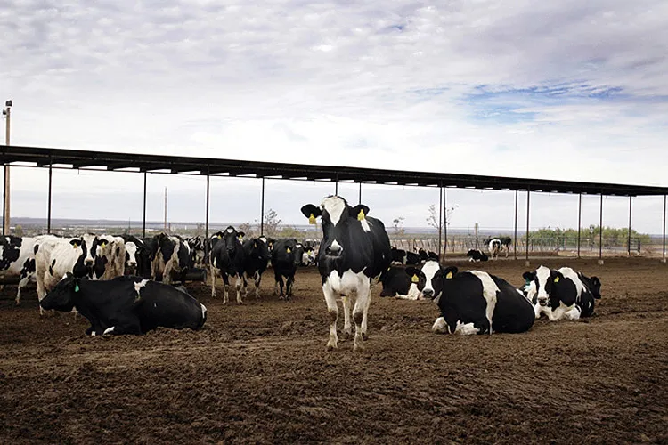
Decision Characteristics/Factors
Proximity
  Prioritize animals near the index case (within 10km) to contain spread.
Density Concerns
  Target high-density herds where transmission risk is greatest.
Calves
  Focus on calves with underdeveloped immunity to reduce illness and death.
Time-to-Slaughter
  Prioritize cattle within 6 moths of slaughter for vaccinate-to-slaughter strategies.
Reproductive Status
  Protect pregnant and lactating cows to maintain herd productivity.
Source: High Country News
Notes:
Proximity
Prioritizing the vaccination of animals near an index case or population (i.e., within or near the 10km buffer zone following initial stamp out procedures) can help contain disease spread more effectively.
Density Concerns
High herd density can facilitate the rapid spread of diseases in crowded conditions.
Calves
Calves are often more susceptible to diseases than adult animals due to their developing immune systems. Prioritizing vaccination for calves can help reduce disease-related morbidity and mortality in this age group, ensuring the future health and productivity of the herd.
Time-to-Slaughter
Cattle should be protected for 6 months with one dose before a booster is required. It is for this reason that animals within 6 months of being slaughtered should be prioritized under the vaccinate-to-slaughter/harvest response strategy.
Reproductive Status
Vaccine prioritization based on reproductive status is a function of business continuity and herd composition: pregnant cows, lactating cows,

Slide 13
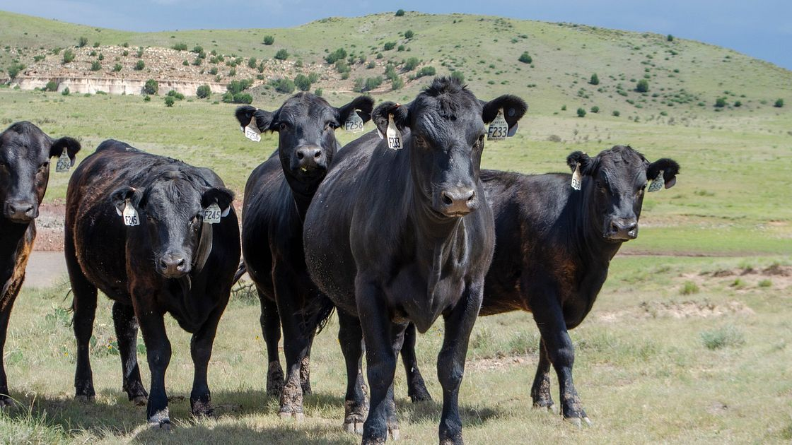
Decision Characteristics/Factors (Cont.)
Biosecurity Planning
  Incentivize biosecurity plans to build a network of disease controls. Plans are required for vaccine approval; existing plans help.
Relevant Infrastructure
  Prioritize vaccination at sites with handling facilities (e.g., chutes) for safe and efficient delivery.
External Exposure Concerns
  Natural barriers can limit disease spread, but build infrastructure (e.g., highways) may increase risk.
Genetic Significance
  Consider genetics when prioritizing vaccinations to maintain herd resilience.
Source: https://www.beefitswhatsfordinner.com/map/new-mexico

Slide 14
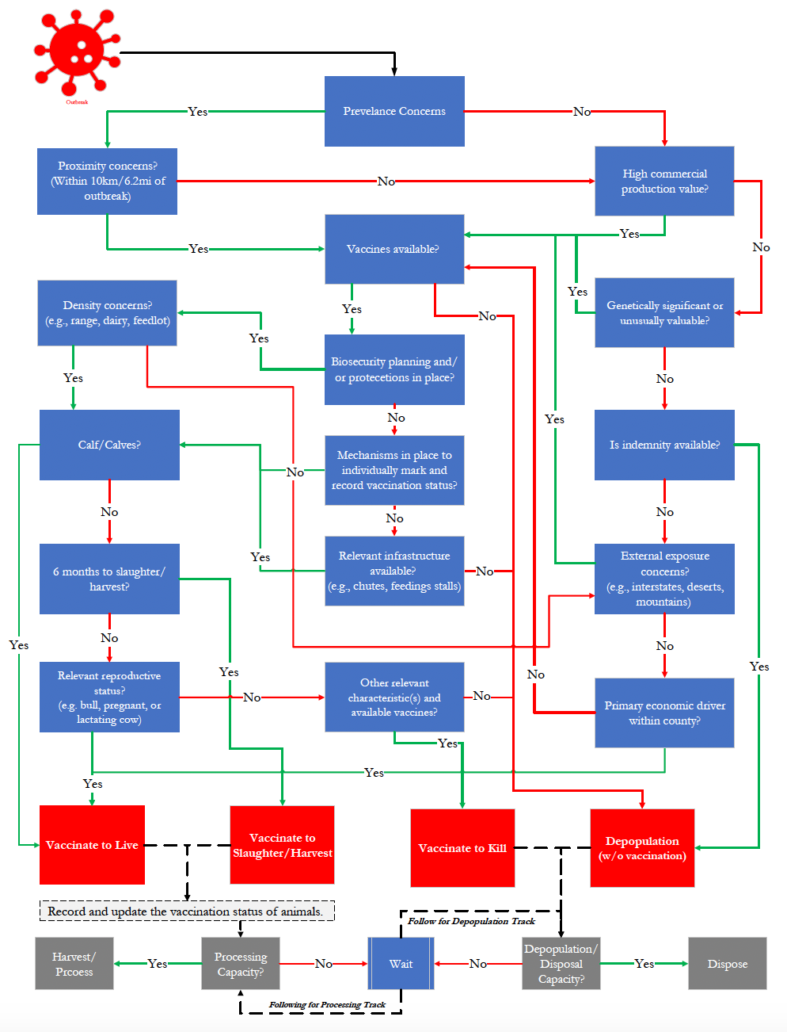
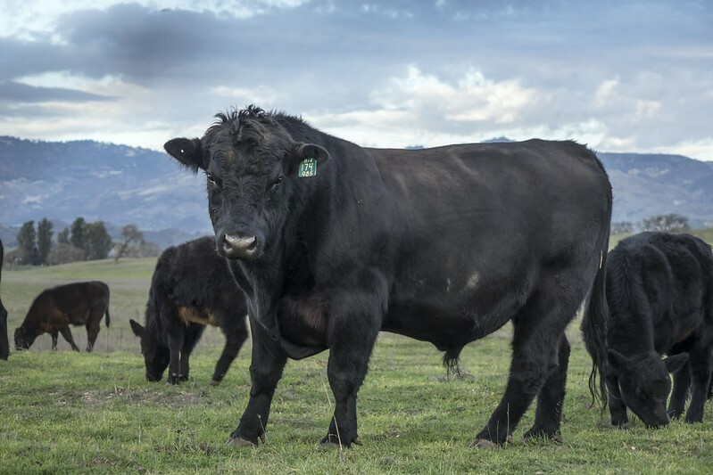
Scenario Walk Trough
Award winning angus beef stock located in neighboring county from index population, vaccines are not yet available within the state, questions remain on indemnity, and there is limited disposable capacity.
Soure: https://www.thecattlesite.com/breeds/beef/7/aberdeen-angus/

Slide 15
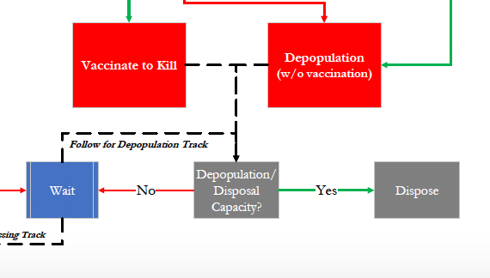
Scenario Walk Through – Results
Award winning angus beef stock located in neighboring county from index population, vaccines are not yet available within the state, questions remain on indemnity, and there is limited disposable capacity.
Answer: Depopulate
Prevenance Concerns?
  Yes
Proximity Concerns?
  No
High Comm Prod Value?
  Yes
Genetic significance?
  Yes
Vaccine Availability?
  No

Slide 16
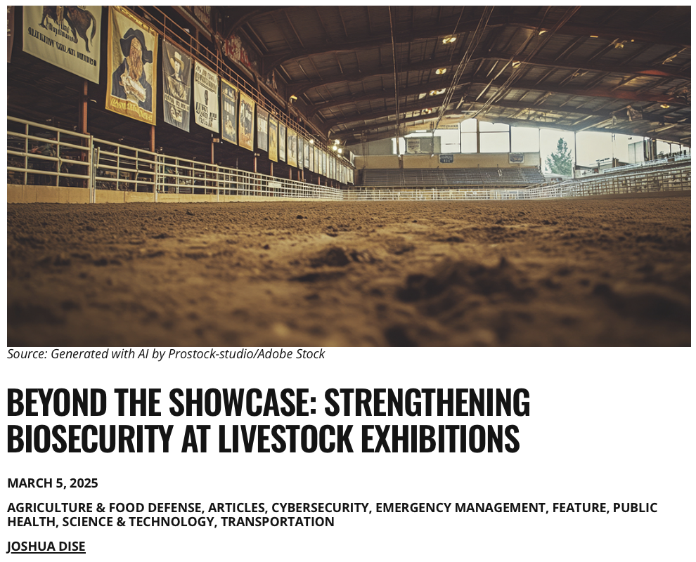
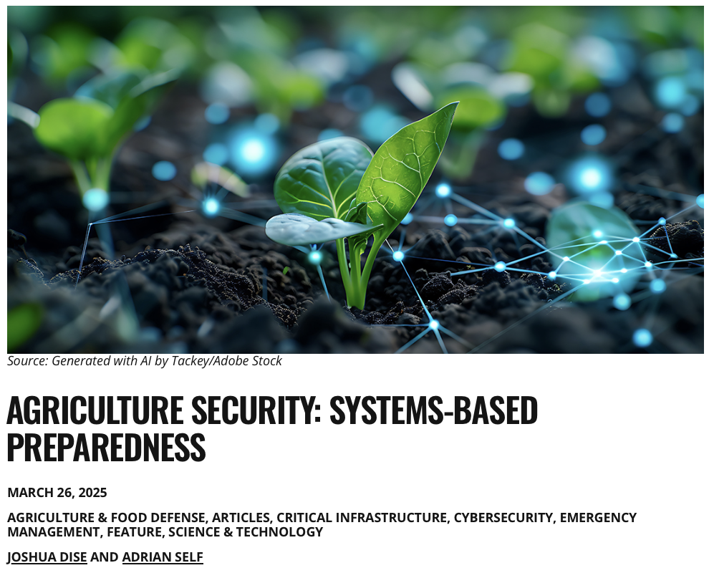
Domestic Preparedness Journal
Beyond the Showcase: Strengthening Biosecurity at Livestock Exhibitions
Agriculture Security: Systems-Based Preparedness

Slide 17
Beyond the Showcase…
High-Risk Settings: Fairs, rodeos, and shows bring thousands of animals together—raising disease risks that threaten agriculture, trade, and public health.
Animal Movement: Transporting livestock across states increases spread risk. Health checks (CVIs) help but can miss issues like incubation periods and subclinical infections.
Outbreak Impact: Past outbreaks (HPAI, VSV, RHD) have forced event cancellations, hurting economies, trade, and youth programs.
Biosecurity Actions:
  Before: Limit access, require health checks, separate species.
  During: Monitor animals, clean regularly, separate equipment.
  After: Disinfect, monitor health, manage waste properly.
Shared Responsibility: Producers, vets, regulators, and event planners must work together to protect animals, public health, and the future of events.

Slide 18
Agriculture Security…
Rising Demand: Nearly 10 billion people by 2050 → ~50% more food needed.
Protecting Agriculture: Safeguard crops, livestock, fisheries, and inputs from natural, biological, and cyber threats.
Key Threats:
  Natural: Extreme weather, droughts, floods, wildfires.
  Biological: Livestock diseases, crop pests, invasive species.
  Technological: Cyberattacks on IoT, AI, supply chains, and data systems.
External Pressures: Trade disruptions, market volatility, labor shortages, geopolitical instability.
Systems-Based Approach:
  Interconnected risks → cascading impacts across food systems and infrastructure.
  Requires integrated biosecurity and cross-sector planning.
  Relies on collaboration across diverse stakeholders.

Slide 19
Foundational Competency Summary
# | Competency | Description
7 | Assess population needs, assets and capacities that affect community health. | Evaluated agricultural vulnerabilities in New Mexico, focusing on livestock, trade, and infrastructure to inform FAD and mortality response planning.
9 | Design a population-based policy, program, project or intervention. | Created scalable vaccination and carcass management plans to protect livestock, limit economic loss, and maintain food system stability.
13 | Propose strategies to identify stakeholders and build coalitions and partnerships for influencing public health outcomes. | Formed cross-sector partnerships with agencies, industry, tribes, and environmental groups to strengthen coordinated response.
21 | Perform effectively on interprofessional teams. | Collaborated with veterinary, public health, and environmental professionals to develop integrated response strategies.
22 | Apply systems thinking tools to a public health issue. | Connected animal health, waste management, and public health to design holistic, multi-system FAD response approaches.

Slide 20
Emphasis Competency Summary
# | Competency | Description
1 | Food Safety and Biosecurity | Evaluated strategies for carcass disposal and FAD vaccination to strengthen food safety and biosecurity across animal and plant sectors. Emphasized prevention of disease spread and protection of public health.
2 | Threats to the food system | Investigated animal disease threats—particularly FADs and mass mortality—and proposed mitigation strategies including emergency vaccination and disposal planning to reduce public health and economic impacts.
3 | Food safety laws and regulations | Highlighted the roles of USDA, APHIS, and other regulatory bodies in emergency response, vaccine approval, and enforcement of movement restrictions to ensure food system integrity.
4 | Food safety policy and the global food system | Analyzed how U.S. biosecurity and food safety policies intersect with global trade and international standards, particularly in border states like New Mexico, where coordination is critical to disease prevention.
5 | Multidisciplinary Leadership | Demonstrated the importance of cross-sector collaboration among regulators, veterinarians, producers, and international partners to align technical needs and manage food system risks effectively.

Slide 21
Noteworthy Courses & Experiences
Coursework at K-State
  Food Protection and Defense (FDSCI 731)
  Globalization, Cooperation, and the Food Trade (DMP 888)
  Trade & Agricultural Health (DMP 816)
    Teaching Assistant and Guest Lecturer (Spring 2025)
Conferences & Other Experiences
  National Alliance of State Animal and Agricultural Emergency Programs Annual Meeting 2024
  Extension disaster Education Network Annual Conference 2024
  Cross Border Tabletop Exercise (Washington & British Columbia) 2023
Time in Manhattan, KS
  Essential Practices for BSL-3 Research Settings (DMP 690)
  Spent time with Dr. Kastner, discussing the program, next steps for ILE/APE, and general academic and professional future.
Notes:
Something that signals interaction with Kastner….

Slide 22

Recognitions
Dr. Ellyn Mulcahy, Director of K-State Public Health Program & MPH Committee Member
Marshal Wilson, Co-Director, Southwest Border Food Protection and Emergency Preparedness Center (NMSU/NMDA)
  ILE/APE Preceptor
Dr. Justin Kastner, Advisor & Committee Member
Dr. Abbey Nutsch, Professor & Committee Member
Dr. Jason Ackleson, Adj. Prof. & Committee Member
Notes:
Something that signals interaction with Kastner….

Slide 23

Thank you!
Questions?
Joshua Dise
jdise@ksu.edu
Notes:
Question from Kastner: converse with me about the top 1-3 causes of mortality in the US? (Latest MMWR)
Unique nature of NM and NMDA (unique model)?
Leadership (Creating multidiplinacy teams)
Social determinants of health in NM
Trade policy in NM and relationships with states
Morbidity and mortality
What are some food borne pathogens aof concern (listeria, ecoli, salmonella)
Differences between chemical hazard vs biological hazard

