Slide 1
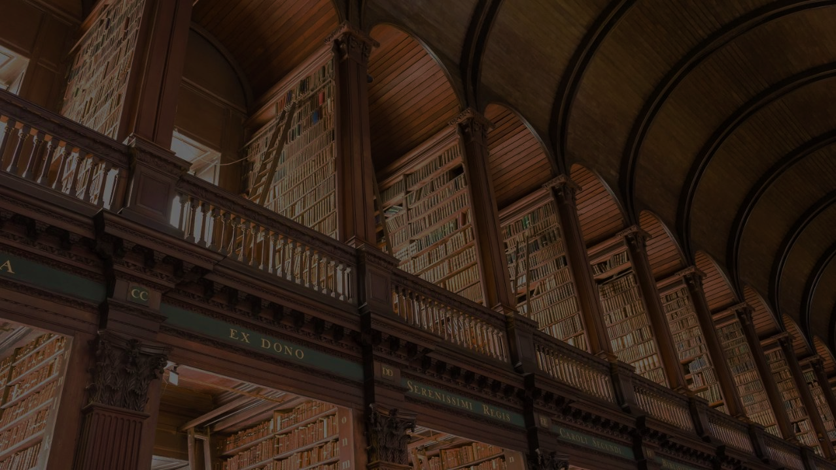
Enjoying "First Sale"
An Appreciation of Lending from Then to Now
Michelle Turvey-Welch, Head of Content Development
Elizabeth Berney, Content Development Librarian
Scott Kickbusch, Inter-Library Loan Coordinator
Gwendolyn Sibley, Copyright Librarian
Ryan Otto, Digital Scholarship Librarian
Carolyn Jackson, Open Educational Resources Librarian

Slide 2
A primer Hypothetical
    What does the library world look like without first sale?

Slide 3

In the Beginning: First Sale

Slide 4
An individual who knowingly purchases a copy of a copyrighted work from the copyright holder receives the right to sell, display or otherwise dispose of that particular copy, notwithstanding the interests of the copyright owner.
“
”
- 17 U.S.C. § 109(a) & (c)
Aka "First Sale"

Slide 5

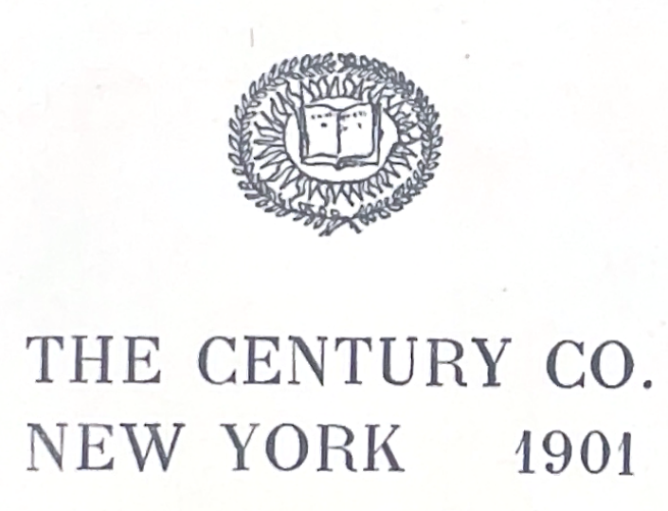
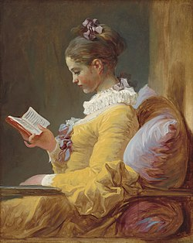


First Sale Doctrine: For Readers
Publishers Sell Books
Readers Own Books

Slide 6
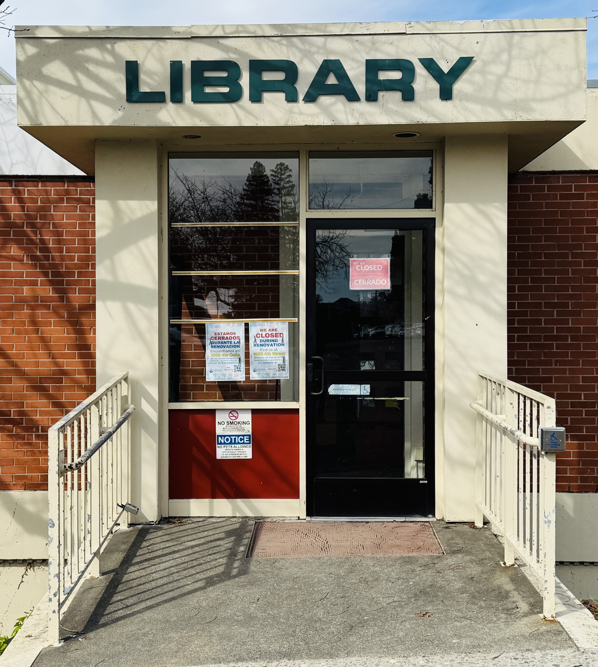
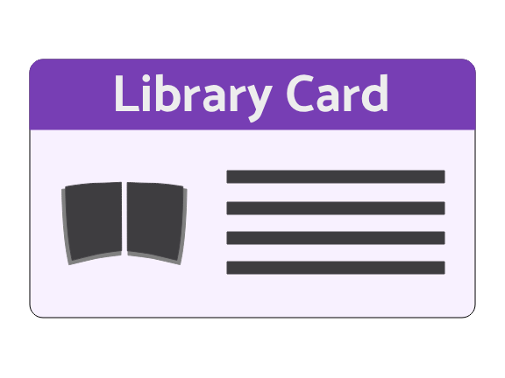

First Sale Doctrine: In Libraries
Libraries also buy books!
Libraries lend based on First Sale
Notes:
https://commons.wikimedia.org/wiki/File:San_Rafael_Public_Library_-_February_2025_-_Sarah_Stierch_02.jpg
https://commons.wikimedia.org/wiki/File:Illustration_of_Reading_Wikipedia_in_the_Classroom_30.png

Slide 7
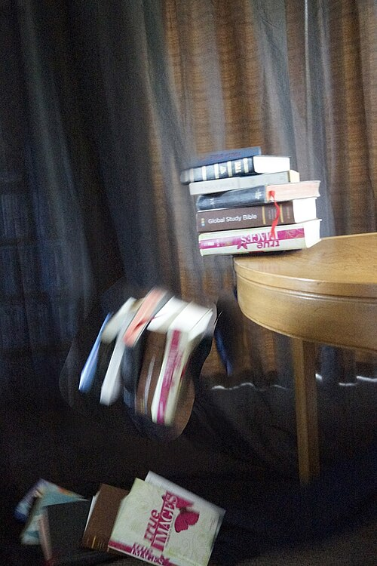
Then along came
Digital Media.
Notes:
https://commons.wikimedia.org/wiki/File:Falling_books_(33263680834).jpg

Slide 8
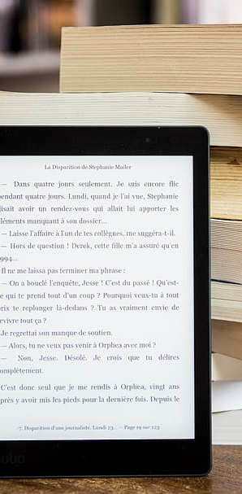
Digital Media & First Sale
Print is Simple
  Libraries Buy, Lend, Weed, Repeat.
Digital is Complex
  Libraries do not own "particular copies" of digital media, so first sale does not apply
  Lending must be agreed upon through licensing contracts as opposed to support through federal law.

Slide 9

Development of Collections
Licenses , Vendors, and Interlibrary loan

Slide 10
Inter Library Loan Trend
With First Sale
  Lending the whole book
  Less restrictions
  Wider access
  Simpler to obtain
Without First Sale
  May not be able to lend at all
  May or may not be able to lend the whole book
  May only be able to lend chapters if a book
  Potentially creates haves vs. have nots
  More complex interlibrary loan process

Slide 11
Print book acquisition models
Firm ordering
Approvals plans
Standing orders
Gifts
Deposits

Slide 12
Digital book acquisition models
Firm ordering
Electronic approvals
Subscription models
Patron-driven acquisitions or Demand-driven acquisitions (DDA)
  Deposit model with user driven selections
Evidence-based acquisitions (EBA)
  Deposit model with librarian driven selections informed by usage

Slide 13
Select digital book Open Access acquisition models
Direct to open (funding goal met, content becomes open)
Freemium (free to download and read content, print on demand for fee)
  National Academies Press (some exceptions but majority freemium)
Membership support for open access books
  DOAB
Pure open access with no acquisitions model involved

Slide 14
How do current print models differ from digital?
Licensing!
The license (contract) determines how the content can be used, whether there is interlibrary loan, how many folks can use the content at a time, etc.

Slide 15

Let's Talk Licenses
Contracts/agreements that permits authority to own, do, or use something.
© is a bundle of rights
Rights holders can transfer or license any of their exclusive rights, including portions of those rights.

Slide 16
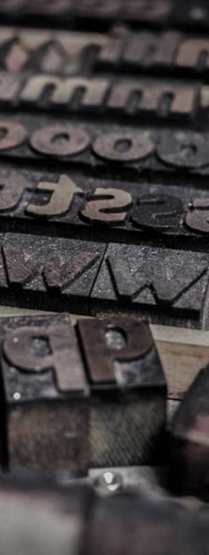
Library Publishing

Slide 17
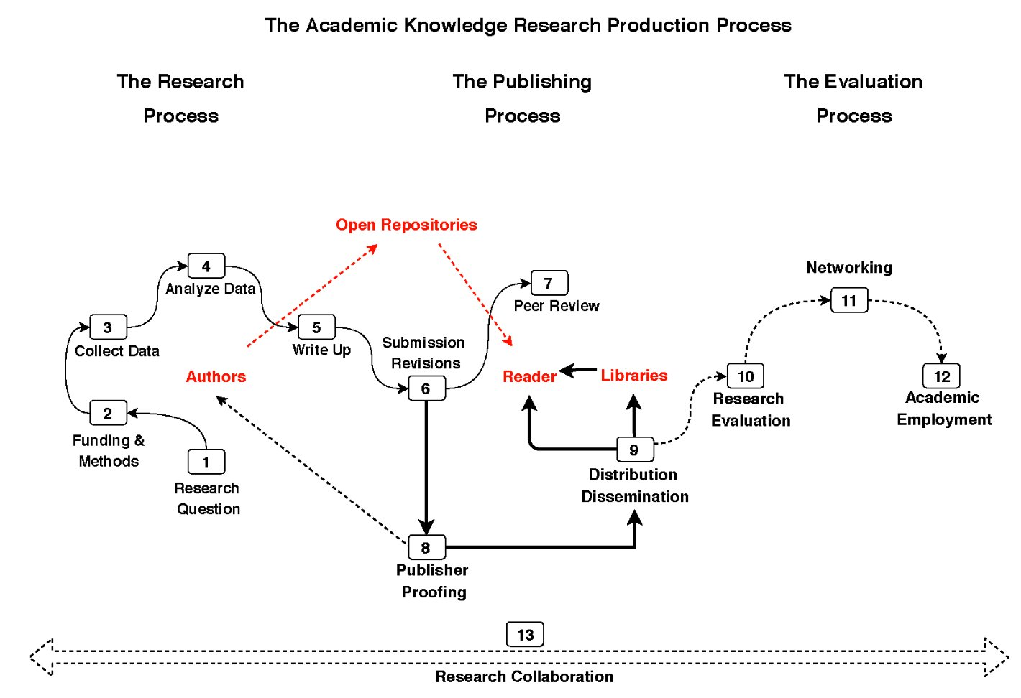
Alejandro Posada, George Chen. Inequality in Knowledge Production: The Integration of Academic Infrastructure by Big Publishers. Leslie Chan; Pierre Mounier. ELPUB 2018, Jun 2018, Toronto, Canada. 〈10.4000/proceedings.elpub.2018.30

Slide 18

Libraries as
Publishers
Adelphi University | Columbia University
Atla | Dartmouth College
Atlanta University Center | Dublin Business School
Boston College | Emory University
Brown University | Florida State University
California Digital Library | George Mason University
Carnegie Mellon University | Grand Valley State University
City University of New York (CUNY) | Indiana University
Claremont Colleges Library | Many of our own KBOR Institutions

Slide 19

Open Licenses
Nonrevocable, open licenses like Creative Commons, though not first sale, helps solve the permanence of access and use issue with digital objects.
Still higher overhead than first sale
  Expertise to aid creation, use, access, and storage

Slide 20
Open Access Licensing
Author
Journal/Library
The General Public
Perpetual Library Access and Use
Creative Commons License
License to Publish

Slide 21

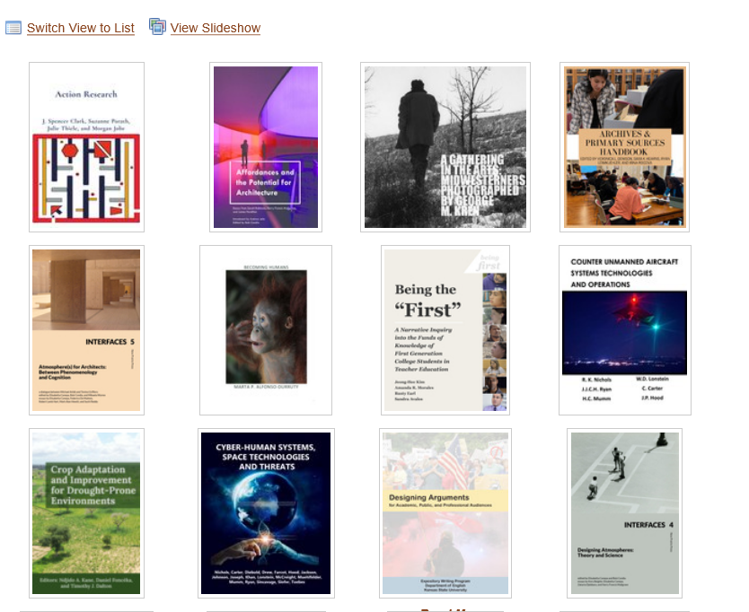
Around one million downloads a year
7 Million downloads since 2013
18,700 Items
49 Monographs
19 Active or in process journals
7 Inactive or archived journals

Slide 22
Considerations & Opportunities
Considerations
Limited services means heavy reliance on monograph authors and journal editorial teams.
Is library publishing sustainable long-term? "Maybe"
Is a distributed publishing environment a pro or a con? "Yes"
  Copyright enforcement
  Can pick up where someone left off
Opportunities
Cooperation among institutions/Efficiencies of Scale
Improving platforms
A growing and strengthening community

Slide 23

What are your thoughts?
Do you think ENJOYING FIRST SALE has an important place in today’s education system?

Slide 24

Discussion questions?
What does a shift away from first sale mean for the future of academic libraries?
What are the implications for independent scholars outside of the academy?
Are there any implications for future scholarly works?
How do we work with vendors to make scholarship widely available in the future?
What changes in ILL have you seen at your institution?
What support does your institution have for Open Education Resources?
WHAT ARE YOUR THOUGHTS?
  Do you think ENJOYING FIRST SALE
  has an important place in today’s education system?

Slide 25
Discussion questions?
How is your monograph collecting split between print monographs vs. electronic monographs?
What are your biggest ILL concerns regarding electronic monographs?
Are you actively diversifying your buying strategies?
What have the changes meant for your ILL services?
How are you approaching contracts in light of requests for whole book exports?
Are you internally discussing the changes in the landscape in your library?
What are your strategies for educating faculty around the evolving monograph publishing landscape?
WHAT ARE YOUR THOUGHTS?
  Do you think ENJOYING FIRST SALE has an important place in today’s education system?

