Slide 1
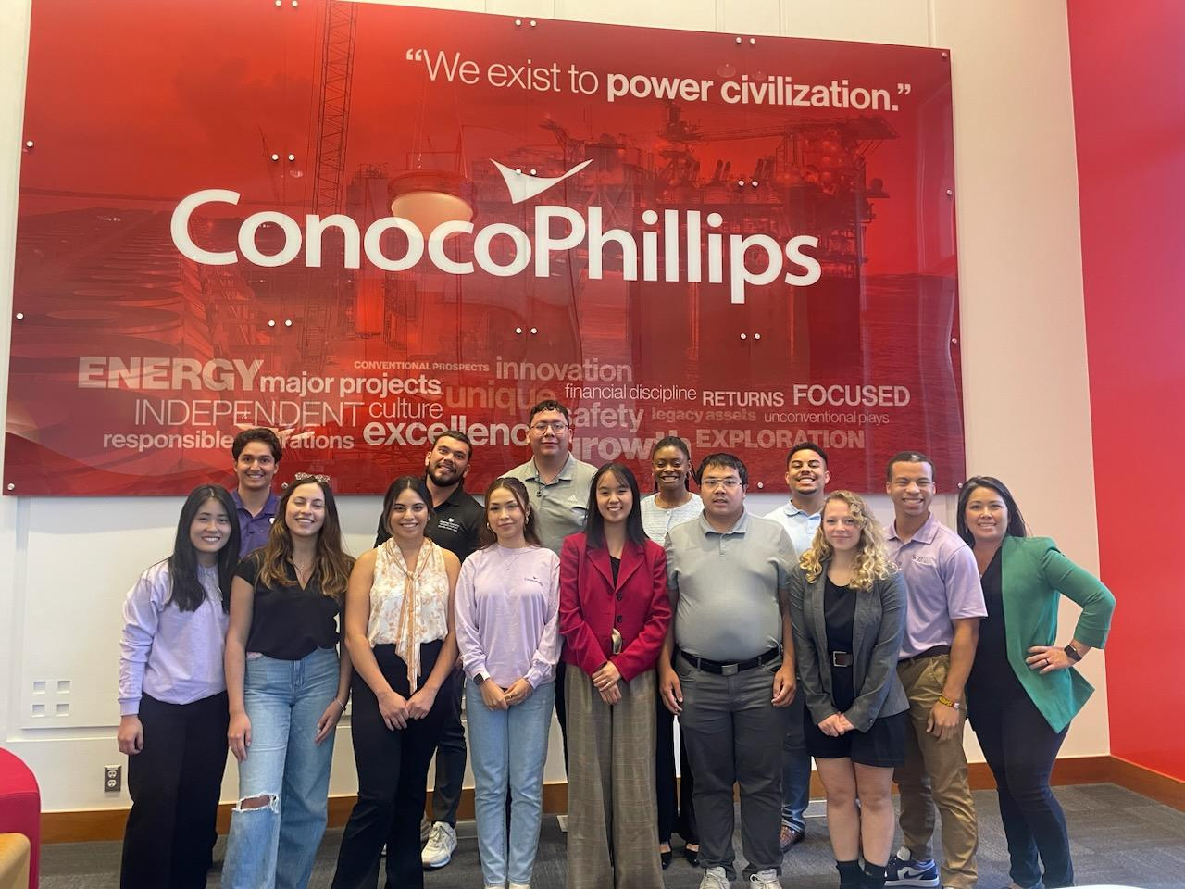
Development of a wellness program and supporting materials for Rise up scholars
Harold Wilcox

Slide 2
Agenda
Problem
Rise Up Wellness
APE & Objectives
Theoretical Approach
Integration
Products
Results
Discussion
Conclusion

Slide 3
Problem
47.1% of college students meet physical activity guidelines (4)
Sedentary behavior significantly contributes towards obesity and causes significant mental and physical health issues (2)
A study of eight campuses across the U.S. showed overweight and obesity rates 30.3% and 10.5% respectively (4)
24.2% of adults meet PA guidelines and have reached an obesity rate of 41.9% (1,7)
Cost to employer
obese individuals have a higher annual cost of $2,640 more than an employee with a healthy weight (9)

Slide 4
Intervention at the College Level
College is a pivotal time where students establish lifelong habits
During this period, students in business programs often engage in academic routines that mimic future office jobs—long hours of sitting, limited physical activity, and high levels of stress
This susceptibility is further underscored in students from marginalized backgrounds
Crucial environmental intervention point for public health professionals to address sedentary behavior

Slide 5
Rise Up Scholars
Scholarship program for College of Business students to develop leadership skills and provides resources for career development
College of Business students seeking a certificate or any level of degree can join
100% job or internship attainment 3 months post graduation
Seeks students committed to belonging and diversity in the work environment as many of the students identify with a marginalized background

Slide 6


Rise Up Wellness (RUW)
An extension of Rise Up focused on providing students with access to the resources needed to establish health behaviors
Voluntary participation that qualifies as part of Rise Up “above and beyond” status
Aims to establish healthy habits as a professional skill
Weekly sessions alternating between practical sessions and educational seminars

Slide 7
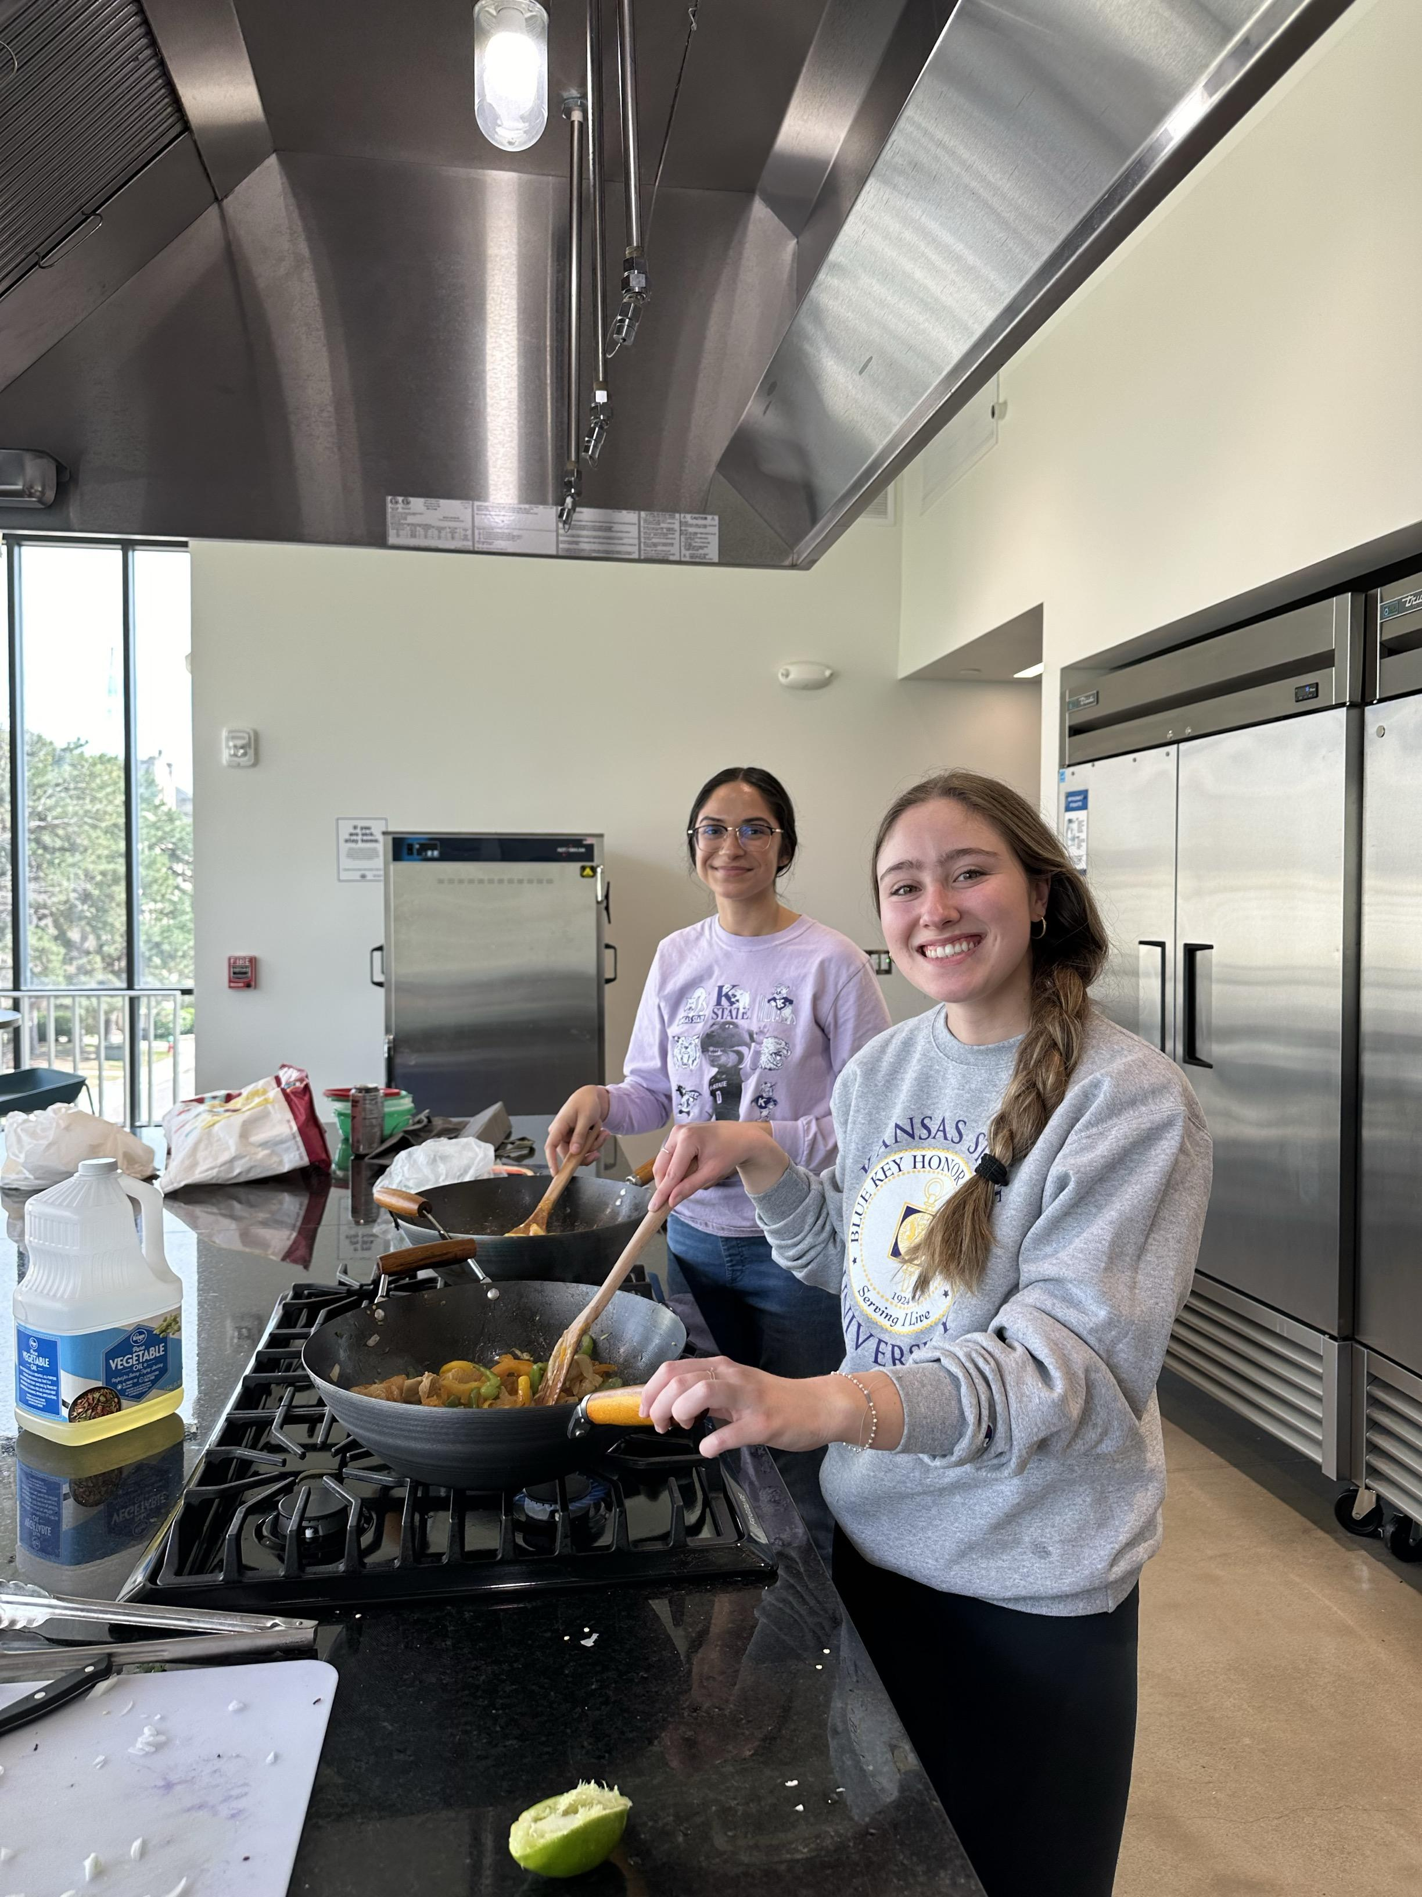
RUW- Applied Practice Experience (APE)
Decrease sedentary behavior and increase PA
Capture future employees at a stage where they can establish a strong foundation of health behaviors that survive the transition into the workforce
Provide programing using evidence-based approaches to increase PA via knowledge, skills and self-efficacy
Develop a sustainable wellness program that could be easily managed by future directors and effectively engage Rise Up students in health-promoting behaviors

Slide 8

Learning Objectives for APE
Program Design and Evaluation
Utilization of Health Behavior Theories
Enhance Written and Verbal Health Communication Skills
Interdepartmental Collaboration
Project Management
Development of Marketing Materials

Slide 9

Theoretical Constructs
SCT (Social Cognitive Theory)
SDT (Self Determination Theory)
Integration accounts for the unique setting of College of Business and Corporate structures these students will be experiencing

Slide 10
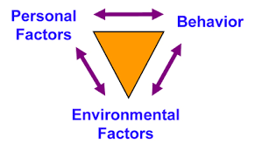
Social Cognitive Theory
Predicts that much of human learning occurs in social environments
Enactive and vicarious learning
Based on reciprocal interaction
Forethought, performance, and self-reflection phases
Self-Efficacy
Self-efficacious students believe their actions will result in positive outcome; this keeps them motivated
Outcome expectations can sustain goal-directed actions over lengthy periods when people believe their actions will eventually produce desired outcomes
Schunk, D. H., & DiBenedetto, M. K. (2023). Learning from a social cognitive theory perspective. In Handbook of Educational Psychology (4th ed., pp. 94-107). Routledge.
Notes:
The forethought phase precedes learners’ actions and includes processes such as setting goals and assessing self-efficacy for learning.
During the performance phase, learners implement strategies and control their attention to focus on the learning context.
The self-reflection phase, which occurs during breaks and after task completion, includes individuals’ responses to their efforts, such
as assessments of their learning progress and the effectiveness of their strategies.

Slide 11
Self Determination Theory
Amotivation: is a lack of intent to act
Extrinsic Motivation:
- External regulation- involves acting for rewards or to avoid punishment
- Introjected regulation- involves acting due to internal pressure, like guilt
- Identified regulation- means acting for personally meaningful reasons, like health
- Integrated regulation- is when these reasons align with one’s values
Intrinsic motivation: is acting because an activity is inherently enjoyable
SDT suggests that fulfilling basic psychological needs promotes intrinsic motivation
SDT also defines three types of motivation on a continuum from least to most autonomous
Self-Determination Theory (SDT) suggests that all people have three core psychological needs—autonomy, relatedness, and competence
Edmunds, J., Ntoumanis, N., & Duda, J. L. (2008). Testing a self‐determination theory‐based teaching style intervention in the exercise domain. European Journal of Social Psychology, 38(2), 375-388.

Slide 12
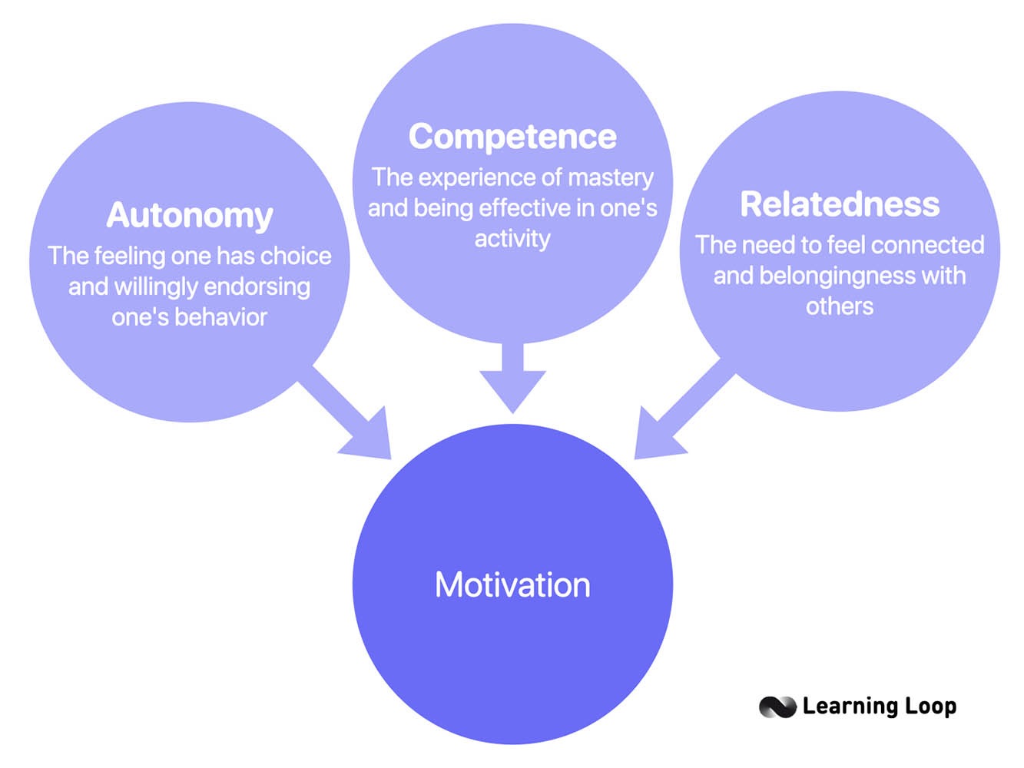
Self Determination Theory
Highlights three socio-contextual factors that influence psychological needs
Autonomy support: providing choices, meaningful rationales, acknowledging others’ perspectives, and minimizing pressure (encourages participants to make their own decisions)
Structure: clear behavior-outcome links, setting expectations, and offering feedback (goal-setting and clarifying expectations)
Interpersonal involvement reflects the quality of the relationship and dedication of time, energy, and care (instructor recognizes participants’ interests, addresses challenges, and maintains an encouraging and non-judgmental environment)
These components, when delivered with autonomy support, promote autonomous regulation, fostering more positive and sustainable outcomes
Edmunds, J., Ntoumanis, N., & Duda, J. L. (2008). Testing a self‐determination theory‐based teaching style intervention in the exercise domain. European Journal of Social Psychology, 38(2), 375-388.

Slide 13




Integration of Theories for Application
Environment
Self-Efficacy
SCT
A positive environment with access to resources has been directly linked to engagement in physical activity (6)
Interventions that target self-efficacy show higher levels of maintenance of PA (10)
SDT
Relatedness
Autonomy
Group based programs create a sense of belonging and support which leads to higher adherence of PA and increases in Self-Efficacy (5)
Utilization of autonomy in programs effectively nurtures intrinsic motivation, a key driver for maintaining physical activity over time (3)

Slide 14
Products & Competencies
Portfolio Product |  | # Competency Addressed
1 | Job Description | 18 | Select communication strategies for different audiences and sectors.
2 | Needs Assessment | 7 | Assess population needs, assets and capacities that affect communities’ health.
3 | Course Syllabus | 9 | Design a population-based policy, program, project or intervention.
4 | Director Checklist | 13 | Propose strategies to identify stakeholders and build coalitions and partnerships for influencing public health outcomes.
5 | Evaluation Plan | 11 | Select methods to evaluate public health programs.
6 | Marking Materials | 19 | Communicate audience-appropriate (i.e., non-academic, non-peer audience) public health content, both in writing and through oral presentation.

Slide 15
Directors Checklist
Competency # 13
RUW Informational Sessions Outline
Self-Efficacy: Educating students about exercise and providing them with SMART goal frameworks increases their confidence in setting and achieving realistic fitness goals. Personalizing goals helps them experience early successes, reinforcing self-efficacy.
Autonomy: Allowing students to create their own goals or work in groups supports their autonomy by giving them the freedom to set meaningful objectives based on personal preferences.
Environment: The seminar setting is conducive to learning and discussion, with all necessary materials prepared in advance. This organized environment supports a focus on planning for health behavior change.
Activity: Conduct a workout session focused on body weight exercises at the Student Recreation Center. Engage with students to set personal fitness goals for the semester during the first informational seminar (Week 4).
Self-Efficacy: Introducing body weight exercises provides a manageable starting point, allowing students to experience initial success and build confidence in their abilities. Encouragement during the session helps reinforce students' belief in their capacity to improve their fitness.
Autonomy: Students are encouraged to set personal fitness goals, which fosters a sense of control over their fitness journey. Allowing them to choose specific exercises or modify movements provides additional autonomy, enhancing intrinsic motivation.
Relatedness: The group setting encourages peer support and creates a sense of community, helping students feel connected and supported in their fitness efforts. Sharing goals and progress fosters a shared commitment to improvement.
Activity: Hold a seminar in the College of Business to discuss exercise foundations, such as CDC guidelines, types of exercise, and benefits. Provide SMART goal worksheets for individual or group use and then have students fill out copping planning worksheets to help them overcome potential barriers to exercise.
Week 4 - Session 2: Seminar (Introduction to Wellness and Goal Setting)
Week 3 - Session 1: Workout (Body Weight Exercises and General Fitness)

Slide 16
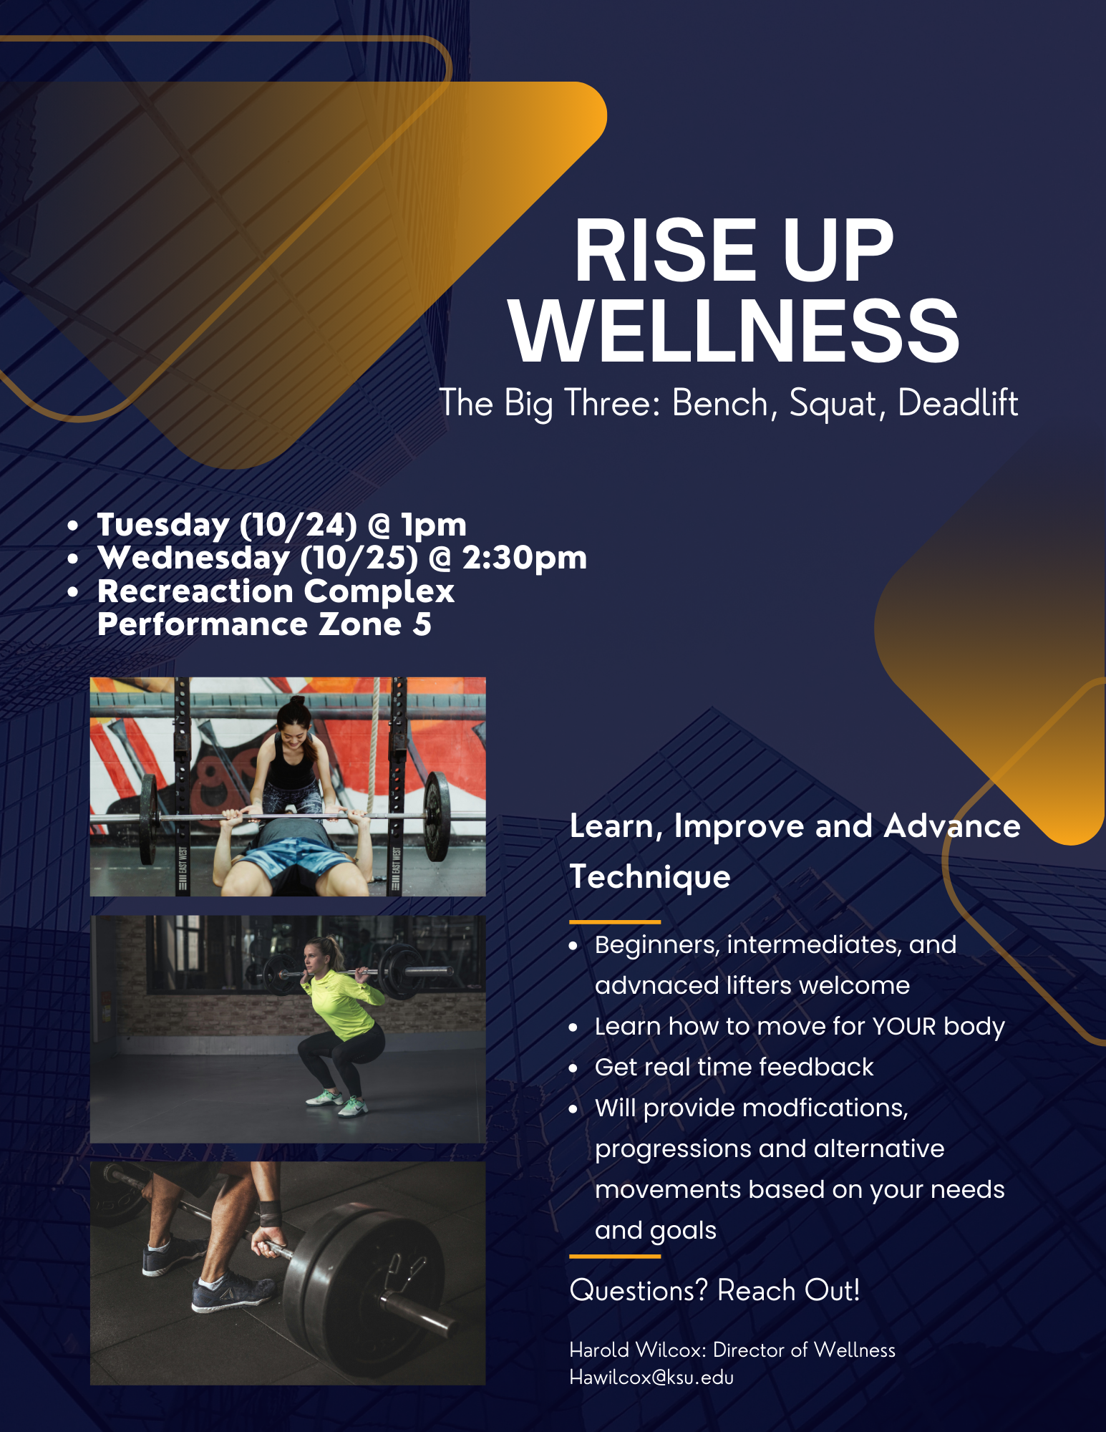
Marketing Materials
Competency #19
Promote the wellness seminars with the goal of reaching the diverse group of students, many of whom may not have a strong background in health or wellness
Written in clear, accessible language that emphasized the practical benefits of attending the seminars
This ensured that students, even in passing, could easily grasp the essential details of the event

Slide 17
Evaluation Plan
Competency #11
Assess both student outcomes and the performance of program director
Feedback is gathered to assess how well the sessions are received and identify areas where improvements in content delivery or session structure may be needed
The evaluation considers the director’s capacity to maintain and build upon the existing design and collaborations

Slide 18
Emphasis Competencies
MPH Emphasis Area: Physical Activity
Number and Competency |  | Description
1 | Population Health | Investigate the impact of physical activity on population health and disease outcomes. KIN 612
2 | Social, behavioral and environmental influences | Investigate social, behavioral and environmental factors that contribute to participation in physical activity KIN 610 and KIN 805
3 | Theory application | Examine and select social and behavioral theories and frameworks for physical activity programs in community settings KIN 610 and KIN 805
4 | Developing and evaluating physical activities interventions | Develop and evaluate physical activity interventions in diverse community settings. KIN 610 and KIN 805
5 | Support evidence-based practice | Create evidence-based strategies to promote physical activity and communicate them to community stakeholders. KIN 612

Slide 19
Results
The results of the project for the Rise Up Scholars wellness program reflect both the observations gathered over three semesters of program delivery and the actions taken to refine and formalize the program's design
Several key factors that influenced attendance, participation, and overall success of the program were identified:
Session Timing: As the week progressed, attendance declined
Autonomy vs. Commitment: Balance between offering flexibility and ensuring some level of commitment or incentive to encourage regular attendance
Content Delivery and Diversification: Condensed information and relied on guest facilitators to improve variety and enhance directors' interdepartmental utilization
Identified the need to integrate online tools; programed into the design via participation polls pre seminar, post-seminar survey, and accessible files to course content

Slide 20
Discussion
Findings
Limitations
The Rise Up program illustrates that wellness programs should not only be offered but also be carefully designed to align with students’ academic schedules and career aspirations
Recommends colleges consider integrating graded wellness components or provide tangible incentives such as wellness credits, or career-related rewards, to foster student engagement
Suggests that public health interventions in academic settings should be seen as integral to student development, not just an optional add-on
Future wellness programs could further develop digital tools to offer flexibility and streamline communication with students.
Behavior change requires significant effort and long-term commitment, and most individuals need consistent support, encouragement, and incentives to maintain these changes
This is a gradual process, and while autonomy can increase intrinsic motivation, it must be balanced with external motivation to ensure participation and long-term success
Consistency in program delivery and maintaining high levels of engagement are crucial for the program’s sustainability, but managing these relationships can be time-consuming and resource-intensive

Slide 21

Accomplishment of Objectives
Designed a wellness program and evaluation to a specific population utilizing evidence-based theories and practices
Enhanced written and verbal communication
Developed skills in marketing and promotion
Project management experience
Created collaborative relationships with:
- Student Recreation Center
- Multicultural Student Center
- Lafene Student Health Center
- KSU Dietetics Department
- Orange Sky Yoga Studio
- Other local businesses

Slide 22
Conclusion for APE
I demonstrated how public health theory and principles can be effectively applied in an academic setting, advancing our ability to address sedentary behavior among business students
The Rise Up Wellness program offers important lessons for promoting wellness among college students, particularly those preparing for sedentary office jobs
By integrating wellness into the academic experience, institutions can play a critical role in shaping the health and success of future generations
The insights gained from this project offer a roadmap for future programs aimed at reducing sedentary behavior in the future workforce, creating a larger impact on public health

Slide 23

Acknowledgements
Dr. Olivia Law-Delrosso
Dr. Gina Besenyi
Dr. Christina Bridges Hamilton
Dr. Ellyn Mulcahy
Dr. Trish Gott
Dr. Jessie Vipham
Dr. RJ Youngblood
Christian Larson
PARCS Lab
Judy Halloran

Slide 24
References
Centers for Disease Control and Prevention. (2023, February 28). Adult obesity facts. https://www.cdc.gov/obesity/php/data-research/adult-obesity-facts.html
Church, T. S., Thomas, D. M., Tudor-Locke, C., Katzmarzyk, P. T., Earnest, C. P., Rodarte, R. Q., ... & Bouchard, C. (2011). Trends over 5 decades in U.S. occupation-related physical activity and their associations with obesity. PloS One, 6(5), e19657.
Edmunds, J., Ntoumanis, N., & Duda, J. L. (2008). Testing a self‐determination theory‐based teaching style intervention in the exercise domain. European Journal of Social Psychology, 38(2), 375-388.
El Zein, A., Colby, S. E., Zhou, W., Shelnutt, K. P., Greene, G. W., Horacek, T. M., ... & Mathews, A. E. (2020). Food insecurity is associated with increased risk of obesity in US college students. Current developments in nutrition, 4(8), nzaa120.
Han, H., Pettee Gabriel, K., & Kohl III, H. W. (2017). Application of the transtheoretical model to sedentary behaviors and its association with physical activity status. PloS One, 12(4), e0176330.
Hardy, J., Eys, M. A., & Carron, A. V. (2005). Exploring the potential disadvantages of high cohesion in sports teams. Small Group Research, 36(2), 166-187.
Kang, S. M., Kim, S. H., Han, K. D., Paik, N. J., & Kim, W. S. (2021). Physical activity after ischemic stroke and its association with adverse outcomes: A nationwide population-based cohort study. Topics in Stroke Rehabilitation, 28(3), 170-180.
National Center for Health Statistics. (2022, April). Percentage of adults meeting physical activity guidelines for aerobic and muscle-strengthening activity: United States, 2020. Centers for Disease Control and Prevention. https://www.cdc.gov/nchs/products/databriefs/db443.htm
Odlaug, B. L., Lust, K., Wimmelmann, C. L., Chamberlain, S. R., Mortensen, E. L., Derbyshire, K., ... & Grant, J. E. (2015). Prevalence and correlates of being overweight or obese in college. Psychiatry Research, 227(1), 58-64.
Shinde, S., Tran, A. T., Jerry, M., & Lee, C. J. (2024, July 8). Work loss among privately insured employees with overweight and obesity in the United States. Obesity Science & Practice, 10(4), e775. https://doi.org/10.1002/osp4.775
Schunk, D. H., & DiBenedetto, M. K. (2023). Learning from a social cognitive theory perspective. In Handbook of Educational Psychology (4th ed., pp. 94-107). Routledge.
Tang, M. Y., Smith, D. M., McSharry, J., Hann, M., & French, D. P. (2019). Behavior change techniques associated with changes in postintervention and maintained changes in self-efficacy for physical activity: A systematic review with meta-analysis. Annals of Behavioral Medicine, 53(9), 801-815.

