Slide 1
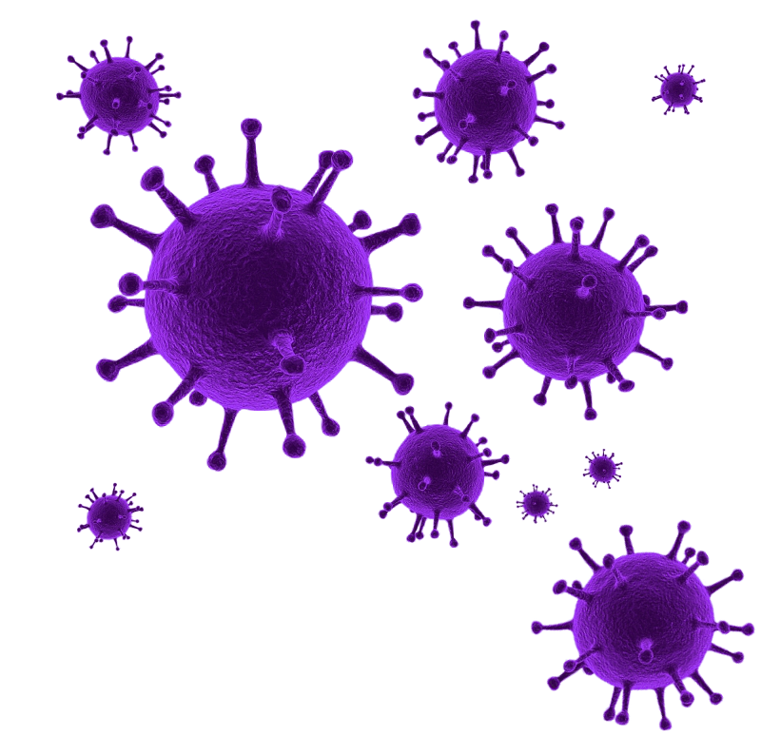
STRENGTHENING COMMUNICABLE DISEASE RESPONSE:
DEVELOPING QUARANTINE AND ISOLATION POLICIES AND TRAINING FOR DISEASE INVESTIGATIONS
by Reese Willis
MPH Candidate - Infectious Disease Control and Zoonoses
APE Site:
Jackson County Public Health (MO)

Slide 2


About Me
From Pittsburg, KS
Kansas State University ‘22
  B.S. Human Health Biology
  Track and Field Athlete
Kansas State University
  MPH Infectious Disease Control/Zoonoses ‘24
Pittsburg, KS
Notes:
Originally from pittsburg KS, - Go Purple Dragons
Came to Kansas-State in 2019 for my undergrad in human Health Biology and to throw hammer and weight for K-State T&F
After undergrad – I started here in the MPH IDZ in 2022 and hopefully after this week I will no longer be an MPH candidate but a MPH degree holder

Slide 3
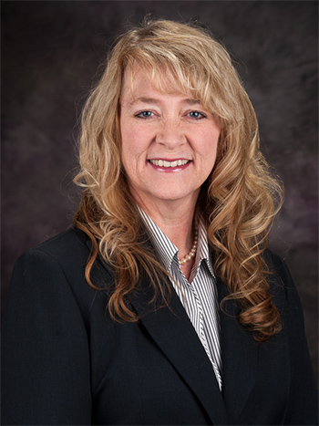

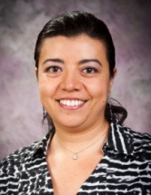
MPH Committee
Dr. Paige Adams
Dr. Justin Kastner
Dr. Perla Reyes C.
Major Professor
Committee Member
Outside Committee Member
Notes:
I would also like to acknowledge the members of my Committee, my major professor Dr. Adams, committee members Dr. Kastner, and Dr. Reyes. Your support and guidance throughout this process means so much and I legitimately would not be in the place I am without you all.

Slide 4
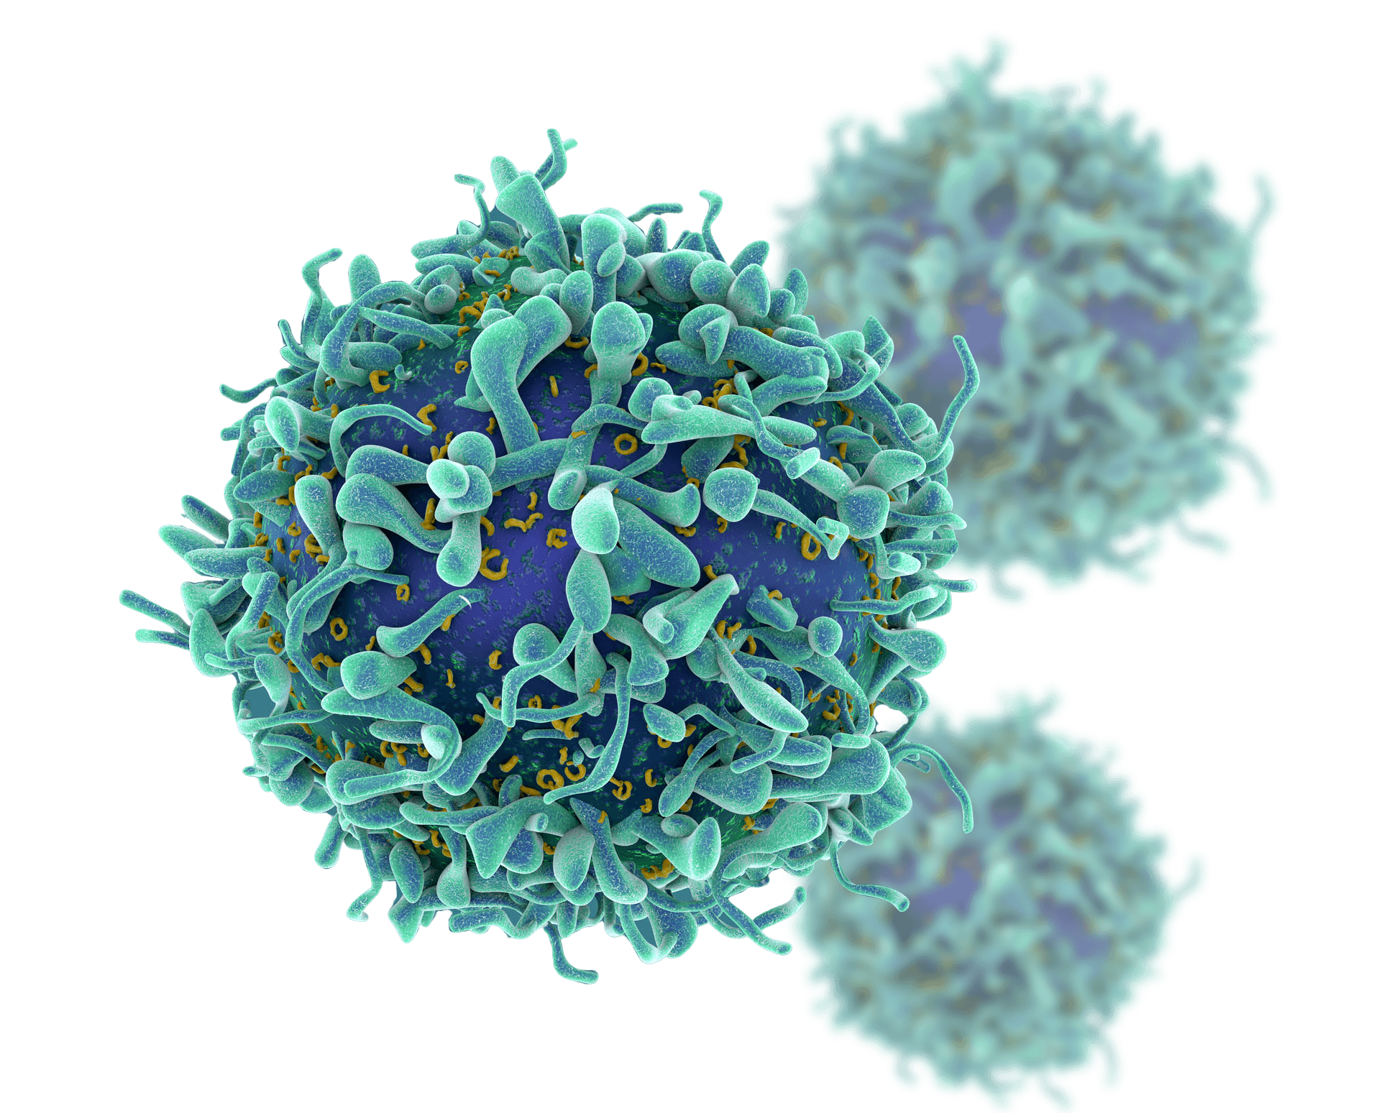

Presentation Overview
Introduction to Jackson County Public Health
Learning Objectives and Projects
Developing A Quarantine and Isolation Policy
Creating a Case Investigation Training Module
Implications and Future Directions
Competencies
Discussion
Conclusion and Q&A

Slide 5
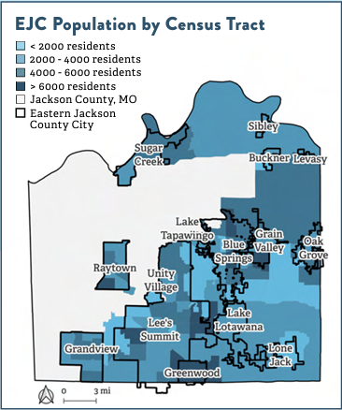
Introduction to Jackson County
Service Population: JCPH serves approximately 350,000 residents across Eastern Jackson County (EJC), Missouri.
Service Area: Excludes Kansas City, MO, and Independence, MO, which have separate health departments.
Population Data (2023):
  Total County Population: Over 700,000
  JCPH Service Area: 269,342 residents
  Poverty Level: 15.3% of households at or below the poverty line
Educational Attainment:
  10.9% without a high school diploma
  33.2% with at least a bachelor’s degree
Racial and Ethnic Diversity:
  11.4% Black or African American
  5.3% Hispanic or Latino
  4.1% Asian
*2023 Jackson County CHA
Notes:
Jackson County Public Health (JCPH) is responsible for serving approximately 350,000 residents in Eastern Jackson County (EJC). While Jackson County has a population of over 700,000, JCPH’s service area specifically excludes Kansas City and Independence, which are covered by their own health departments.
The EJC area exhibits significant diversity and distinct challenges. For example, 15.3% of households live below the poverty line, and educational attainment varies considerably, with nearly 11% of adults lacking a high school diploma, while 33.2% hold at least a bachelor’s degree. This educational disparity impacts health literacy, which is essential in developing effective public health communication strategies.
EJC’s racial and ethnic makeup also underscores the need for culturally sensitive public health interventions. A diverse population—over 11% Black or African American, 5.3% Hispanic or Latino, and 4.1% Asian—means that JCPH must approach public health strategies with a focus on accessibility, health literacy, and trust-building to ensure effective outbreak response, including quarantine and isolation measures.
These socioeconomic and demographic characteristics frame the public health landscape in EJC, underscoring the need for adaptable and culturally competent public health policies, like the Quarantine and Isolation (Q/I) Policy and Professional Development Day (PDD) training module that I’ll be discussing in this presentation.

Slide 6
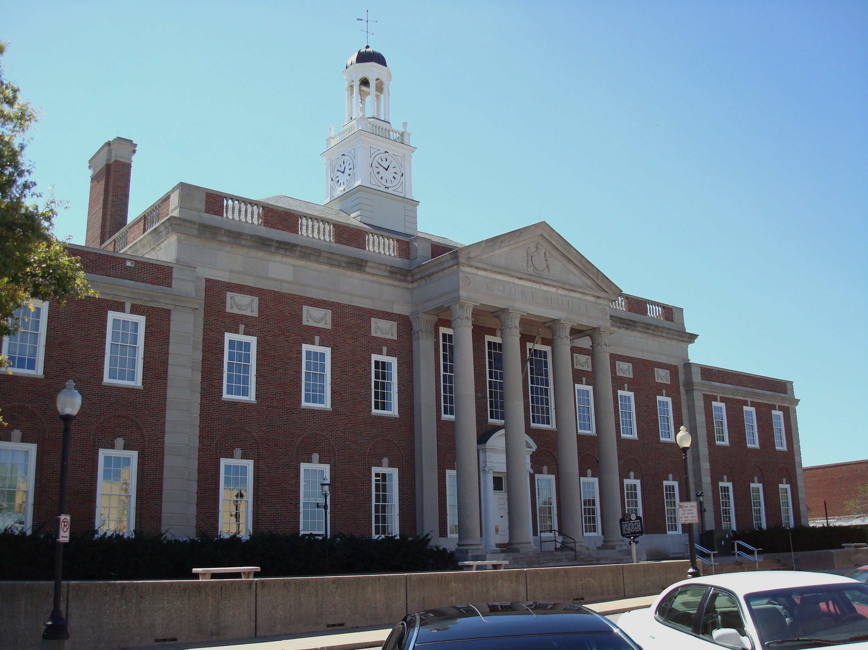


Projects Overview
Primary Learning Objectives:
  Assist in developing an internal policy framework for quarantine and isolation (Q/I) to enhance communicable disease control within Jackson County.
  Design and implement a Professional Development Day (PDD) training module for JCPH staff on epidemiology and case investigation.
PLACE
TIME
PERSON
Notes:
In my Integrative Learning Experience (ILE) with Jackson County Public Health, I had two primary learning objectives.
First, I aimed to develop a comprehensive Quarantine and Isolation (Q/I) policy that aligns with public health best practices to improve communicable disease control.
My second objective was to design a training module for JCPH staff, specifically through a Professional Development Day (PDD), to enhance the department’s emergency preparedness. I will be detailing both projects, their objectives, key results, and competencies addressed in this presentation.

Slide 7




Project 1 - Quarantine and Isolation (Q/I) Policy Overview
Objective: Develop a standardized policy framework to guide Jackson County Public Health in implementing quarantine and isolation (Q/I) measures.
Core Activities:
  Policy Research: Reviewed state and federal quarantine regulations, local health ordinances, and CDC guidelines.
  Process Flowcharts: Created visual aids for streamlined decision-making in outbreak scenarios.
  Tracking System: Developed a Q/I tracking sheet for case monitoring and data accuracy.
  Collaboration: Worked with JCPH’s Community Engagement and Policy team to identify support resources for quarantined individuals.
  Policy Documentation: Drafted policy documents with iterative feedback for clarity and adherence to public health standards.
Notes:
Project 1 focused on developing a comprehensive Quarantine and Isolation policy to support Jackson County Public Health in managing communicable disease outbreaks effectively. This policy was designed to standardize the Q/I process, ensuring a consistent approach for future public health emergencies.
I began with policy research to understand existing federal, state, and local quarantine laws and best practices. This included an in-depth review of CDC recommendations and the Missouri Department of Health and Senior Services (MDHSS) guidelines. I also researched various support resources that JCPH could provide to those in quarantine or isolation, such as food assistance, mental health resources, and rent support.
For practical application, I developed process flowcharts that clearly outline procedures for managing both vaccine-preventable and non-vaccine-preventable diseases. These flowcharts serve as quick-reference guides for public health officials, helping them make timely decisions during outbreaks.
An essential component of this policy was creating a tracking system using Excel to monitor individuals under quarantine or isolation. This tracking sheet includes key variables for case management, data validation, and compliance monitoring. My mentor, Dr. Adedokun, provided valuable feedback on this system, ensuring it was both comprehensive and user-friendly.
Collaboration was also key in this project. I worked closely with the Community Engagement and Policy Division, led by Kristin Schlenk, to discuss support services that individuals might need during quarantine. We considered partnerships with local organizations for essential resources like food and mental health support.
Finally, I took an active role in drafting the policy documents themselves, iterating on each draft based on feedback from Dr. Adedokun. The final policy is intended to provide clear guidelines on implementing quarantine and isolation measures, with the potential to be adopted as a county ordinance in the coming year.
This project has significantly strengthened JCPH’s response capabilities by ensuring a well-defined and scalable policy framework for future communicable disease outbreaks.

Slide 8
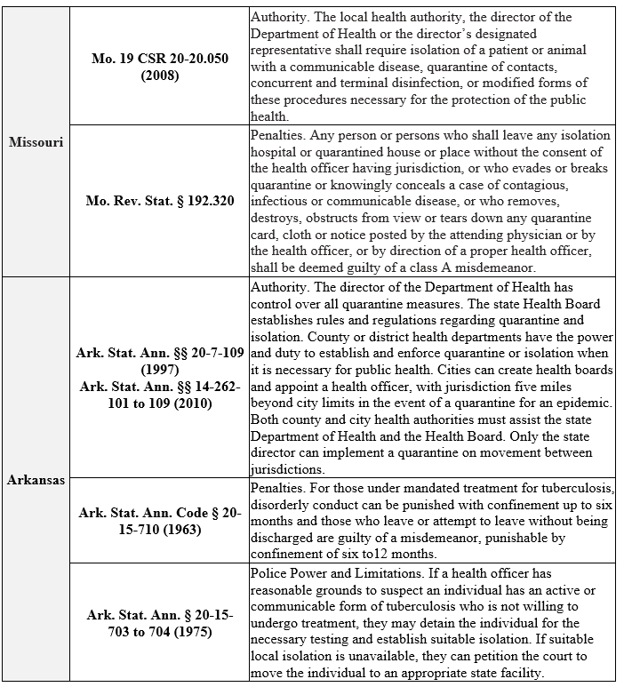
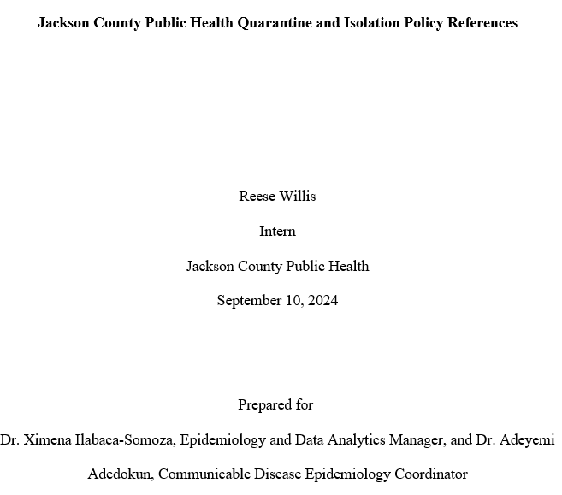
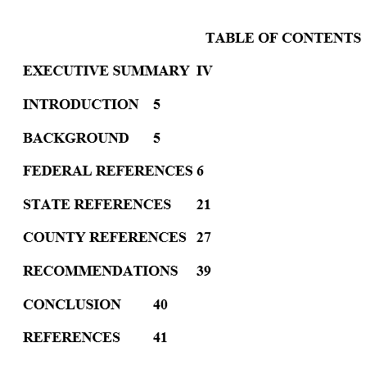
Project 1 – Q/I Policy Key Results
Notes:
Legal and Support Services Reference Reports
Developed as a reference when drafting the policy, the reference reports provide guidelines for legal compliance and support for isolated individuals. They cover relevant state and federal quarantine laws, ethical obligations, and practical resources (e.g., food delivery, financial aid). These references ensure that the policy adheres to both legal standards and best practices in public health ethics, making it more robust and community-focused.

Slide 9


Project 1 – Q/I Policy Key Results
Overview of Existing Support Services
  NC DHHS COVID-19 Support Services
  Multnomah County, Oregon
  Contact Tracing Playbook
  IHDA COVID-19 Housing Assistance
  CA COVID-19 Rent Relief
  Massachusetts CVRF
  Alameda County ERAP
Notes:
Key References for Support Services
North Carolina Department of Health and Human Services (NC DHHS): Through its COVID-19 Support Services Program, NC DHHS assisted over 41,800 households with essential items such as masks, hand sanitizers, and direct financial relief for food and transport. This program is a model for providing practical resources that facilitate compliance with quarantine measures and reduce barriers.
Multnomah County, Oregon: Known for its robust 211 hotline, this county provides access to food, healthcare, and mental health resources, especially for quarantined individuals facing financial constraints. Their focus on broad resource availability ensures that isolated individuals have access to comprehensive support.
Contact Tracing Playbook: Highlighted services like daily check-ins, care packages, and telehealth as essential for holistic isolation support. Their emphasis on negotiating with employers and landlords to maintain stability during isolation is particularly relevant for enhancing adherence.
Illinois Housing Development Authority (IHDA) COVID-19 Housing Assistance: Provided targeted emergency rental and mortgage support to renters and homeowners during quarantine. This ensured individuals could remain housed, avoiding the added stress of housing insecurity.
California COVID-19 Rent Relief: A major state initiative providing rent and utility coverage to prevent evictions. This resource served as a potential model for integrating housing security within quarantine policies, helping families maintain stability during mandatory isolation.
Massachusetts Coronavirus Relief Fund (CVRF): Enabled local governments to fund quarantine support services, including PPE, food, and housing. Municipalities used these funds for rent and mortgage relief, enhancing isolation compliance among financially impacted residents.
Alameda County Emergency Rental Assistance Program (ERAP): A county-specific initiative prioritizing financial assistance for rent and utilities, especially for those impacted by quarantine. By focusing on housing stability, ERAP helped to reduce the risk of homelessness during the pandemic.

Slide 10
Project 1 – Q/I Policy Key Results
1. Endangerment to Public Health
  Used when there’s a high risk of widespread transmission (e.g., Measles with R₀ of 12–18).
All Reasonable Means Exhausted
  Only after alternatives like voluntary isolation and public education are tried.
No Less Restrictive Alternatives Exist
  Critical for cases where no other method can contain the threat (e.g., multidrug-resistant TB).
Duration and Legal Safeguards
  Typically up to 30 days, extendable with a court order if the threat persists.
  Regular assessments to protect individual rights and public safety.
Notes:
After research was done on legality, and existing support resources:
Quarantine and Isolation (Q/I) policies are essential tools for managing communicable disease threats. These criteria ensure that measures are ethically justified and align with public health principles. Let’s look into each criterion that guides JCPH’s decision-making on implementing Q/I.
Endangerment to Public Health
JCPH will consider Q/I when there’s a significant threat to public health, necessitating an immediate response to prevent a major outbreak.
An example is measles: with an R₀ of 12–18, it can spread rapidly among susceptible populations. Immediate isolation helps mitigate this risk.
Scientific assessment of a disease's transmission rate, incubation period, and feasibility of implementation is fundamental to this step.
Exhaustion of All Reasonable Means
JCPH exhausts all less restrictive methods, including voluntary isolation and public education, before enforcing mandatory measures.
If an individual with measles, for example, refuses voluntary isolation, then JCPH might have to enforce isolation to protect the community.
No Less Restrictive Alternatives Exist
This criterion is applied when no effective alternative exists to contain the disease threat.
Multidrug-resistant tuberculosis (TB) is a pertinent example, where individuals not complying with Directly Observed Therapy (DOT) may require isolation due to the public health risks involved.
Duration and Legal Safeguards
Q/I measures are generally set for up to 30 days with regular reviews to either shorten or extend based on the situation.
Legal procedures are in place to safeguard individual rights, including court orders for extending isolation. For instance, measles patients who continue to be infectious may need extended isolation.
Conclusion JCPH’s Q/I policy balances public health safety with individual rights by adhering to established legal and ethical frameworks. This structured approach allows JCPH to respond swiftly and effectively while ensuring that public health interventions remain justifiable and fair.

Slide 11
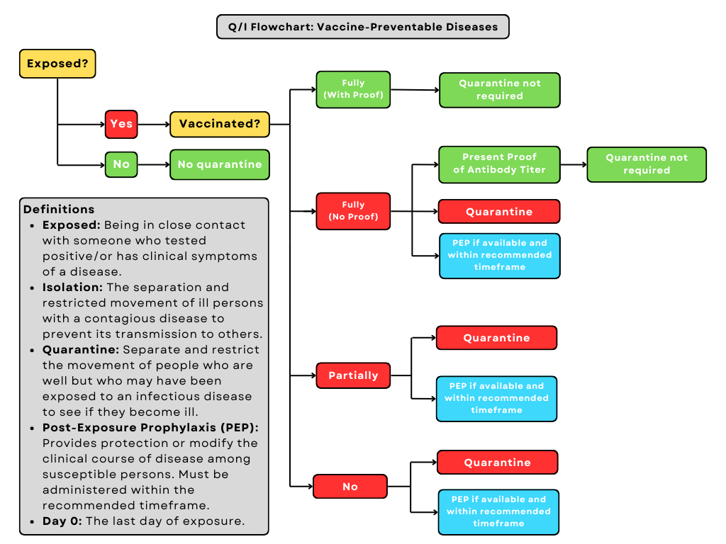
Project 1 – Q/I Policy Key Results
Decision Tree/Flowcharts
Designed for Case management
Corresponding Written Workflow
Available PEP Reference Table
Notes:
Alongside the criteria to implement a quarantine or isolation order, to complement this I made an accompanying Flowchart for the disease investigators to use, in order to have a visual representation of the flow, alongside a written flow for each. These flowcharts take into account Vaccine-Preventable, and general commiunicable diseases, alongside Confirmed case management flow.

Slide 12
Notes:
Flow/chart/decision tree for vaccine-preventable disease exposure.

Slide 13
Project 1 – Q/I Policy Key Results
Exposure
Question: Has the individual been exposed to a vaccine-preventable communicable disease?
  No: Quarantine is not required. The individual can continue normal activities.
  Yes: Proceed to Vaccination Status.
Vaccination Status
Fully Vaccinated with Proof
  No Quarantine Required: The individual does not need to quarantine due to their verified immunity. Proof of vaccination should be sent to Jackson County Public Health (JCPH) and documented (ex - vaccination card, medical records).
  Administer Post-Exposure Prophylaxis (PEP): If available and within the recommended time frame, PEP is recommended as an extra precaution. PEP can modify the course of the disease and may prevent onset if given promptly. Refer to the JCPH PEP list for availability.
Notes:
This is the corresponding written workflow

Slide 14
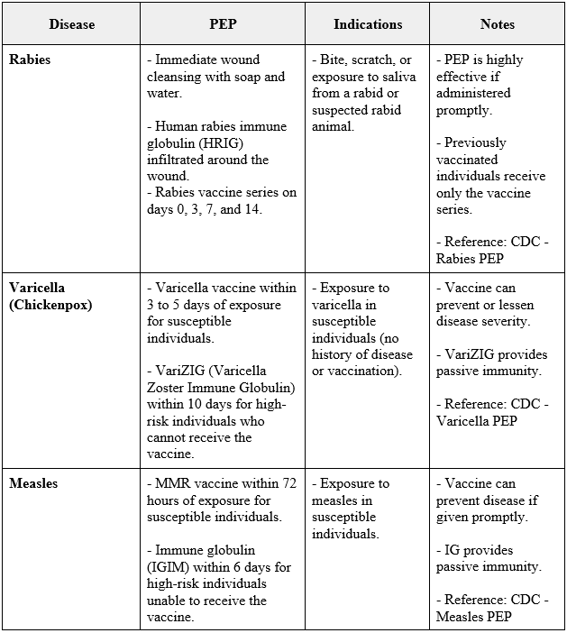
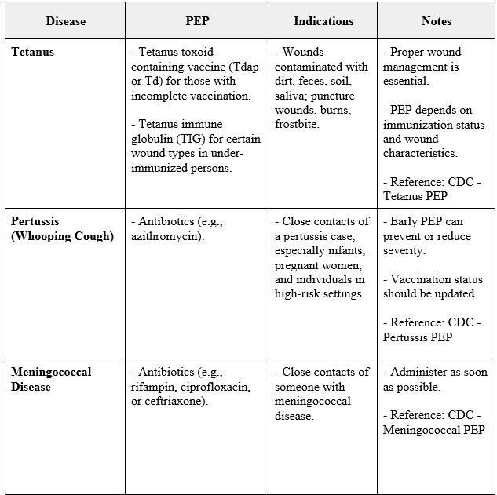
Project 1 – Q/I Policy Key Results
Notes:
accompanying the decision tree/flowchart is the available PEP which covers 17 diseases identified from the CDC website with their available PEP name, indications, and a notes section. This will be used by disease investigators and epidemiologists when investigating

Slide 15
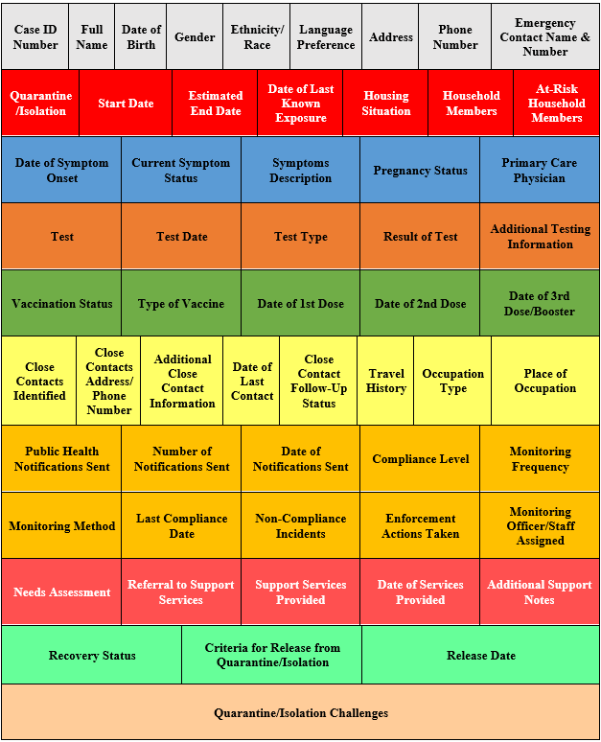
Project 1 – Q/I Policy Key Results
Quarantine and Isolation (Q/I) Tracking Sheet
Color-Coding for Quick Reference:
  Grey: Demographics
  Red: Q/I-Specific Data
  Blue: Health Information
  Dark Orange: Testing & Diagnostics
  Green: Vaccination
  Yellow: Contact Tracing
  Orange: Compliance Monitoring
  Light Red: Support & Resources
  Light Green: Outcome & Recovery
  Light Orange: Additional Information
Notes:
And finally, once patients are in Q/I, we needed a way to track them. "This tracking sheet is an essential tool for managing individuals under quarantine or isolation as part of Jackson County Public Health’s communicable disease protocols. It organizes case information in a way that enhances efficiency and accuracy for public health staff.
As you can see in the image, each section is color-coded by data type, making it easier for staff to find and update specific information quickly. This design was adapted from JCPH’s standard epidemiology logs, so it’s familiar to our team and aligns with established data management practices.
This tracking sheet will be maintained by a JCPH disease investigator or epidemiologist, helping to ensure thorough case management and allowing for data-driven decisions that meet both compliance and individual support needs."

Slide 16
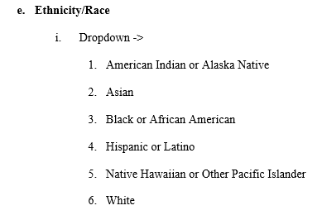

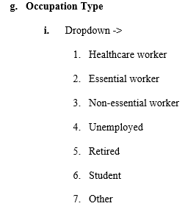

Project 1 – Q/I Policy Key Results
Standardizes Data Entry: Ensures consistency and accuracy
Minimizes Errors: Format specific fields, and data validation
Enhances Usability: Pre-defined Options for commonly used fields.
Supports Data Analysis: Structured formats across the sheet allow for further use
Notes:
The Q/I Tracking Sheet leverages data validation extensively to ensure data quality and consistency, which is crucial for effective public health response. Here’s how data validation enhances the workflow:
Standardization: Dropdowns in key fields like Gender, Ethnicity, and Occupation Type streamline data entry, allowing staff to select from a set list of options, reducing variability and ensuring that similar information is recorded uniformly.
Error Reduction: For fields like date of birth, test dates, and quarantine start and end dates, only date entries are allowed, which prevents accidental text entry errors and ensures clarity.
Usability: By using dropdown menus for commonly used categories (e.g., Symptom Status, Vaccination Type), the sheet becomes more user-friendly, saving investigators time and enabling quick entry during high-stress scenarios.
Data Analysis: By having standardized entries across all cases, we enable reliable tracking, analysis, and interpretation of data. This structure supports effective outbreak response and future evaluations.

Slide 17
Project 2 – Professional Development Day Training Overview
Objective: Equip all JCPH staff with knowledge and skills in communicable disease investigation.
Scope of Training: Covers epidemiological principles, contact tracing, outbreak investigation, and case management tools.
Alignment with Public Health Goals: Supports JCPH’s mission to strengthen outbreak response and public health emergency preparedness.
Key Areas: Training content, interactive activity, session facilitation, and feedback assessment.
Notes:
Taking place on November 11th, next Monday, I will be assisting in the facilitation of the PDD training module.
This slide provides an overview of the PDD Training Module. The objective was to create a comprehensive training program that would prepare all JCPH staff, not just those in the epidemiology department, to respond effectively to communicable disease outbreaks. This is going to be used as a yearly training, to make sure JCPH is well equipped in the event of another pandemic/outbreak scenario.
A little bit about JCPH’s experience with COVID: In 2020, JCPH only had two diseases investigators, and in wake of the COVID-19 pandemic, hundreds of cases per day were coming in, so with grant funding, they were able to hire 50 temporary disease investigators. Luckily, this got them through, but in the event this was not possible, JCPH would have been in an insurmountable situation of case volume. This training is designed so that in the event of another pandemic, anyone can step up and help.
The training module covers:
Epidemiology Fundamentals – including core principles of outbreak investigation, contact tracing techniques, and case management.
Real-World Relevance – specifically tailored to the local context, such as recent outbreaks in Jackson County, making the training practical and relevant.
Project Summary: I collaborated closely with Dr. Adeyemi Adedokun, who provided mentorship and feedback throughout the project. The module includes both content delivery and practical application through hands-on case investigations. In the following slides, I’ll walk you through each material and result created for the training.

Slide 18
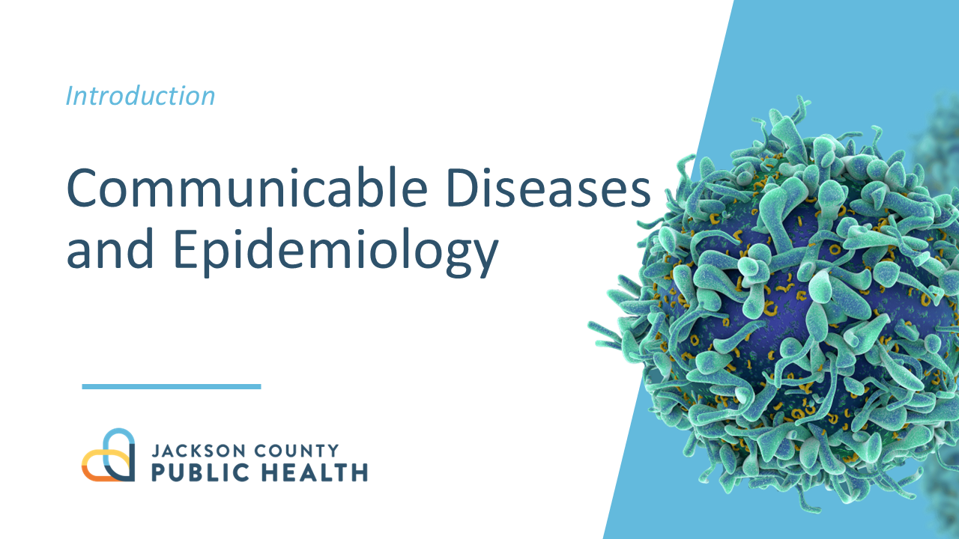
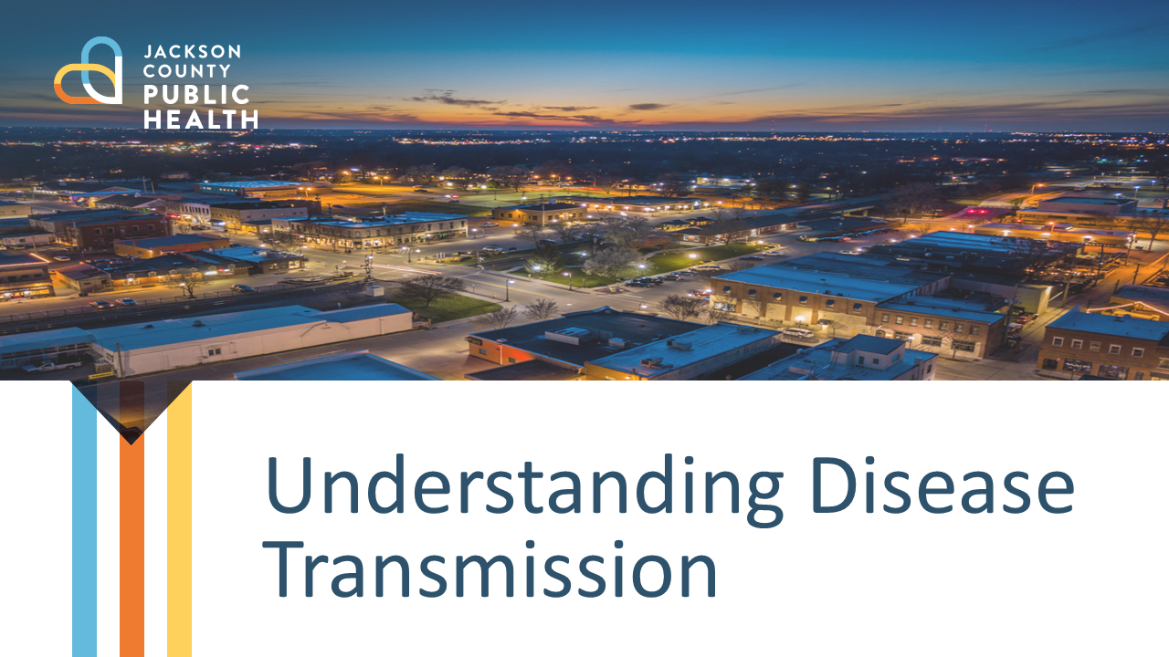
Project 2 – PDD Presentation Anticipated Results
PDD Training PowerPoint Presentation Topics:
  Epidemiology & Public Health
  Disease Surveillance & Reporting
  Outbreak Investigation Process
  Contact Tracing Methods
  Legal & Ethical Considerations in Disease Control
  Visual Aids: Charts, flow diagrams
  Audience: All JCPH Staff (~60 People)
Notes:
The PowerPoint presentation is the core teaching tool for the PDD training. It included essential public health topics that staff will need to understand for effective outbreak response. Key topics include:
Epidemiology Basics – Introduction to disease surveillance and variables like person, place, and time.
Outbreak Investigation Process – Step-by-step guidance, from identifying cases to tracing contacts and monitoring outcomes.
Legal & Ethical Considerations – Addressing the rights and responsibilities of public health practitioners in outbreak settings.
To enhance engagement, the slides incorporated charts, flow diagrams, and case studies, making complex topics accessible for staff across various backgrounds. Data visualization is a key step in making sure the presentation is digestible.
And upon completion of the lecture, there will be a time for discussion and questions before we move to the activity

Slide 19
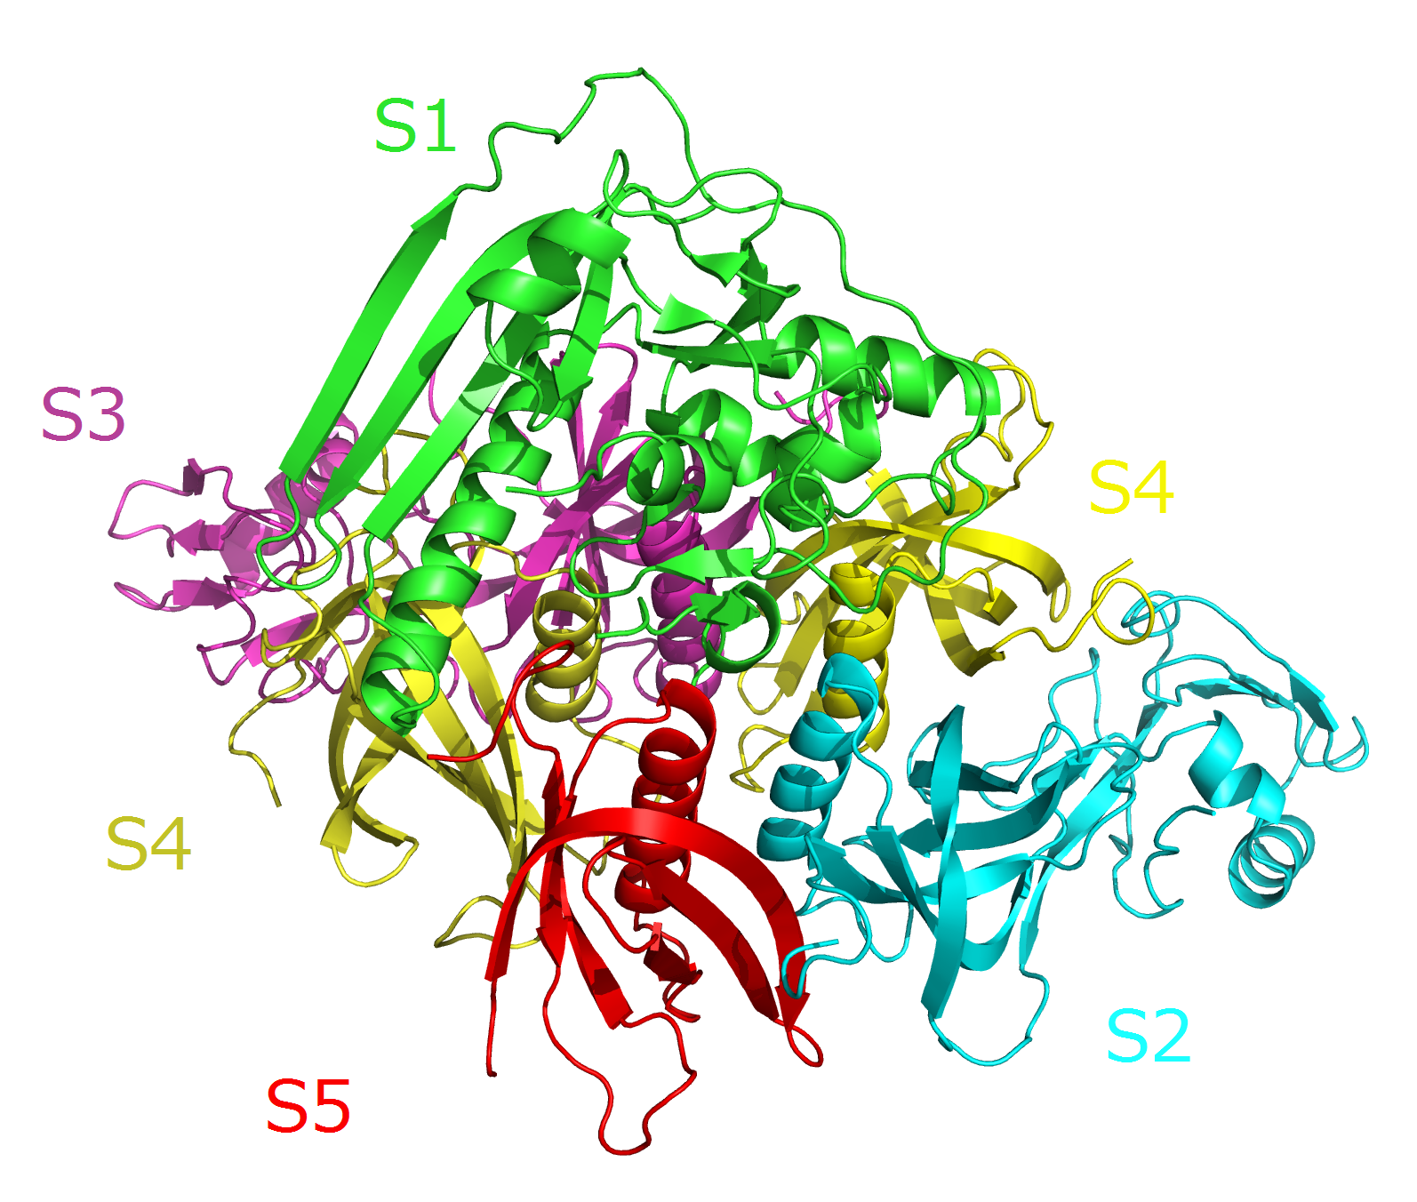
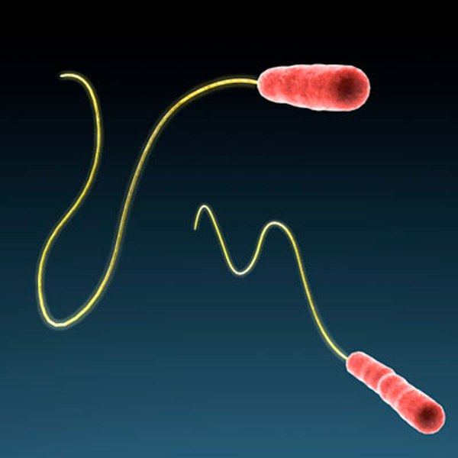
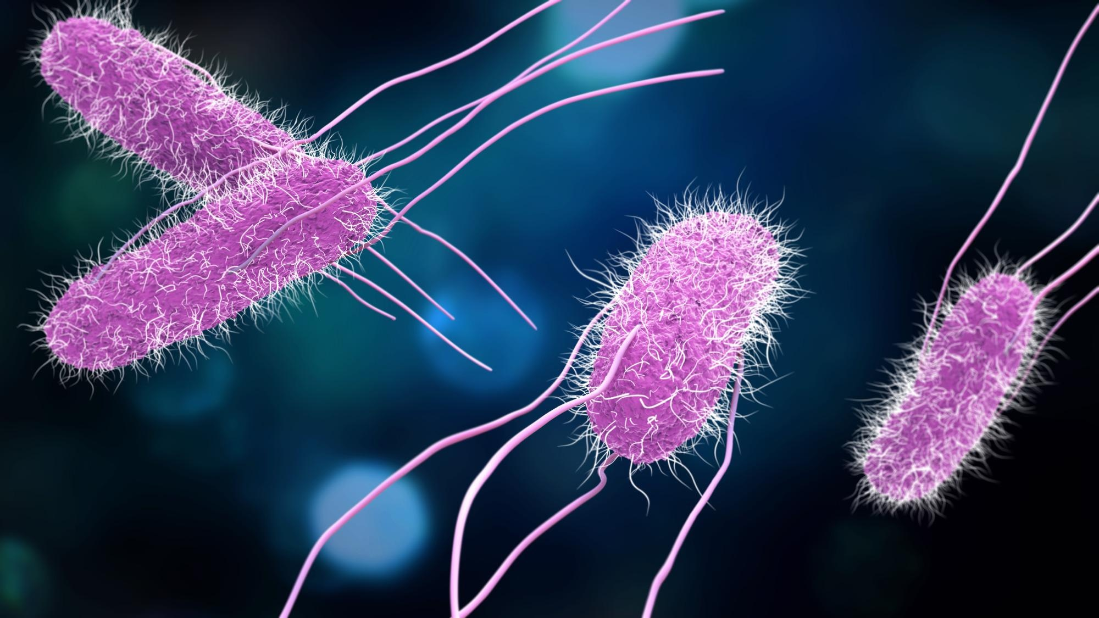
Project 2 – PDD Activity Anticipated Results
Interactive Case Investigation Activity
Scenarios Created:
  Salmonella Outbreak – Focus on foodborne illness and source tracing
  Pertussis Outbreak – Emphasis on vaccination history and contact tracing
  Legionella Outbreak – Environmental health assessment for waterborne transmission
Hands-On Experience: Simulated phone interviews and case documentation
Notes:
An essential component of the training is the interactive learning activity, where participants will engage in case investigation scenarios to apply theoretical knowledge learned from the presentation. I developed three scenarios:
Salmonella Outbreak – Staff practiced tracing foodborne transmission and identifying sources. Heavy focus on the food exposures, with a longer form
Pertussis Outbreak – Participants worked on contact tracing with a focus on vaccination history. Heavy emphasis on showmevax, looking for the right places for vaccine records, and contact tracing to warn others
Legionella Outbreak – This scenario involved environmental assessment, simulating real-world complexities of disease transmission. Highlights the importance of environmental factors, many of which are the classic legionella examples
In each scenario. There are a total of six unique scripts. These scripts will be used to practice interview and data collection techniques. Each interview has a certain tone or personality that represents a common theme amongst these types of disease interviews. On one hand someone is happy to provide further information, contacts, etc, on the other hand, someone may be angry, questioning, or doubtful in the conversation making it difficult to complete. This was taken into account and is shown in the scripts to highlight this reality.

Slide 20
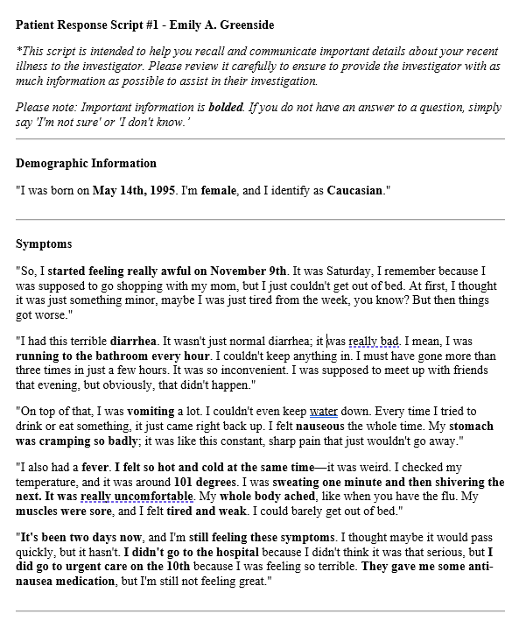
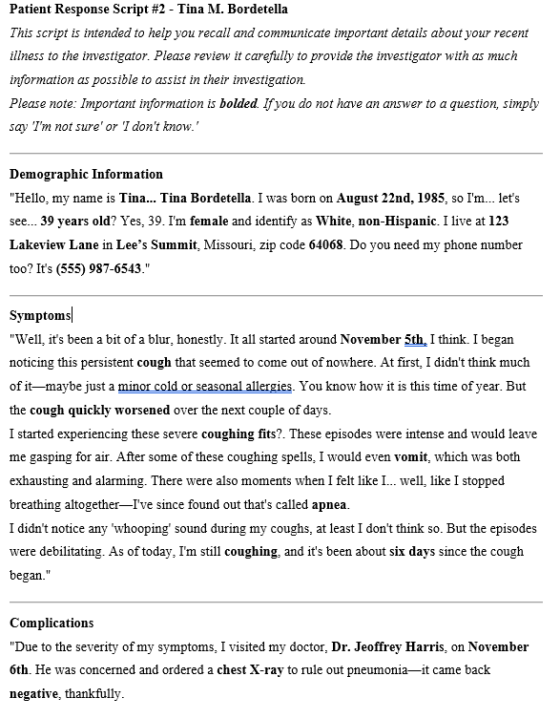
Notes:
Left – Salmonella
Right – Pertussis
At the conclusion of this activity there will be a feedback survey provided by JCPH to assess the effectiveness of the training, retention, and overall engagement

Slide 21
Implications and Future Directions
Strengthened framework for communicable disease response.
Expanded staff preparedness through the PDD training.
Potential for Q/I policy adoption as a county ordinance.
Continuous improvement through feedback and adaptive training.
Future opportunities for integrating more advanced tracking technologies and predictive analytics.
Notes:
"These projects have set a strong foundation for Jackson County Public Health's response to communicable diseases. By establishing a standardized Q/I policy, we’ve created a repeatable framework that ensures consistency and compliance in outbreak response. The Professional Development Day training expanded staff readiness and will be repeated annually, ensuring that all staff can step in during high-demand situations.
Looking forward, there's potential for the Q/I policy to be formally adopted as a county ordinance, which would give it stronger enforcement power. Additionally, we aim to enhance the training module based on feedback from staff and explore advanced tracking technologies to improve real-time case management and predictive analytics for outbreak preparedness."

Slide 22
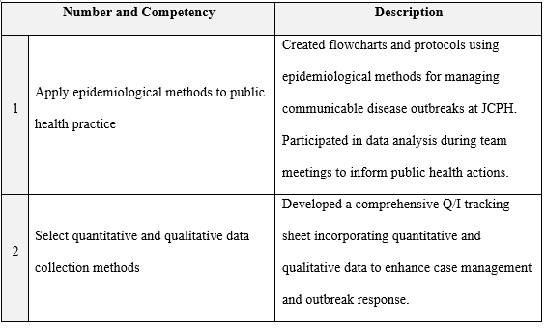
MPH Foundational Competencies Fulfilled

Slide 23
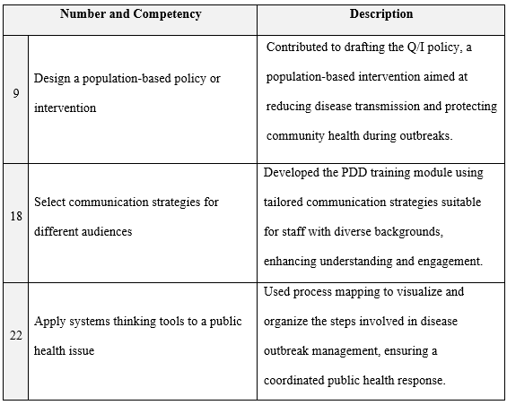
MPH Foundational Competencies Fulfilled

Slide 24
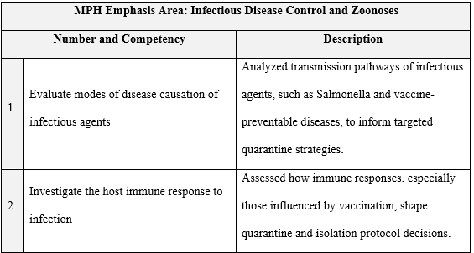
MPH Emphasis Competencies Fulfilled

Slide 25
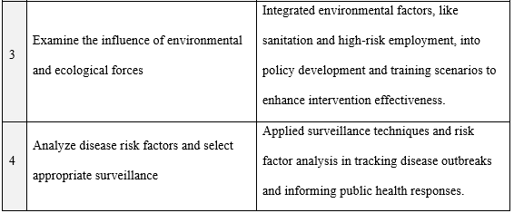
MPH Emphasis Competencies Fulfilled

Slide 26
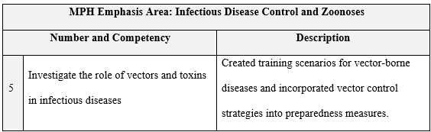
MPH Emphasis Competencies Fulfilled

Slide 27
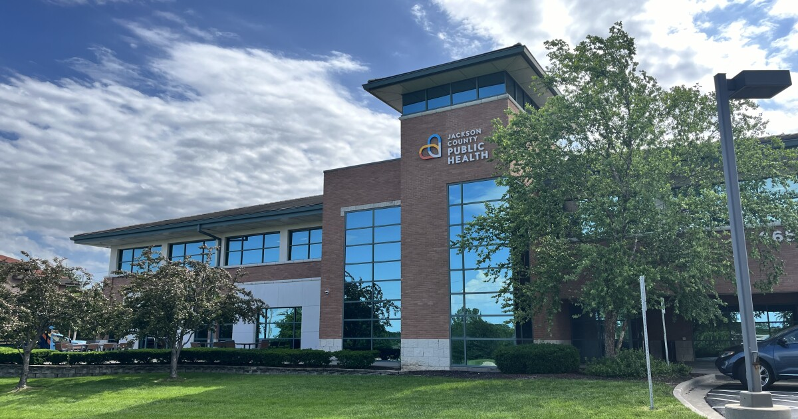
New Insights and Professional Growth
Practical application of theoretical knowledge.
Enhanced understanding of local public health systems and policies.
Developed skills in policy drafting, data tracking, and interprofessional collaboration.
Notes:
Dr. Kastner – writing from DMP 815
Dr. Adams – environmental health (first place I learned about legionella)
Dr. Reyes – Multivariate Stats 730 being able to talk to data analytics and interpret information on a better level
first experience working in public health, working with a team of public health professionals

Slide 28
Conclusion
Developed a standardized Q/I policy framework for outbreak response.
Designed a sustainable training module to equip JCPH staff with essential skills.
Enhanced Jackson County’s capacity to manage communicable disease threats.
Future directions focus on continuous improvement and the potential adoption of policies as formal ordinances.
Notes:
"To conclude, my time at JCPH focused on strengthening Jackson County’s response to communicable disease threats. The Q/I policy framework provides standardized guidance, while the PDD training module aims to ensure that staff have the necessary skills for effective response. This work has significantly enhanced JCPH’s outbreak management capacity, all while putting my knowledge to work, and pushing me to grow as a public health professional. Moving forward, the policies may be formalized as county ordinances, and continuous improvements will ensure JCPH remains prepared for future challenges."

Slide 29
References
Guerra, F. M., Bolotin, S., Lim, G., Heffernan, J., Deeks, S. L., Li, Y., & Crowcroft, N. S. (2017). The basic reproduction number (R₀) of measles: A systematic review. The Lancet Infectious Diseases, 17(12), e420–e428. https://doi.org/10.1016/S1473-3099(17)30307-9
National Academies of Sciences, Engineering, and Medicine. (2020). Implementing quarantine to reduce or stop the spread of a contagious disease. In A. Downey, L. Brown, & N. Calonge (Eds.), Evidence-Based Practice for Public Health Emergency Preparedness and Response (Chapter 7). National Academies Press.
North Carolina Department of Health and Human Services. (2021, May 12). COVID-19 support services program helped more than 41,800 households quarantine and isolate. Retrieved November 1, 2024, from https://www.ncdhhs.gov/news/press-releases/covid-19-support-services-program-helped-more-41800-households-quarantine-and
Multnomah County Health Department. (2020, March 4). Community resources. Retrieved November 1, 2024, from https://www.multco.us/health/diseases-and-conditions/community-resources
Resolve to Save Lives. (2020, December 7). Supports checklist. Retrieved October 10, 2024, from https://contacttracingplaybook.resolvetosavelives.org/checklists/supports
California State Controller's Office. (2022, January 12). COVID-19 relief and assistance for individuals and families. Retrieved October 10, 2024, from https://sco.ca.gov/covid19ReliefAndAssitanceIF.html
Massachusetts Government. (2024, June 12). Coronavirus relief fund (CVRF). Retrieved October 10, 2024, from https://www.mass.gov/info-details/coronavirus-relief-fund-cvrf
Alameda County Housing Secure. (2023, June 12). Emergency rental assistance program. Retrieved October 10, 2024, from https://www.ac-housingsecure.org/about-us#:~=About%20The%20Emergency%20Rental%20Assistance,successfully%20distributed%20to%20eligible%20applicants

