Slide 1
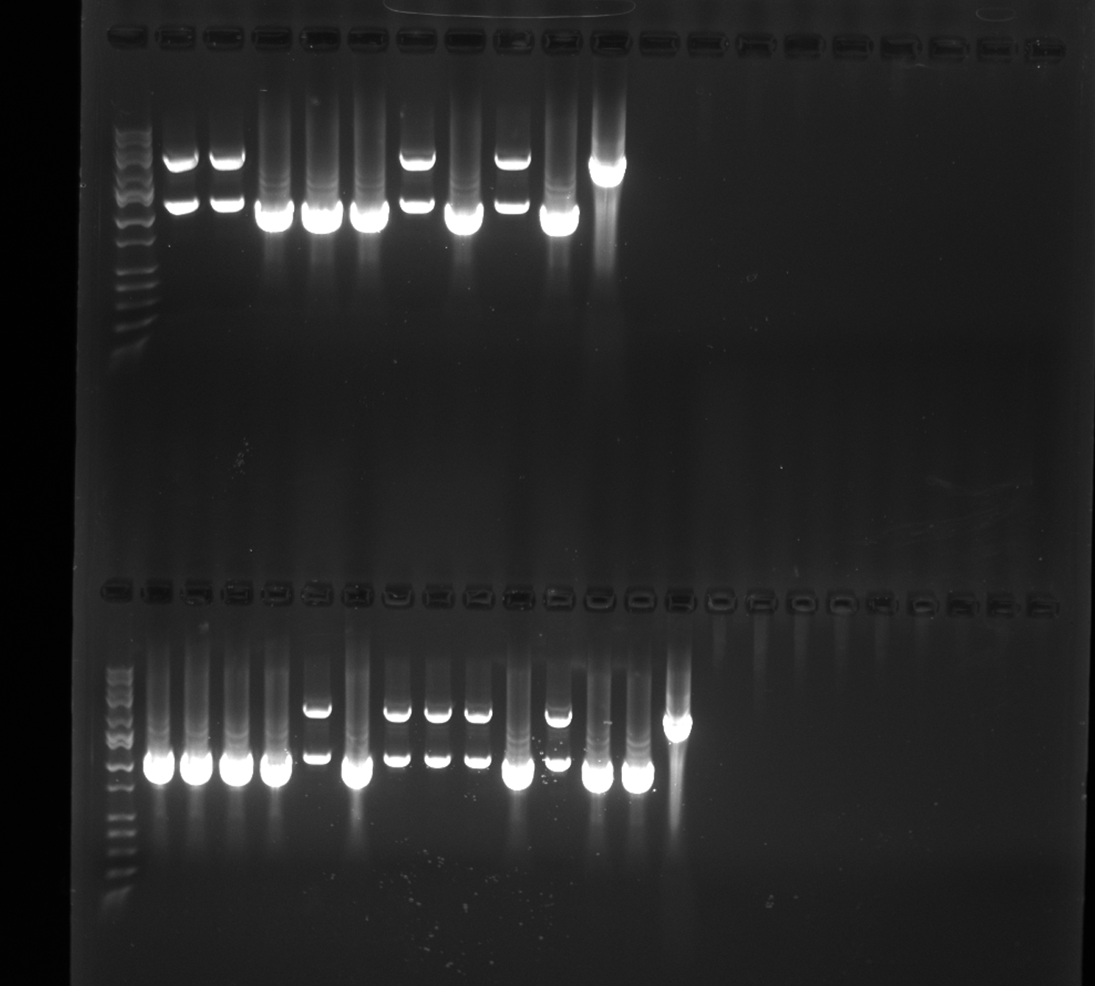
A
M
1
2
3
4
5
6
7
8
P1
N
P2
Litters 73 and 74 Genotyping via PCR and Gel Electrophoresis. Primers targeted a 2,788 bp product of the endogenous porcine CD1D gene. Animals that possessed an edited CD1D allele produced a deletion of 1,599 bp resulting in a modified product of 1,189 bp. Gel (A) shows DNA from litter 73. Samples 3, 4, 5, and 7 are homozygous for the 1,599 bp deletion and display an absence of a “wildtype” product. Samples 1, 2, 6, and 8 contain both the modified and “wildtype” alleles.
Gel (B) shows DNA from litter 74 exhibiting a different distribution of the same modification. P1 represents a positive control for the modified allele, P2 represents a positive control for an unmodified, “wildtype” sample. N represents a negative control, water.
3000 bp
1000 bp
B
M
1
2
3
4
5
6
7
8
9
10
11
12
P1
P2
N
3000 bp
1000 bp

Slide 2
Genotyping Text
Genotyping was performed via PCR and gel electrophoresis. Primers were designed to amplify a large region surrounding the start codon of the endogenous CD1D gene. Primer sequences were 5’-3’ TGTTGATGTGGTTTGTTTGCCC and 5’-3’ TGTTCCTAGTCGGATTCCCGC and were used at a 10 uM. A 2,788 bp product was amplified out of a nonmodified, “wildtype” animal. Modified animals produced a smaller product of 1,189 bp. Animals that were homozygous for the modified CD1D gene had an absence of a “wildtype” sized product. PCR parameters are as follows: initial denaturation at 94C for 1:00 minute, 30 cycles of 94C for 30 seconds, 60C for 30 seconds, 68C for 1:30 minute, and a final extension of 72C for 3 minutes. The use of LA Taq (Takara Bio, San Jose, CA , Cat # RR02AG) was made due to its proficiency at producing large amplimers. PCR reaction reagents were used at the concentration and amount suggested by the supplier. DNA marker for gel electrophoresis was HI-LO (Bionexus, Oakland, CA, Cat # BN2050), ran on a 1.0% agarose gel.

Slide 3
Original Genotyping Images
Top image is the same PCR from the first slide.
Bottom image is a confirmation PCR that will only produce a wildtype, unmodified product. This was used for validation purposes only.

